Slide 1
CS 0008 Introduction to Computer Programming
Jan Wiebe: wiebe@cs.pitt.edu

Slide 2
Today
Learn what the course is about
Go over the syllabus
Get our feet wet with a first program

Slide 3
This Course
Teaches the basics of programming
Uses Python
Industrial strength programming language used at 1000s of companies. One of four official Google languages (the others are Java, C++, and Go)
Clean syntax
Free, well documented, well supported

Slide 4
This Course
Programming ideas are the same from one language to another
Once you learn one language, it is straightforward to learn others
Python programs are shorter and simpler than Java programs. So, you can concentrate on the ideas, and learn programming concepts quicker.

Slide 5
Examples
Java:
Public class HelloWorld
{
public static void main (String[] args)
{
System.out.println(“Hello, world!”);
}
}
Python:
print(“Hello, world!”)

Slide 6
Examples
Java:
Int myCounter = 0;
String myString = String.valueOf(myCounter);
If (myString.equals(“0”)) …
Python:
myCounter = 0
myString = str(myCounter)
If myString == “O”: …
Later in the course, we will discuss appropriate uses of the two languages

Slide 7
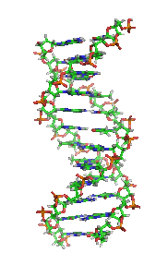
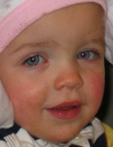
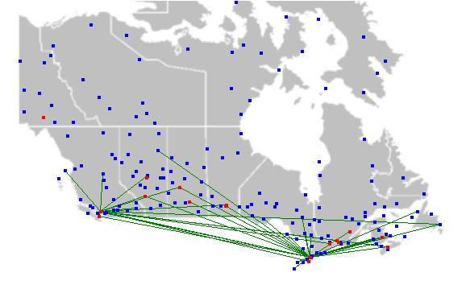
What sorts of problems are solved with programming?
Remove red-eye from a picture
Find the complement of a DNA strand
Display maps with airplane flight paths
Multiply matrices
Assess the reading level of a text book
Programming is used in all areas

Slide 8
Syllabus and Course Website
http://www.cs.pitt.edu/~wiebe/courses/CS0008/Sp2015
The link is reachable from courseweb, under “syllabus”

