Slide 1
CS 0007 Introduction to Computer Programming
Jan Wiebe: wiebe@cs.pitt.edu
Office Hours: T: 3-4pm; Th 2-3pm; and by appt

Slide 2
Today
Learn what the course is about
Go over the basics of the syllabus
Get our feet wet with a first program
Admin details: on Wednesday

Slide 3
This Course
Teaches the basics of programming
Uses Python
Industrial strength programming language used at 1000s of companies. One of three official Google languages
Clean syntax
Free, well documented, well supported

Slide 4
This Course
Is intended for students with no programming experience
You will learn how to make computers do what you want them to do. You may not be planning to be a computer scientist, but whatever you do, being able to program is as important as being able to write a letter or do arithmetic.
Goal: getting you to apply your new programming skills in your own projects.
And, maybe some of you will decide you want to be a computer scientist. You’ll be ready for CS401

Slide 5
The Course
Busy throughout the term. Like learning to play an instrument – you need to practice to play well
Weekly labs (in recitation)
Weekly CodeLabs (online exercises)
3 assignments
1 project
3 tests + final

Slide 6
The Course
Busy throughout the term. Like learning to play an instrument – you need to practice to play well
Weekly labs (in recitation)
Weekly CodeLabs (online exercises)
3 assignments
1 project
3 tests + final
With Partner
With Partner
With Partner

Slide 7
The Course
Busy throughout the term. Like learning to play an instrument – you need to practice to play well
Weekly labs (in recitation)
Weekly CodeLabs (online exercises)
3 assignments
1 project
3 tests + final
With Partner
With Partner
With Partner
Don’t panic – I know you don’t know how to program!

Slide 8
What’s CS0007 About?
At the end of the course, you will
Know most instruc I instructions
Be able to take human problems and write Python programs to solve them
Understand what computer scientists do
Have an appreciation for how computer science research applies to science, text processing, multi-media, etc

Slide 9
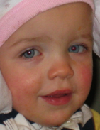
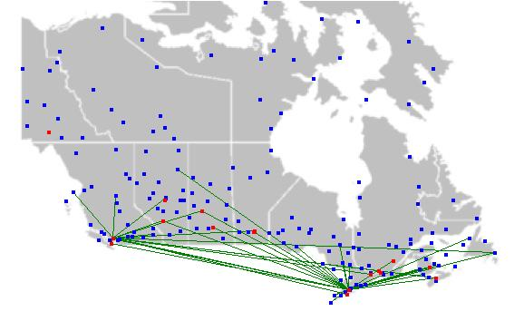
What sorts of problems?
Remove red-eye from a picture
Find the complement of a DNA strand
Display maps with airplane flight paths
Multiply matrices
Assess the reading level of a text book

Slide 10
Quick look at the course website
Details on Wednesday
http://www.cs.pitt.edu/~wiebe

