Slide 1
Cutting the Electric Bill for Internet-Scale Systems
Asfandyar Qureshi, Rick Weber,
Hari Balakrishnan,John Guttag,
Bruce Maggs
Presented by Patrick McClory

Slide 2
Introduction
With the rise of “Internet-scale” systems and “cloud-computing” services, there is an increasing trend toward massive, geographically distributed systems
Increasing in size at a rapid clip
Conventional approach for reducing energy costs has been to reduce the amount of energy consumed.
Alternative approach – map computation to locations where energy is cheaper.

Slide 3
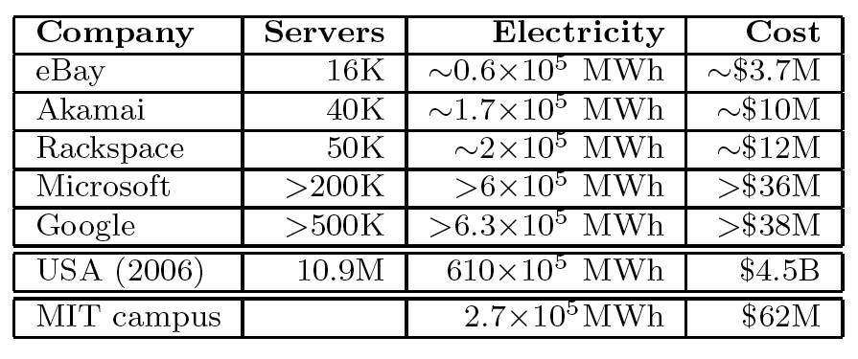
Wh = n * (P_idle + (P_peak – P_idle) * U + (PUE -1) * P_peak) * 365 * 24
Server numbers estimated from a variety of sources.
PUE = 2, U= 30%, P_peak = 250 W, P_idle = 60-75% P_peak
$60 per MWh

Slide 4
Key Observations
Electricity Prices vary
Over time, geographically
Large distributed systems already incorporate request routing and replication

Slide 5
Problem Specification
Given a large system composed of server clusters spread out geographically, want to map client requests to clusters such that the total electricity cost of the system is minimized.
Assume the system is fully replicated.
Optimize for cost every hour, with no knowledge of the future.
Cost is in dollars, not Joules.

Slide 6
Energy Elasticity
Maximum reduction in cost depends on the energy elasticity of the clusters
Ideally in the absence of load a server would draw no power.
State of the art – idle power around 60% of peak power.

Slide 7
Wholesale Electricity Markets
Day-ahead Markets (futures) – provide hourly prices for delivery during the following day.
The outcome is based on expected load.
Real-time Markets (spot) – balancing markets where prices are calculated at some time interval (~ 5 minutes).

Slide 8
Market Assumptions
The authors assume a simple market model that assumes the following:
Real-time prices are known and vary hourly.
The electric bill paid by the service operator is proportional to consumption and indexed to wholesale prices.
The request routing behavior induced by our method does not significantly alter prices and market behavior.

Slide 9
Empirical Market Analysis
Obtained market data from government sources, trade publication archives and public data archives maintained by different RTOs.
Data for 30 locations, covering January 2006 through March 2009.

Slide 10
Price Variation
Daily variation.
Different Market types.
Hour-to-Hour Volatility.

Slide 11
Daily Variation

Slide 12
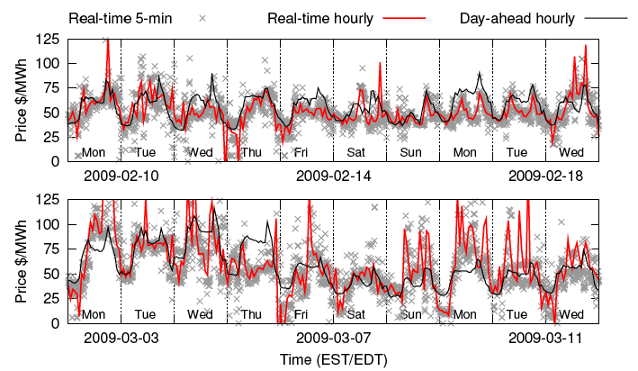
Market Variation

Slide 13
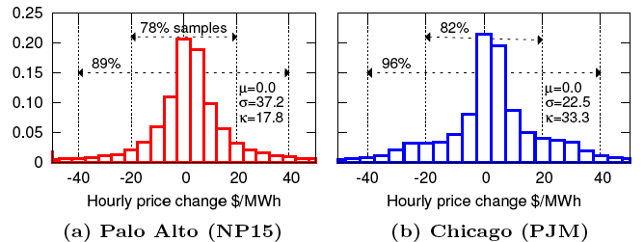
Hourly Variation

Slide 14
Geographic Correlation
The authors approach would fail if hourly prices are well correlated at different locations.
Locations in different regional markets are never highly correlated, even when nearby.
Locations in the same region are not always well correlated.

Slide 15
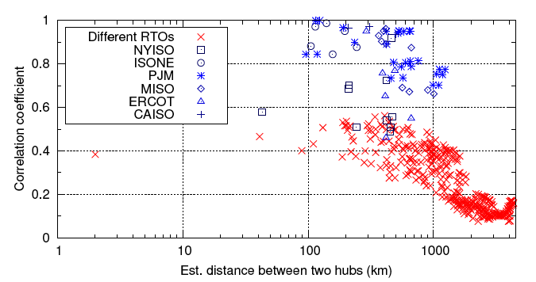
Geographic Correlation

Slide 16
Price Differentials
In order for this dynamic approach to yield substantial savings the price differential between two locations must:
Vary in time
The distribution will ideally have a zero mean and a reasonably high variance.
Neither site strictly better than the other, and a dynamic approach, always buying from the cheaper of the two, could yield meaningful savings.

Slide 17
Price Differentials

Slide 18
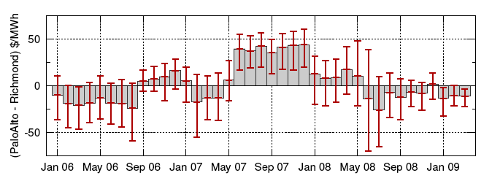
Evolution in Time

Slide 19
Time-of-Day

Slide 20
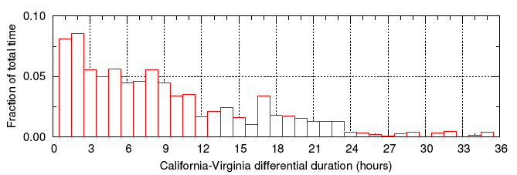
Differential Duration

Slide 21
Akamai Data
Traffic data was collected at 5-minute intervals on servers housed in Akamai’s public clusters.
For each cluster - # of hits and bytes served to clients, a rough geography of where clients originated, and the load.

Slide 22
Akamai Data
Constrain energy-price rerouting so that it does not increase the 95th percentile for bandwidth at any location.
Use geographic distance as an estimator for network performance in simulations.

Slide 23
Energy Model
Cluster energy consumption adapted from Google’s empirical study of data centers:
P_cluster(u_t) = F(n) + V(u_t, n) + ε
F(n) = n * (P_idle + (PUE-1) * P_peak)
V(u_t, n) = n * (P_peak – P_idle) * (2u_t – u_t^r)
PUE – Power Usage Effectiveness – ratio of total power delivered to data center to the power delivered for computing equipment.

Slide 24
Simulation
Step through Akamai usage statistics, let a routing module allocate traffic to clusters. Modeled energy consumption at each cluster, and used observed hourly market prices to calculate energy expenditures.
Used hourly real-time market prices for 29 locations.
Only had traffic data for Akamai public clusters in 9 of those locations.

Slide 25
Routing Schemes
Look at two routing schemes:
Akamai’s original allocation
Distance constrained electricity price optimizer.
Distance threshold
Price threshold

Slide 26
Energy Models
Optimistic future – 0% idle, 1.1 PUE
Cutting-edge/Google – 60% idle, 1.3 PUE
State-of-the-art – 65% idle, 1.7 PUE
Disabled Power Management – 95% idle, 2.0 PUE

Slide 27
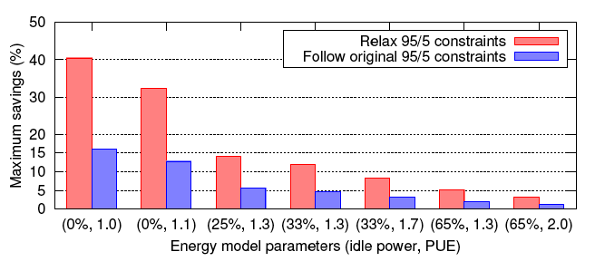

Slide 28
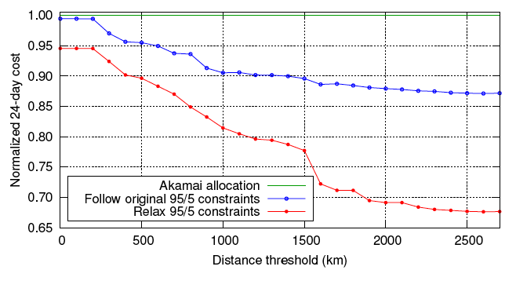
Effect of Distance Threshold

Slide 29
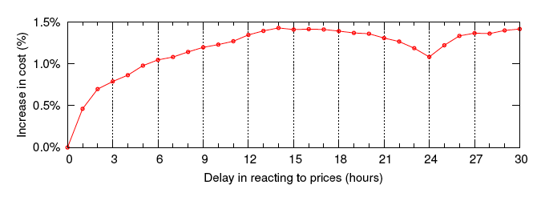
Reaction Delays

Slide 30
Future Work
Joint optimizations
RTO Interaction
Weather Differentials
Environmental Cost

