Slide 1
ElasticTree: Saving Energy in Data Center Networks
Brandon Heller, Srini Seetharaman, Priya Mahadevan, Yiannis Yiakoumis, Puneed Sharma, Sujata Banerjee,
Nick McKeown
Presented by Patrick McClory

Slide 2
Introduction
Most efforts to reduce energy consumption in Data Centers is focused on servers and cooling, which account for about 70% of a data center’s total power budget.
This paper focuses on reducing network power consumption, which consumes 10-20% of the total power.
3 billion kWh in 2006

Slide 3
Data Center Networks
There’s potential for power savings in data center networks due to two main reasons:
Networks are over provisioned for worst case load
Newer network topologies

Slide 4
Over Provisioning
Data centers are typically provisioned for peak workload, and run well below capacity most of the time.
Rare events may cause traffic to hit the peak capacity, but most of the time traffic can be satisfied by a subset of the network links and switches.

Slide 5
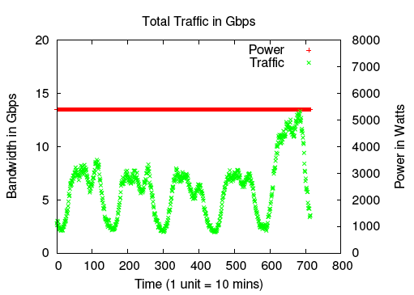

Slide 6
Network Topologies
The price difference between commodity and non-commodity switches provides strong incentive to build large scale communication networks from many small commodity switches, rather than fewer larger and more expensive ones.
With an increase in the number of switches and links, there are more opportunities for shutting down network elements.

Slide 7
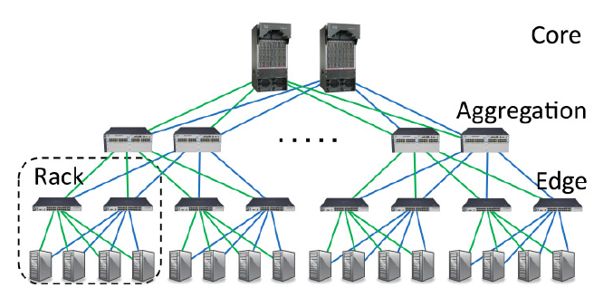
Typical Data Center Network

Slide 8
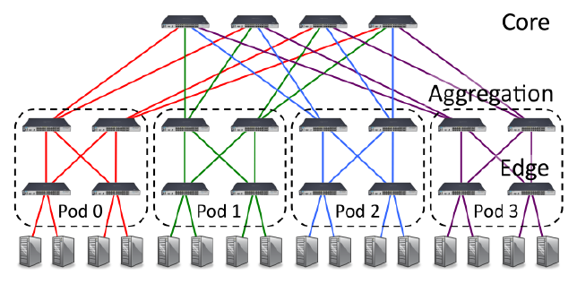
Fat-Tree Topology

Slide 9
Energy Proportionality
Today’s network elements are not energy proportional
Fixed overheads such as fans, switch chips, and transceivers waste power at low loads.
Approach: a network of on-off non-proportional elements can act as an energy proportional ensemble.
Turn off the links and switches that we don’t need to keep available only as much capacity as required.

Slide 10
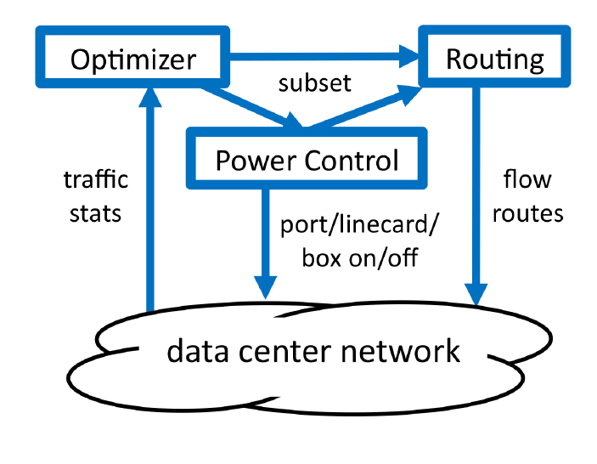
ElasticTree

Slide 11
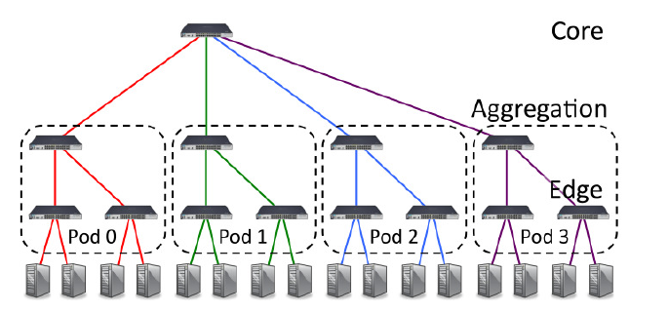
Example

Slide 12
Optimizers
The authors developed three different methods for computing a minimum-power network subset:
Formal Model
Greedy-Bin Packing
Topology-aware Heuristic

Slide 13
Formal Model
Extension of the standard multi-commodity flow (MCF) problem with additional constraints which force flows to be assigned to only active links and switches.
Objective function:

Slide 14
Formal Model
MCF problem is NP-complete
An instance of the MCF problem can easily be reduced to the Formal Model problem (just set the costs for each link and switch to be 0).
So the Formal Model problem is also NP-complete.
Still scales well for networks with less than 1000 nodes, and supports arbitrary topologies.

Slide 15
Greedy Bin-Packing
Evaluates possible flow paths from left to right. The flow is assigned to the first path with sufficient capacity.
Repeat for all flows.
Solutions within a bound of optimal aren’t guaranteed, but in practice high quality subsets result.

Slide 16
Topology-Aware Heuristic
Takes advantage of the regularity of the fat tree topology.
An edge switch doesn’t care which aggregation switches are active, but instead how many are active.
The number of switches in a layer is equal to the number of links required to support the traffic of the most active switch above or below (whichever is higher).

Slide 17
Experimental Setup
Ran experiments on three different hardware configurations, using different vendors and tree sizes.

Slide 18
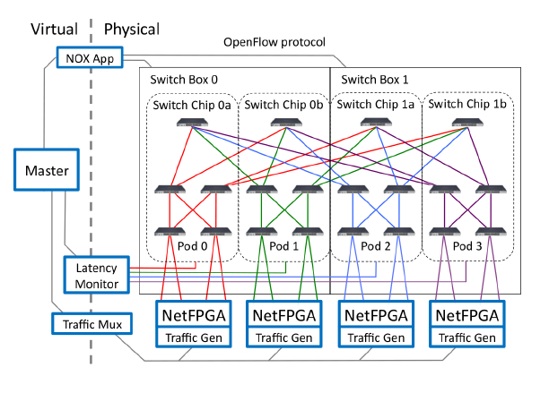

Slide 19
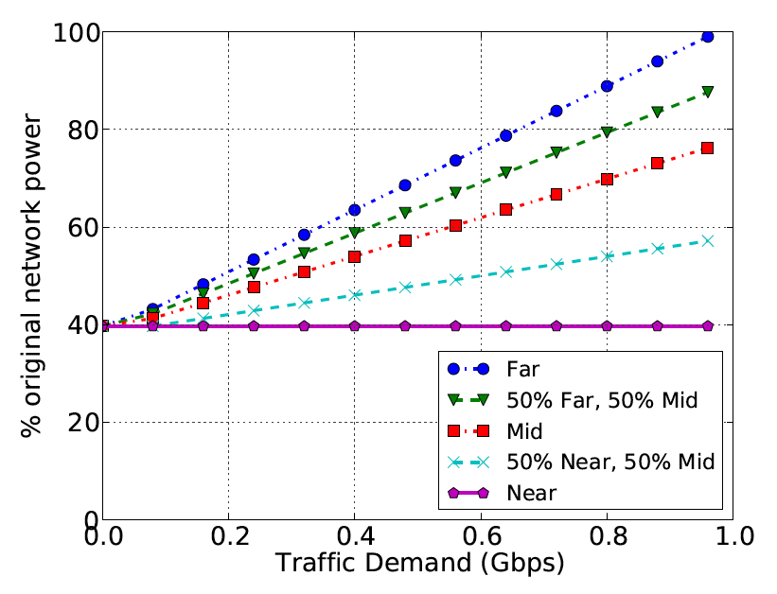
Uniform Demand

Slide 20
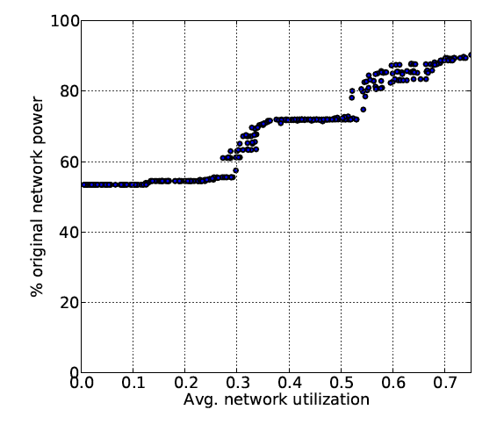
Variable Demand

Slide 21
Traffic in a Realistic Data Center
Collected traces from a production data center hosting an e-commerce application with 292 servers.
Application didn’t generate much network traffic so scaled traffic up by a factor of 10 to increase utilization.
Need a fat tree with k=12 to support 292 servers, testbed only supported up to k=12, so simulated results using the greedy bin-packing optimizer.
Assumed excess servers and switches were always powered off.

Slide 22
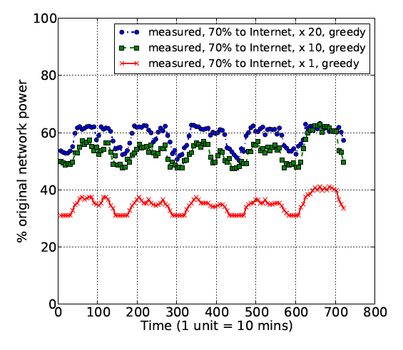
Realistic Data Center Results

Slide 23
Fault Tolerance
If only a MST in a Fat Tree topology is powered on, power consumption is minimized, but all fault tolerance has been discarded.
MST+1 configuration – one additional edge switch per pod, and one additional switch in the core.
As the network size increases, the incremental cost of additional fault tolerance becomes an insignificant part of the total network power.

Slide 24
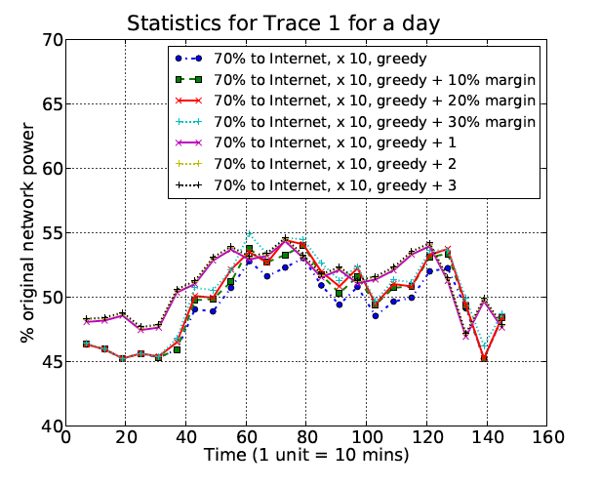

Slide 25
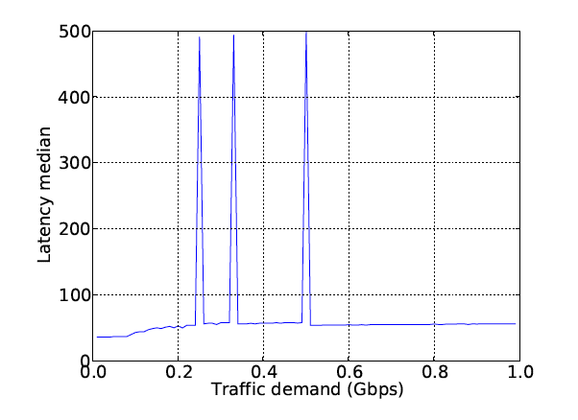
Latency vs. Demand

Slide 26
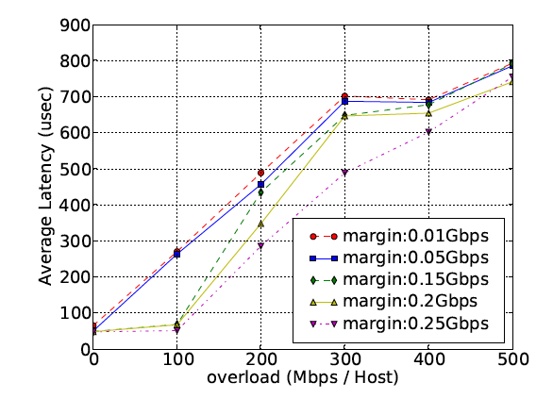
Safety Margins
Amount of capacity reserved at every link by the solver.

Slide 27
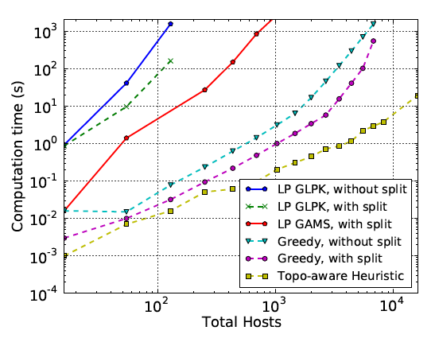
Comparison of Optimizers

