Slide 1
Software Thermal Management of DRAM Memory for Multicore Systems (SIGMETRICS 2008)
Authors: Jiang Lin, Hongzhong Zheng, Zichun Zhu, Eugene Gorbatov, Howard David, and Zhao Zhang
Presenter: Daniel Cole

Slide 2
Overview
First study of thermal management for memory subsystems on real machines
Assumes very warm environment where emergencies often occur resulting in performance loss
Results (bandwidth throttling as baseline)
Core gating: up to 24.2% improvement, 13.3% on average
DVFS: up to 23.9% improvement, 15.3% on average
DVFS improved power by 15.5% and energy by 22.7%
Combining both may give addition performance improvement of 5.7%
DVFS previously not thought to have major impact

Slide 3
A bit of background
In the latest generation of servers (2008), DRAM power can be comparable to processor
DRAM dynamic power is almost proportional to memory throughput

Slide 4
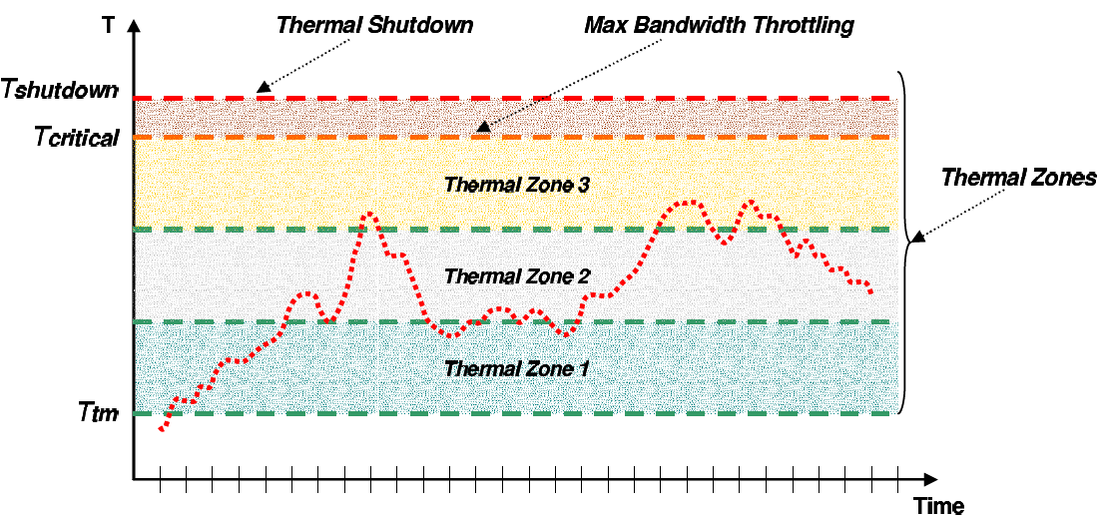
Methods

Slide 5
Methods
Core gating:
Lowers the temp by lowering cache misses, if the workloads are memory bandwidth-bound, the lower cache contention actually offsets the reduced computation
Thermal constraints already put a limit on memory bandwidth anyway
Note that active threads are migrated
DVFS
Reduce processor heat, which means less processor heat is being dissipated onto DIMMs
Note that this is uniform scaling on all cores

Slide 6
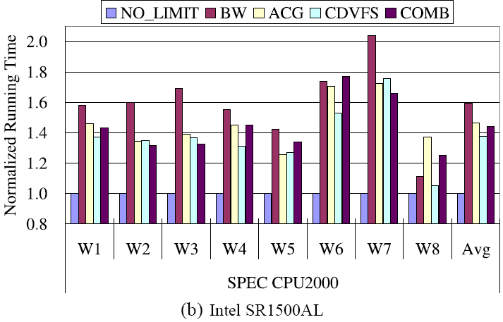
Results

Slide 7
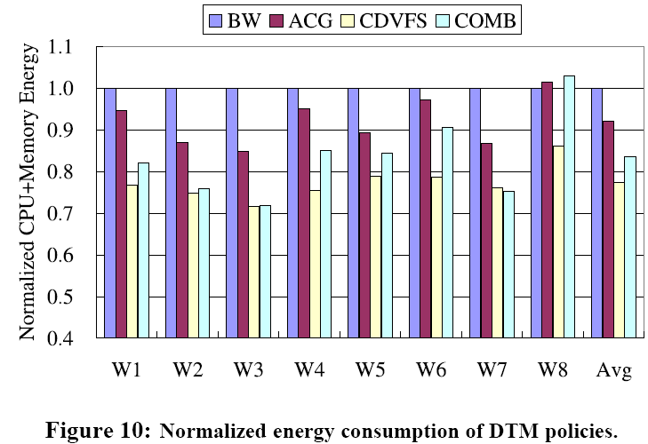
Results

Slide 8
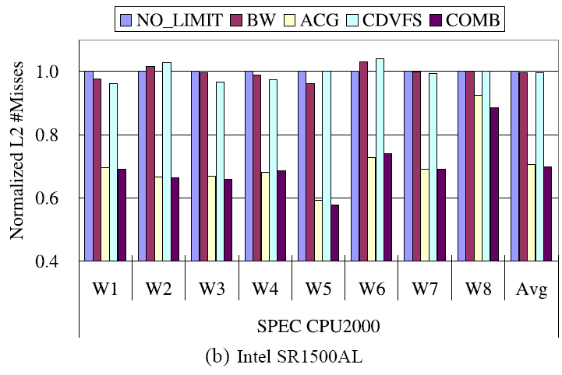
Results

Slide 9
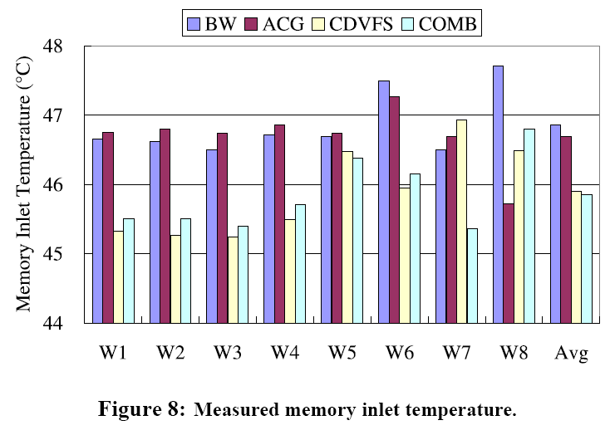
Results

Slide 10
Points of Note
The processor’s effect on memory temp is because the processor is usually very close to the memory DIMMs
In the machine where processor and DIMMs were closer DVFS helped more
DVFS doesn’t seem to help cache misses (makes sense)
Can’t seem to combine DVFS lower temp and gating cache miss improvement to get the benefits of both (only 5.7% on a certain machine)
Core gating doesn’t seem to reduce power at all (energy must be through faster execution: with no speed scaling, faster execution = lower energy)

