Slide 1
Power Management Features in Intel Processors
Shimin Chen
Intel Labs Pittsburgh
UPitt CS 3150, Guest Lecture, February 24, 2010

Slide 2
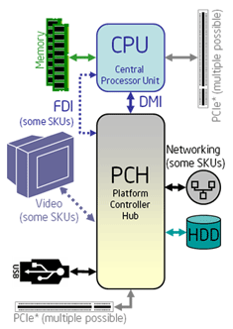
Power Management
Many components in a computer system:
CPU(s)
DRAM memory
Hard drives
Graphics card
Monitor
Network card
……
System-wide power management actions are based on power management features of individual components
Our focus: CPUs
PC system with Intel core i7

Slide 3
Why CPU Power Management?
Save power
For mobile devices: longer battery life
For servers: lower operational cost
More environmentally friendly
Thermal management (less obvious but very important)
Higher power ➔ more heat ➔ higher temperature
Maximum operating temperature
Beyond this temperature, transistors may not operate correctly. Then one sees weird bugs, or even system crashes.
Running CPU at too high temperature reduces the CPU life.

Slide 4
Many Terms When Reading About CPU Power Management
P-states, C-states
ACPI
Enhanced Intel SpeedStep
Dynamic frequency and voltage scaling
Halt state
Idle state
Suspend …

Slide 5
Two Perspectives
Hardware perspective
Bottom up description
Hardware mechanisms
E.g., Intel processor manuals take this approach
ACPI standard perspective
ACPI: Advanced Configuration and Power Interface
Top down description
Define programming APIs and functionalities
Confusions often arise because
The same concept may be represented with different terms
And the two descriptions do not exactly match

Slide 6
The Description in This Talk
Combined approach:
Provide a high level overview of ACPI
Describe the hardware mechanisms and their relationships to ACPI
I hope that this can give you a structured view of the CPU power management, and clarify the aforementioned terms and their relationships

Slide 7
Outline
Introduction
ACPI Overview
Enhanced Intel SpeedStep Technology (P-States)
Low-Power Idle States (C-States)
Multi-core considerations
Summary

Slide 8
What Is ACPI?
ACPI (Advanced Configuration and Power Interface)
Standard interface specification
OS can perform power management using this API
Hardware and software drivers support this API
Mapping from CPU mechanisms to ACPI is provided by BIOS and software drivers
Applications
OS Power Management
ACPI
Software drivers
Hardware: CPU, BIOS etc.

Slide 9
ACPI State Hierarchy (1/3)
Global system states (g-state)
G0 : Working
G1 : Sleeping (e.g., suspend, hibernate)
G2 : Soft off (e.g., powered down but can be restarted by interrupts from input devices)
G3 : Mechanical off
Lower number means higher power

Slide 10
ACPI State Hierarchy (2/3)
Global system states (g-state)
G0 : Working
Processor power states (C-state)
C0 : normal execution
C1 : idle
C2 : lower power but longer resume latency than C1
C3 : lower power but longer resume latency than C2
G1 : Sleeping (e.g., suspend, hibernate)
Sleep State (S-state)
S0
S1
S2
S3: suspend
S4: hibernate
G2 : Soft off (S5)
G3 : Mechanical off

Slide 11
ACPI State Hierarchy (3/3)
G0 : Working
Processor power states (C-state)
C0 : normal execution
Performance state (P-State)
P0: highest performance, highest power
P1
Pn
C1, C2, C3
G1 : Sleeping (e.g., suspend, hibernate)
Sleep State (S-state): S0, S1, S2, S3, S4
G2 : Soft off (S5)
G3 : Mechanical off

Slide 12
Supporting ACPI States
ACPI defines data structures to track the states and functions to operate on the states
CPUs implement mechanisms to support these states
BIOS and software drivers hide the difference of CPU implementations to support the ACPI defined data structures and functions

Slide 13
Outline
Introduction
ACPI Overview
Enhanced Intel SpeedStep Technology (P-States)
Low-Power Idle States (C-States)
Multi-core considerations
Summary

Slide 14
Enhanced Intel SpeedStep Technology (EIST)
Enhanced Intel SpeedStep == dynamic frequency and voltage scaling
An operation point (frequency, voltage) == P-state
Note that the CPU is in normal operation, executing instructions (C0)

Slide 15
Why Dynamic Frequency and Power Scaling?
Physics:
Lower voltage ➔ slower transistor switch speed ➔ longer latency of CPU operations ➔ lower frequency
Larger power savings if reducing frequency and voltage at the same time:
P= CV²F
P: power; C: capacitance; V: voltage; F: frequency

Slide 16
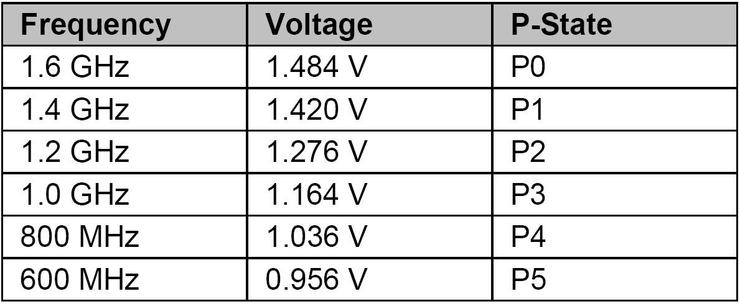
Example: Intel Pentium M at 1.6GHz
Source: Ref[4]

Slide 17
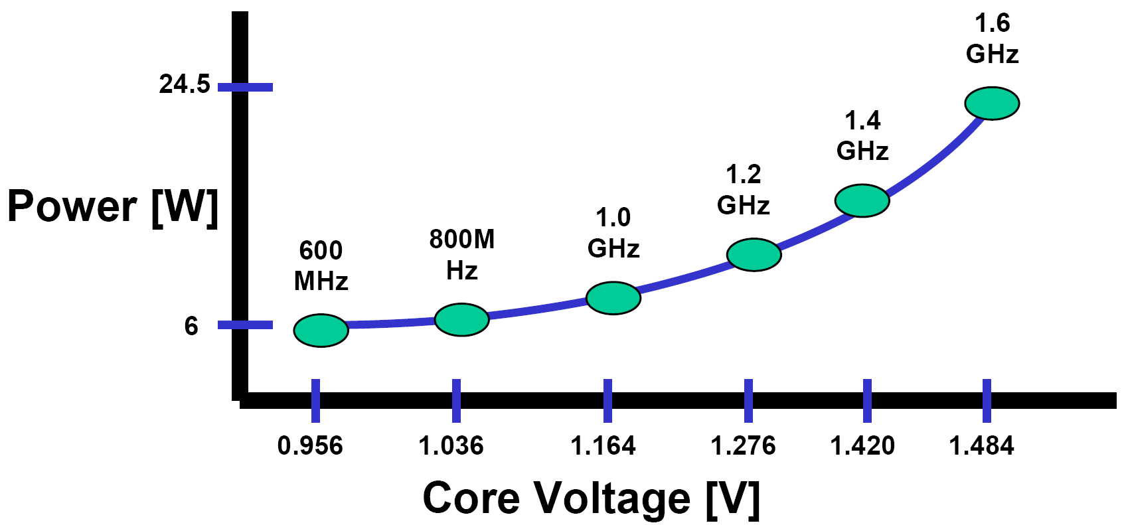
Power vs. Core Voltage of Intel Pentium M at 1.6GHz
Source: Ref[4]

Slide 18
Hardware Mechanisms
Select voltage
Voltage Regulator
Processor
Components
Vcc
Frequency multiplier
Clock

Slide 19
Enhanced SpeedStep vs. Legacy SpeedStep
“Enhanced”:
Supports are mainly in CPU itself as opposed in chipsets
Faster transition time (e.g., 10us down from 250us for the Intel Pentium M processor)

Slide 20
How to Control EIST in Software?
EIST is available or not?
CPUID instruction, ECX feature bit 07
Enable EIST (in OS kernel)
Set special register IA32_MISC_ENABLE bit 16
Change operational point (in OS kernel)
Write operation point ID to special register IA32_PERF_CTL
This ID is processor model specific

Slide 21
EIST Availability
Enhanced Intel SpeedStep® Technology is available in
Pentium M processor
Pentium 4
Intel Xeon
Intel® Core™ Solo
Intel® Core™ Duo
Intel® Atom™
Intel® Core™2 Duo

Slide 22
Outline
Introduction
ACPI Overview
Enhanced Intel SpeedStep Technology (P-States)
Low-Power Idle States (C-States)
Multi-core considerations
Summary

Slide 23
Low-Power Idle State
These are the idle C-State: C1, …
CPU is not executing instructions in these C-states
Power saving mechanisms:
Stop clock signal
Flush and shutdown cache
Turn off cores

Slide 24
C-State in Intel Core i7 Processor
Core C0 State
The normal operating state of a core where code is being executed.
Core C1/C1E State
The core halts; it processes cache coherence snoops.
C1E: if possible, reduce voltage and frequency to the lowest

Slide 25
C-State in Intel Core i7 Processor
Core C0 State
The normal operating state of a core where code is being executed.
Core C1/C1E State
The core halts; it processes cache coherence snoops.
Core C3 State
The core flushes the contents of its L1 instruction cache, L1 data cache, and L2 cache to the shared L3 cache, while maintaining its architectural state. All core clocks are stopped at this point. No snoops.
C2 not defined. The C-States are processor model specific.

Slide 26
C-State in Intel Core i7 Processor
Core C0 State
The normal operating state of a core where code is being executed.
Core C1/C1E State
The core halts; it processes cache coherence snoops.
Core C3 State
The core flushes the contents of its L1 instruction cache, L1 data cache, and L2 cache to the shared L3 cache, while maintaining its architectural state. All core clocks are stopped at this point. No snoops.
Core C6 State
Before entering core C6, the core will save its architectural state to a dedicated SRAM on chip. Once complete, a core will have its voltage reduced to zero volts.

Slide 27
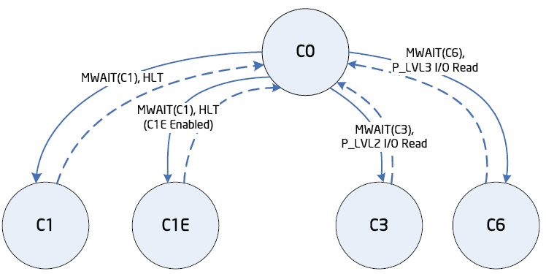
C-State Transition
hlt or mwait instruction triggers the transition to lower power states
Interrupts (among others) triggers the transition to C0

Slide 28
C-State Availability
C0 is always available
The low power idle C-States are processor model specific
Described in processor data sheet.

Slide 29
Outline
Introduction
ACPI Overview
Enhanced Intel SpeedStep Technology (P-States)
Low-Power Idle States (C-States)
Multi-core considerations
P-States
C-States
Intel Turbo Boost Technology
Summary

Slide 30
Multi-core Chip
4-core CPU (Nehalem)
Question: can we set the individual core’s p-state and c-state?

Slide 31
P-State: Enhanced Intel SpeedStep Technology
Dynamic frequency and voltage scaling
Current Intel processors use the same frequency and voltage for all the cores
Therefore, it is impossible to actually run different cores at different p-states.
Processor p-state = MIN (core desired p-states)

Slide 32
C-State: Low-Power Idle States
The actions are:
Halting the execution
Flushing cache
Stopping clock …
These actions can be performed on individual cores
Different cores can have different C-State

Slide 33
How about C1E?
C1E is C1 + the lowest frequency P-state
Therefore, C1E is only used when all the cores are in C1E.

Slide 34
How about C-State for Hyper Threading?
There can be two hardware threads per core
Each thread may use mwait instruction to specify the desired C-state
However, the C-state action cannot be performed for individual threads
core c-state = MIN (thread c-state)

Slide 35
General Optimization Guideline
In general, it is better to use the cores evenly
Distribute computations so that the cores have similar utilization
Then all the cores can go into the same P-State
The processor can actually go into the P-State
For single-threaded application, there is a new Intel processor feature

Slide 36
Intel Turbo Boost Technology
Basic idea:
Processor frequency is fundamentally limited by the operating temperature
If there is head-room in operating temperature, one can increase the processor frequency to achieve higher performance
Intel Turbo Boost Technology:
All but one core are in C3/C6
Automatically increase frequency given temperature and other constraints

Slide 37
Summary
ACPI defines a standard interface for operating systems to utilize hardware power features
Supported by most OS, e.g., Linux, Windows
CPUs, BIOS, and software drivers combined to support the ACPI interface
Intel processor power features:
Enhanced Intel SpeedStep Technology: P-State
Low power idle states: C-State
Intel Turbo Boost Technology: not in ACPI standard

Slide 38
References
http://www.acpi.info
“Intel® 64 and IA-32 Architectures Software Developer’s Manual”. Volume 3A: System Programming Guide. Order Number: 253668-033US. December 2009. Chapter 14.
“Intel® 64 and IA-32 Architectures Optimization Reference Manual”. Order Number: 248966-020. November 2009. Chapter 11.
“Enhanced Intel® SpeedStep® Technology for the Intel® Pentium® M Processor”. Order Number: 301170-001. March 2004.
“Intel® Core™ i7-800 and i5-700 Desktop Processor Series, Datasheet – Volume 1”. September 2009. Chapter 4.

Slide 39
Thank you!

Slide 40
Backup

Slide 41
Summary: ACPI State Hierarchy
G0 : Working
Processor power states (C-state)
C0 : normal execution
Performance state (P-State) : Enhanced Intel SpeedStep Technology
Other C-state: model-specific low-power idle states
G1 : Sleeping (e.g., suspend, hibernate)
Sleep State (S-state): S0, S1, S2, S3, S4
G2 : Soft off (S5)
G3 : Mechanical off

Slide 42
Clock Duty Cycle Modulation
Some Intel processors support an additional mechanism to reduce power consumption:

Slide 43
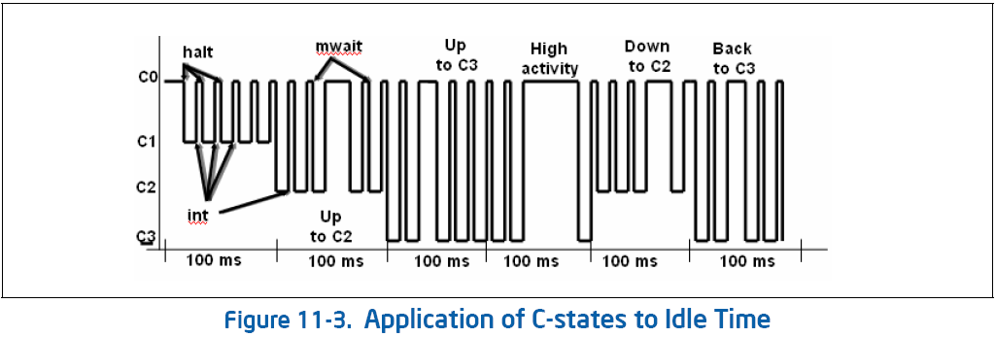
Use C-State to Reduce Power
OS can monitor activity level (e.g., for every 100ms) and determine the desired C-State

