Slide 1
Skilled in the Art of Being Idle: Reducing Energy Waste in Networked Systems
Sergiu Nedevschi, Jaideep Chandrashekar, Junda Liu, Bruce Nordman, Sylvia Ratnasamy, Nina Taft
Presented by Pat McClory

Slide 2
Introduction
It’s estimated in the U.S. energy consumption of networked systems approaches 150 TWh, costing around 15 billion dollars.
About 75% of this consumption can be attributed to homes and enterprises.

Slide 3
Introduction
Problem: Because sleep states cause a machine to effectively lose it’s network presence, many users decline to utilize them.
Goal: To develop a strategy where machines can take advantage of sleep states during idle periods without the penalty of losing network presence.

Slide 4
Possible Approaches
“magic packets” – wake-on-arrival of packet
Use a proxy that handles idle-time traffic on behalf of sleeping host(s).

Slide 5
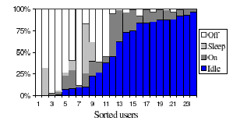
Potential Energy Savings
Assuming an 80W power consumption for an idle PC, and assuming these machines are idle for 50% of the time, this amounts to roughly 60 TWh/year of wasted electricity.

Slide 6
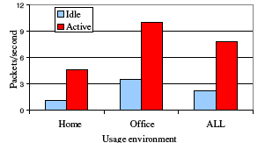
Wake-on-arrival
Machine is woken up for every packet it receives.

Slide 7
Wake-on-arrival
Although in both the work and home scenario there is a relatively large amount of background chatter when idle, but if traffic exhibits burstiness there still could be potential for savings.

Slide 8
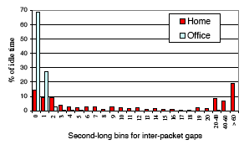
Inter-packet Gaps

Slide 9
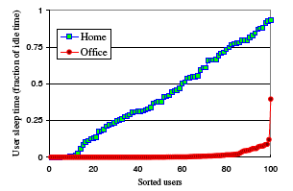
Actual Savings

Slide 10
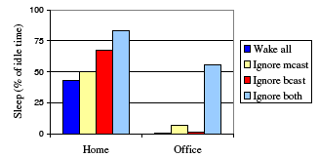
Potential Proxy Savings by Traffic Type

Slide 11
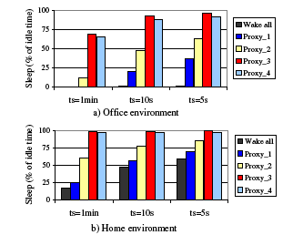
Energy Savings of Different Proxying Approaches

