Slide 1
Power Provisioning for a Warehouse-Size Computer (ISCA 2007)
Authors: Xiabo Fan, Wolf-Dietrich Weber, and Luis Andre Barroso
Google
Presenter: Kirk Pruhs

Slide 2
First power usage study at data center level on real data center workloads
Findings:

Slide 3
First power usage study at data center level on real data center workloads
Findings:
Difference between measured peak power and aggregate theoretical per machine maximum power is 40% at data center level
Power capping can allow you to use significantly more (40%) machines without effect maximum power
More effective at data center level than rack level
Speed scaling is moderately effective (20%) at reducing average power, and has measurable effect on reducing peak power

Slide 4
Background
Contracts with electrical utilities specifies peak power usage, with significant penalties for exceeding these peaks
In newest Google data centers, 85% of power hits the computing equipment
(www.google.com/corporate/green/datacenters/step2.html)

Slide 5
Experimental Set
5K machines
Used CPU utilization to estimate power
Workloads
Websearch
Webmail
Map reduce
Mixture of the above three
Actual data center workload

Slide 6
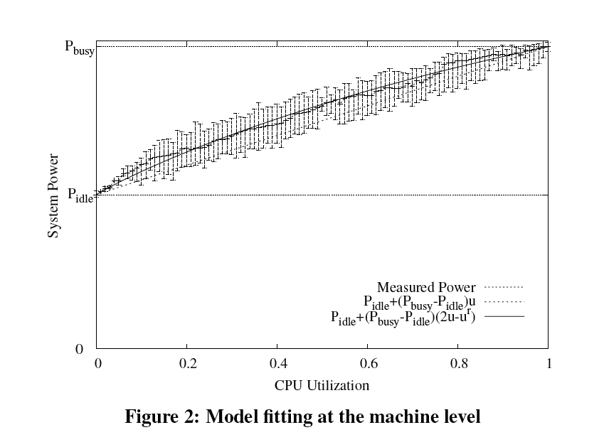
Power Was Estimated Using CPU Utilization

Slide 7
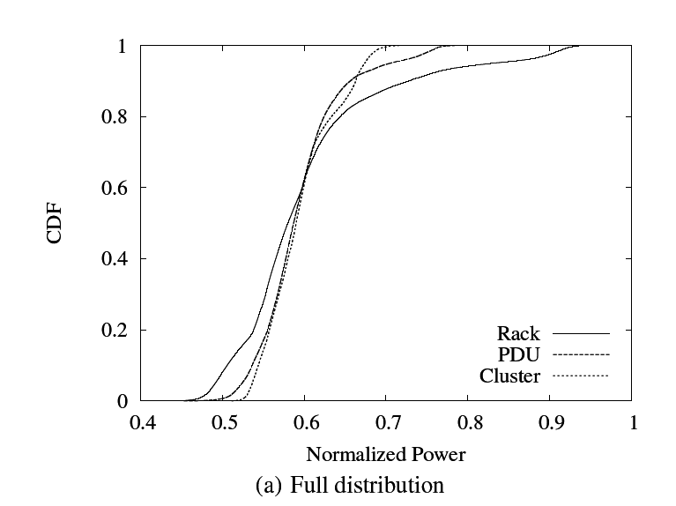
Typical Measure Result (here real data center workload)

Slide 8
Power Capping
Definition: Reducing power consumption to stay below some threshold
Need measurements
Option 1: Throttle the workload by delaying less essential work
Option 2: Throttle the power per machine, say by speed scaling

Slide 9
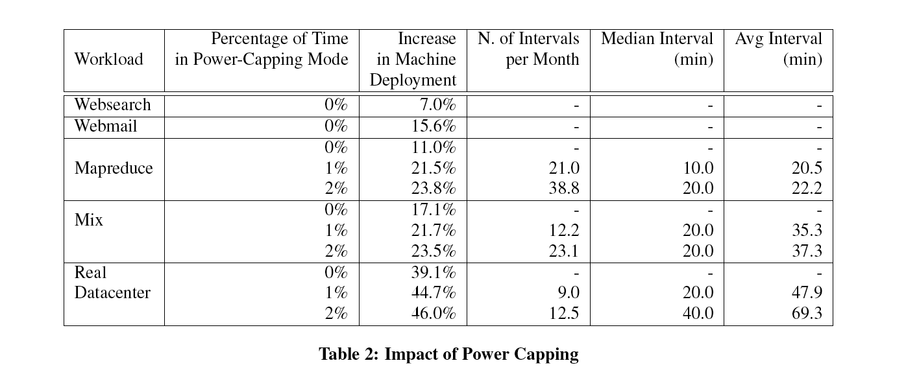
Potential Benefits of Power Capping

Slide 10
Speed Scaling Experiments
When CPU utilization was below a certain threshold (5% or 20% or 50%) the contribution of CPU power was estimated to be reduced by half and the power for other components was unchanged (so there were no measurements of actual power usage)

Slide 11
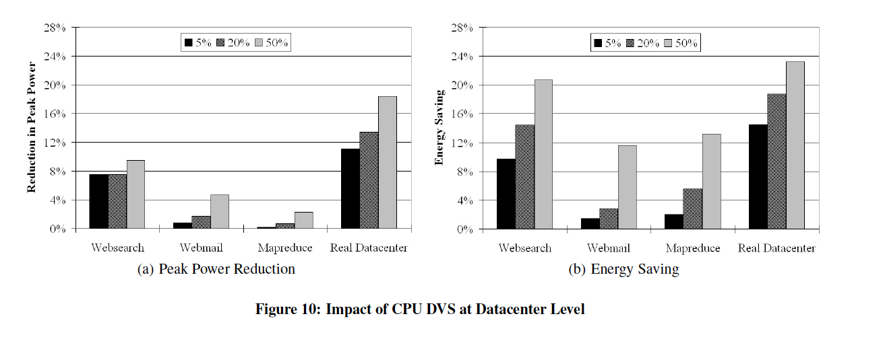
Effect of Using Speed Scaling

Slide 12
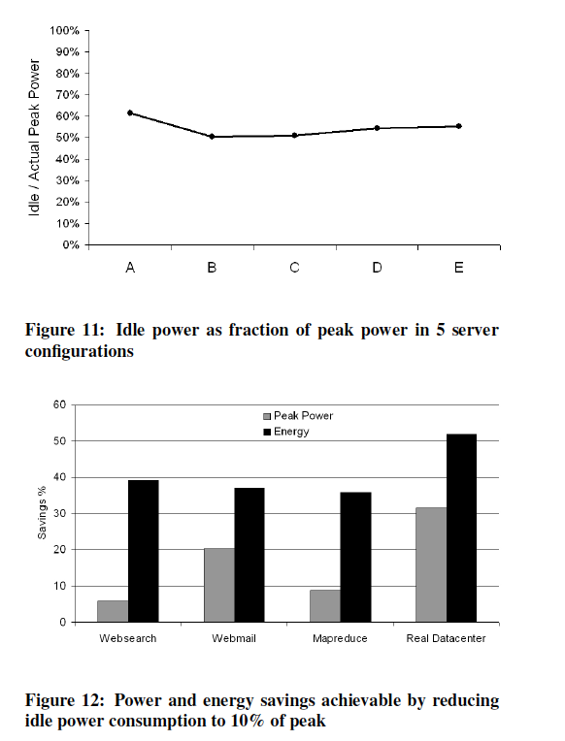
Idle Power

Slide 13
First power usage study at data center level on real data center workloads
Findings:
Difference between measured peak power and aggregate theoretical per machine maximum power is 40% at data center level
Power capping can allow you to use significantly more (40%) machines without effect maximum power
More effective at data center level than rack level
Speed scaling is moderately effective (20%) at reducing average power, and has measurable effect on reducing peak power

Slide 14
Discussion Points
Do we buy the conclusions reached in the paper?
How significant/interesting is the paper?
What interesting research directions does it suggest?
More specifically, what algorithmic problems does the paper suggest?

