Slide 1
Evaluating the Impact of Job Scheduling and Power Management on Processor Lifetime for Chip Multiprocessors (SIGMETRICS 2009)
Authors: Ayse K. Coskun, Richard Strong, Dean M. Tullsen, and Tajana Simunic Rosing
Presenter: Daniel Cole

Slide 2
Overview
Effect of Thermal Management on a chip multi-processor’s lifetime (MTTF) using simulations
Focusing on Thermal Reliability, critical factors:
Asymmetric thermal characteristics of the cores, inner cores have very different properties
Frequency of job migration can inhibit sleep states and cause thermal cycling
Provides polices that can decrease the failure rate by a factor of 2 with a performance cost of < 4%

Slide 3
Reliability
High temperature does cause failures, but some failures, such as those caused by fatigue, do not occur because of high temperature per se, but rather by thermal cycling (a common materials problem)

Slide 4
Models
Power and Thermal essentially use existing applications/models
Temperature Induced Reliability:
Electromigration and Time dependent dielectric breakdown (TDDB) are of the form: C_1*e^(-C_2/T)
Thermal Cycling: failure rate ≈ C*(∆T)^(-q)*f
∆T = temperature cycling range
f = frequency of thermal cycles
Failure rates are combined using an existing sum-of-failure rates model
Average MTTF is computed using the average failure rate throughout the simulation
System dependent constants are estimated by using the fact that the three forms of temperature induced reliability contribute equal weight to the overall failure rate at nominal temperatures

Slide 5
Side Note
Thermal Gradients: Temperature differences between adjacent locations on the die
Not included because although they can induce hard errors, they primarily cause device latency (increase in timing errors)

Slide 6
Reliability Aware Scheduling
Stop_Go: Core Gating (at thermal threshold)
Thread migration:
Migration: send jobs on cores exceeding the thermal threshold to cooler cores (swap if cool core has a job)
Balance: Jobs with highest instructions per second assigned to currently coolest core (every scheduling interval)
Balance_Location: Highest instructions per second to outer cores
Heuristics performed poorly (too much movement)
DVFS:
Threshold
Location: fixed 85% max on 4 inner cores, 100% on 4 corners, rest 95%
Performance: Scale down memory-bound tasks all the time
Performance + Threshold
Turn off idle cores
Combination

Slide 7
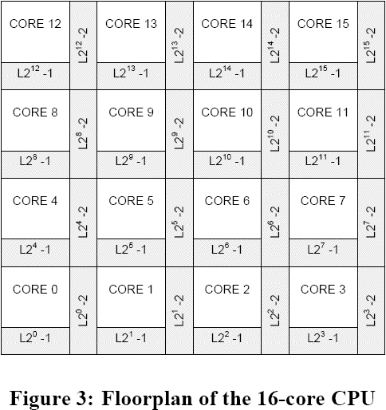
Floor Plan

Slide 8
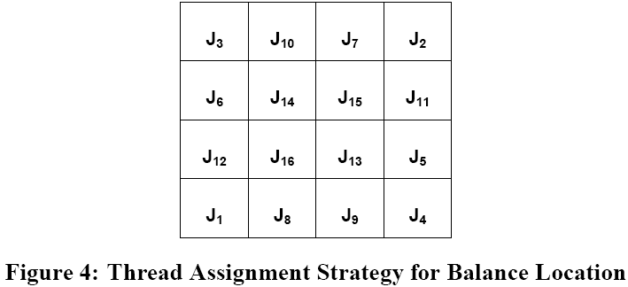
Balance Location Job Assignments

Slide 9
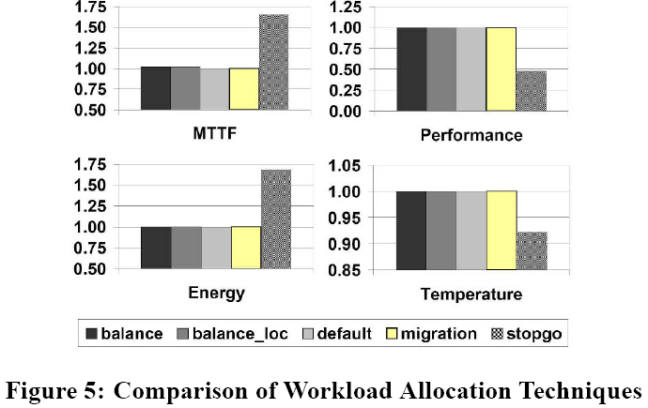
Full Utilization

Slide 10
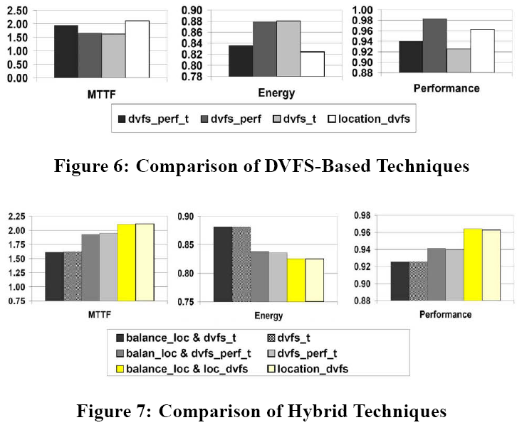
Full Utilization

Slide 11
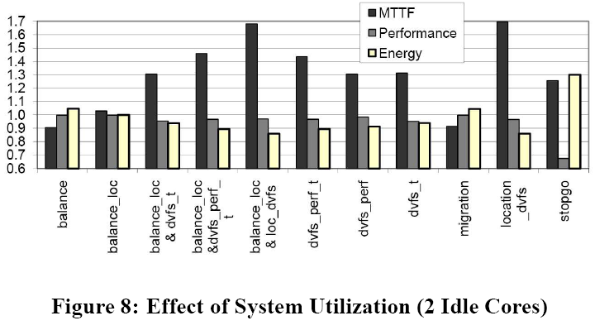
Partial Utilization

Slide 12
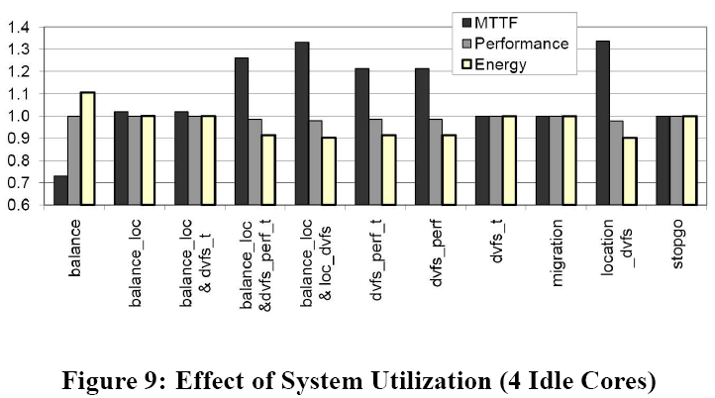
Partial Utilization

Slide 13
Initial Idle Core Locations
Paper claims “it is critical to combine a conservative migration technique…with DVFS techniques.” (end of 6.3)
However, it only uses dvfs_perf_t as an example of how bad initial job allocation hurts DVFS for MTTF
According to previous results, dvfs_perf_t is not best DVFS at handling MTTF, in fact taken alone, location_dvfs always beats it

Slide 14
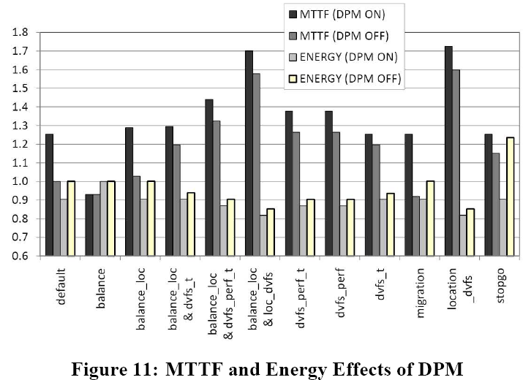
Turning Idle Cores Off

Slide 15
Points
Is location_dvfs enough? Does balance_loc + location_dvfs really offer enough improvement to be more than noise? (overall)
Algorithmic model for MTTF using thermal cycling (single core, multicore)
Algorithmic model for temperature gradients inducing device latencies in multicore processors (not considered in paper’s model)
Hottest cores are determined mostly by location, not jobs

