Slide 1
Power Routing: dynamic Power Provisioning in the Data Center (ASPLOS 2010)
Authors: Steven Pelley, David Meisner, Pooya Zandevakili, Thomas F. Wenisch, Jack Underwood
Presenter: Daniel Cole

Slide 2
Concept
Instead of “routing” power by dynamically changing the requested power of components (speed scaling, job distribution) this paper seeks to actually dynamically change all components’ sources of power.
The goal is to reduce capital costs by allowing each power distribution unit (PDU) to run with less capacity thereby reducing the number and/or size of the required PDU’s
Recall that “The cost of building datacenter facilities capable of delivering a given power capacity to such a computer can rival the recurring energy consumption costs themselves.” – Fan, et al.

Slide 3
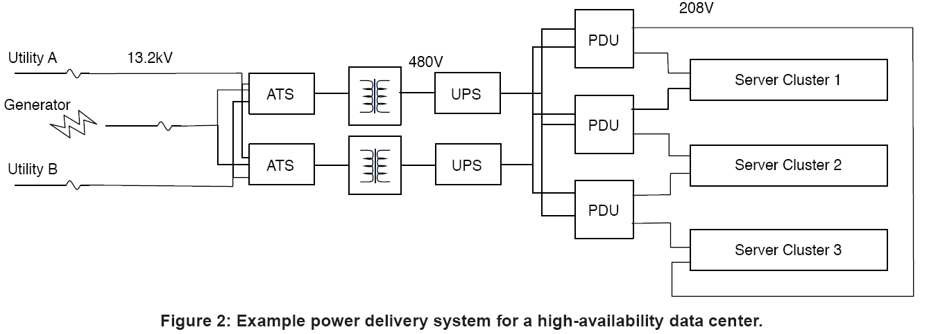
High-tier Data Center (Wrapped Topology)
In the event of PDU failure, half of its load fails over to its neighboring PDUs

Slide 4
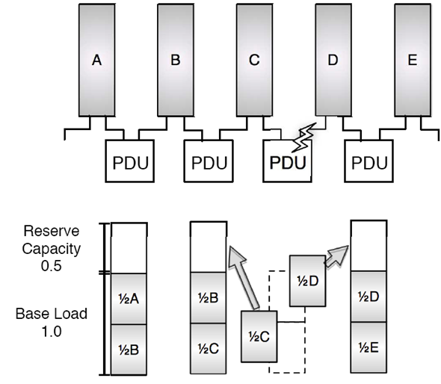
Example
Worst case means we can handle this if B,C,D, & E are all “full”
Fail

Slide 5
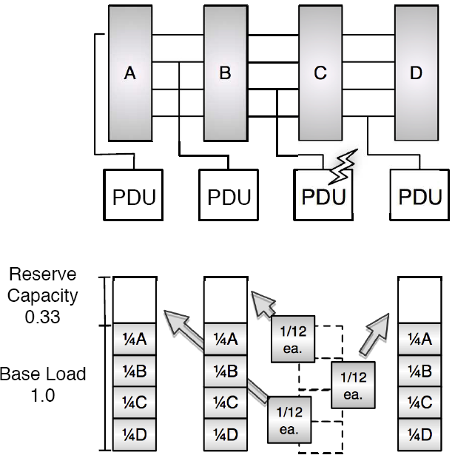
What if we distribute A,B,C, & D among all PDUs? (Shuffled Topologies)
We still have the same base load but our needed reserve is smaller.
Fail

Slide 6
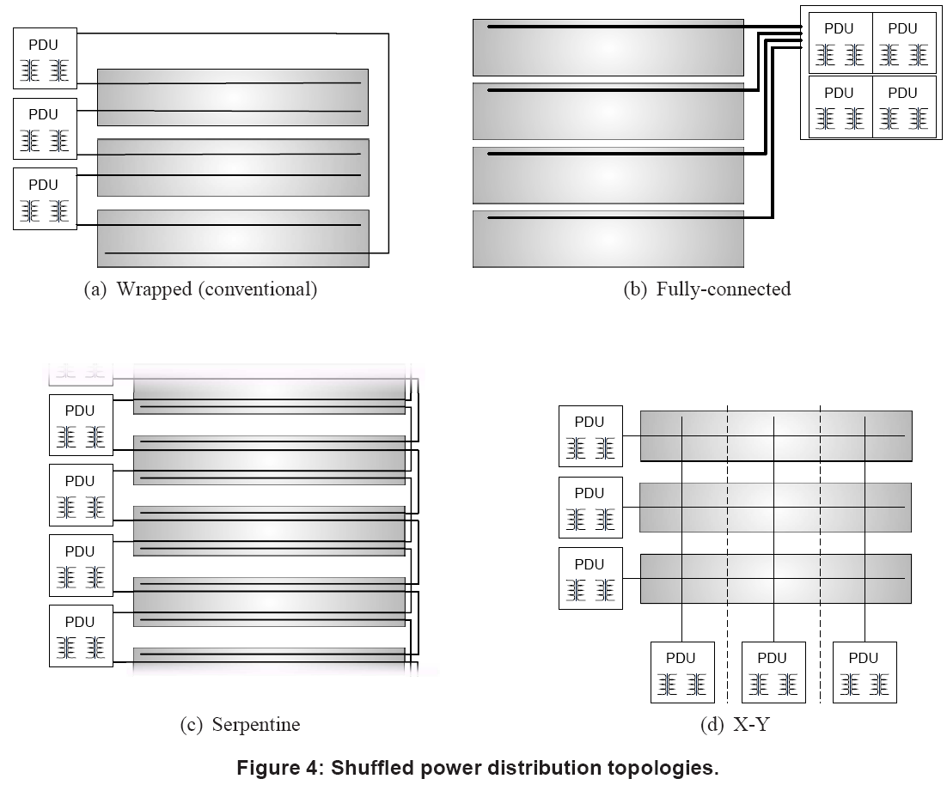
Topologies

Slide 7
Dynamic Power Routing
Each server is assigned to get power from its primary or secondary power feed as well as a power budget
When the server hits its power cap, it can request more power
If the feed that the server is getting power from can spare more power the server’s budget is increased
If not, then the scheduler creates a new assignment of power feeds and budgets to servers in an attempt to prevent performance throttling
Scheduler ensures that any single PDU failure can be handled
Notes:
Apparently each server only gets two power feeds but in the same manner in which a fail over allowed us to give a small amount to everyone else, so if a PDU is reaching a point where capping is needed, it has lots of options for off loading because it has a large number of small server “groups” each group going to a separate PDU. This gives it many options of off loading.

Slide 8
Why not just use shuffled topologies?
Individual PDUs are unlikely to reach peak load simultaneously. (Need heterogeneity in global workload.)
If all PDUs are either under or over provisioned, power routing doesn’t help.
If one or more PDUs are over provisioned, normally, we would just have to throttle the servers on the over provisioned PDU

Slide 9
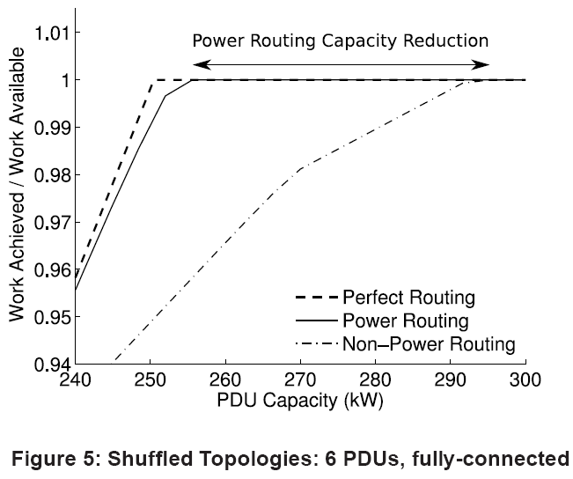
When aggregate power infrastructure meets demand
If we fix our performance we find the required PDU capacity at the leftmost intersection point.
If we fix our PDU capacity we can compare performance vertically.
Notes:
Perfect routing here is, perfect, meaning we can fractionally split power to one server over multiple PDUs and every server is connected to every PDU.

Slide 10
New Assignment Scheduling
Input: Set of servers and PDUs, each server is connected to 2 PDUs, and has a desired power, each PDU has a power capacity
Output: Each server assigned to one of its PDUs, any single PDU failure can be handled by failover
Not formally defined in the paper.

Slide 11
Reduction (WITHOUT REDUNDANCY)
NP-hard:
Reduction from PARTITION:
PARTITION instance: set of positive integers, want a partition of the set such that they have equal value
Power Routing Instance: 2 PDUs, each with capacity equal to half the value of the set, set of integers is the set of server power requests
But with redundancy enforced, this reduction doesn’t work, as the Power Routing instance has no solution
For any two PDU instance, we always need two PDUs both with capacity equal to the total aggregate demand to allow single PDU failure
They say “power feed assignment...even without redundancy, is an NP-complete problem.”
But redundancy seems to make the problem easier for at least certain cases (any case with 2 PDUs).

Slide 12
Solution: LP with fractional power
Input:
Power(i,j) is total requested power by any server connected to PDU i and j
Capacity(i) is capacity of PDU I
Variables:
For all possible PDU pairs: Feed(i,j)-i and Feed(i,j)-j, i.e., the power to each feed for servers that are connected to i and j
Slack: minimum slack between any feed and its capacity
Objective: Maximize Slack
Constraints (For all i,j):
Feed(i,j)-i + Feed(i,j)-j = Power(i,j) [feed’s must supply needed power]
Sum_k Feed(i,k)-i + Sum_{l in j’s PDU} Feed(i,l)-l + Slack <= Capacity(i) [All power a feed handles plus what fails over to it if j’s PDU fails]
PDUs actually have multiple feeds which all need to be within a certain factor of each other (omitted)
Notes:
Minimize the maximum required capacity (maximize minimum slack) [Max Slack]

Slide 13
When fractional solutions don’t divide
Sort power requests for Power(i,j) and give the largest to the feed with the largest amount of its Feed(i,j)-i remaining, repeat until all servers assigned
At worst 1 is not assigned:
Will be assigned to the feed with the largest remaining capacity once all servers have been assigned
If capacity constraints have been violated by non-fractional assignment they formulate a new LP that selects power caps by maximizing the sum of the server budgets while ensure PDUs maintain capacity requirements
This LP is only described in a few sentences and is probably not used all in their experiments because they are looking for minimum capacity to avoid capping, thus they would never use this.

Slide 14
Evaluation
Traces of server utilization (once per minute):
A small cluster of departmental web servers
1.5 MW facility for clinical operations
4MW facility for high performance computing
Hypothetical Facility:
400 medical center servers
300 high performance nodes
300-node web search cluster
Utilization converted to power using SPECPower benchmarks
Primary evaluation benchmark is minimum total power capacity required to assure zero performance throttling
Notes:
In reality we over provision and use power routing to exploit open power on a PDU that is under utilized when another one is over utilized.

Slide 15
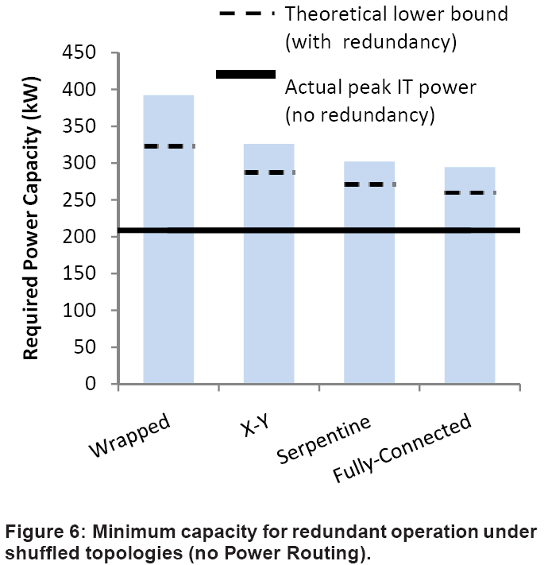
Impact of Shuffled Topologies
If server power draw could be fractionally and dynamically split.
Result of imbalances across PDUs.

Slide 16
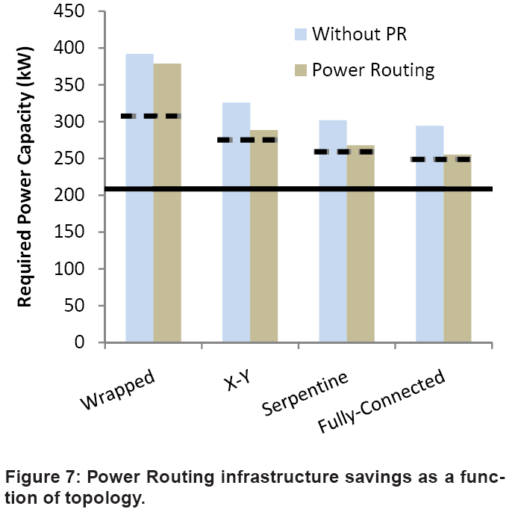
Closing the Gap
32% savings compared to Wrapped without power routing.

Slide 17
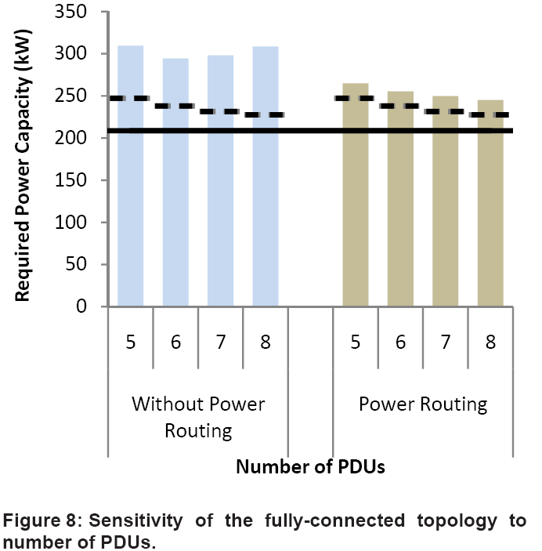
Number of PDUs
“For a fixed total power demand, as the number of PDUs increases, each individual PDU powers fewer servers…With fewer servers, the variance in power demands seen by each PDU grows and it becomes more likely an individual PDU will overload.”

Slide 18
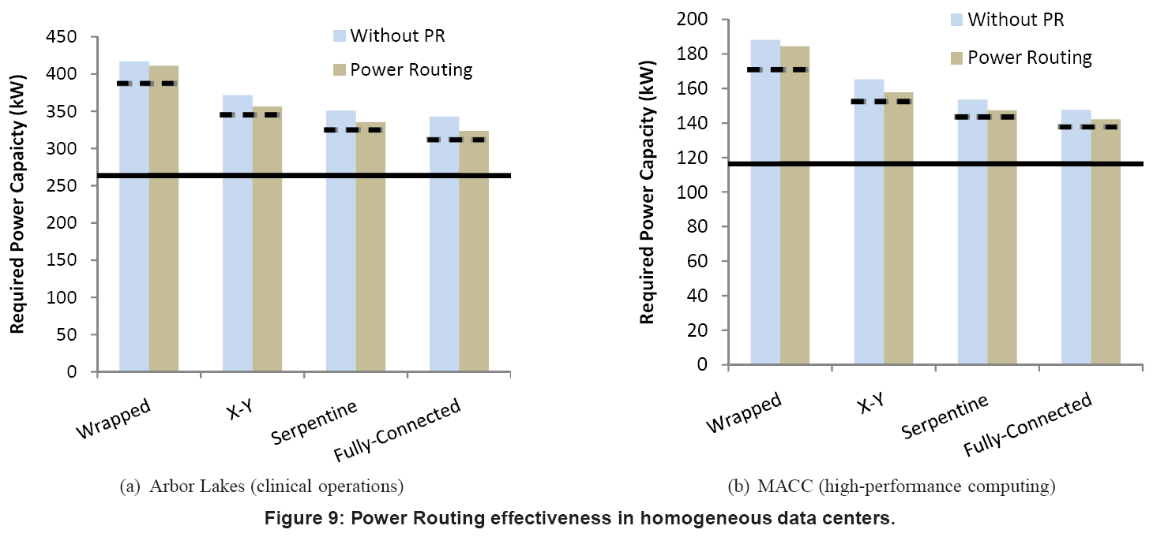
Homogeneous Workloads

Slide 19
Energy Proportional Servers
Power draw varies linearly with utilization, static power is 10% of peak
Rerun the Power Routing experiment
Trace Comparisons:
 | Time-Avg | Maximum | σ
Original | 180.5 kW | 208.7 kW | 9 kW
Erg. Prop. | 99.8 kW | 153.9 kW | 18.9 kW

Slide 20
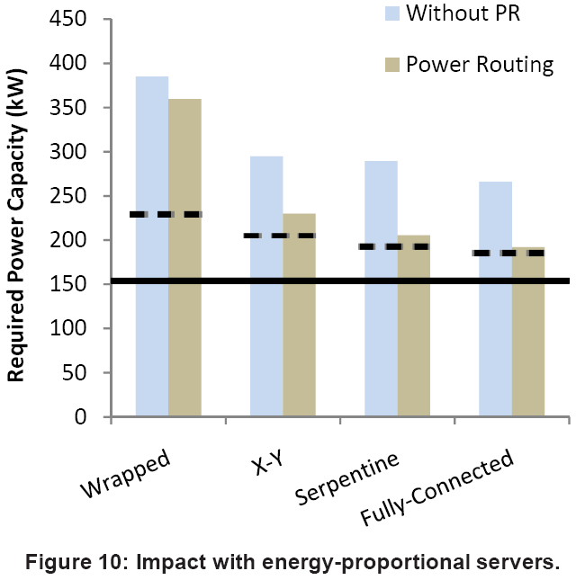
Energy Proportional Severs

Slide 21
Summary
Shuffled Topologies: Allow reserve capacity to be spread among more than 1 PDU so that in the even of a fault more PDUs handle the failed PDU’s load, but each receives a smaller amount
Power Routing: Even in an under provisioned data center a single PDU may experience a spike requiring power capping. However other PDUs probably aren’t experiencing a spike. We would like to route this spare power to the servers on the spiking PDU.

