Slide 1
Algorithmic Game Theory and Internet Computing
Algorithmic Game Theory and Networked Systems
Amin Saberi

Slide 2
Outline
Game Theory and Algorithms efficient algorithms for game theoretic notions
Complex networks and performance of basic algorithms

Slide 3
Internet Algorithms Game Theory
Huge, distributed, dynamic owned and operated by different entities
efficiency, distributed computation, scalability
strategies, fairness, incentive compatibility

Slide 4
Internet Algorithmic Game Theory
Huge, distributed, dynamic owned and operated by different entities
efficiency, distributed computation, scalability
strategies, fairness, incentive compatibility
Fusing ideas of algorithms and game theory

Slide 5
Find efficient algorithms for computing game theoretic notions like:
Market equilibria
Nash equilibria
Core
Shapley value
Auction
...

Slide 6
Find efficient algorithms for computing game theoretic notions like:
Market equilibria
Nash equilibria
Core
Shapley value
Auction
...

Slide 7
Market Equilibrium
Arrow-Debreu (1954): Existence of equilibrium prices (highly non-constructive, using Kakutani’s fixed-point theorem)
Fisher (1891): Hydraulic apparatus for calculating equilibrium
Eisenberg & Gale (1959): Convex program (ellipsoid implicit)
Scarf (1973): Approximate fixed point algorithms
Use techniques from modern theory of algorithms Is linear case in P? Deng, Papadimitriou, Safra (2002)

Slide 9
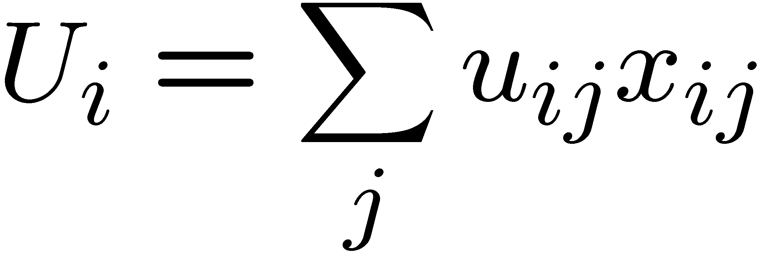
Market Equilibrium
n buyers, with specified money
m divisible goods (unit amount)
Linear utilities: uij utility derived by i
on obtaining one unit of j
Find prices such that
buyers spend all their money
Market clears

Slide 10
Market Equilibrium
Buyer i’s optimization program:
Global Constraint:

Slide 11
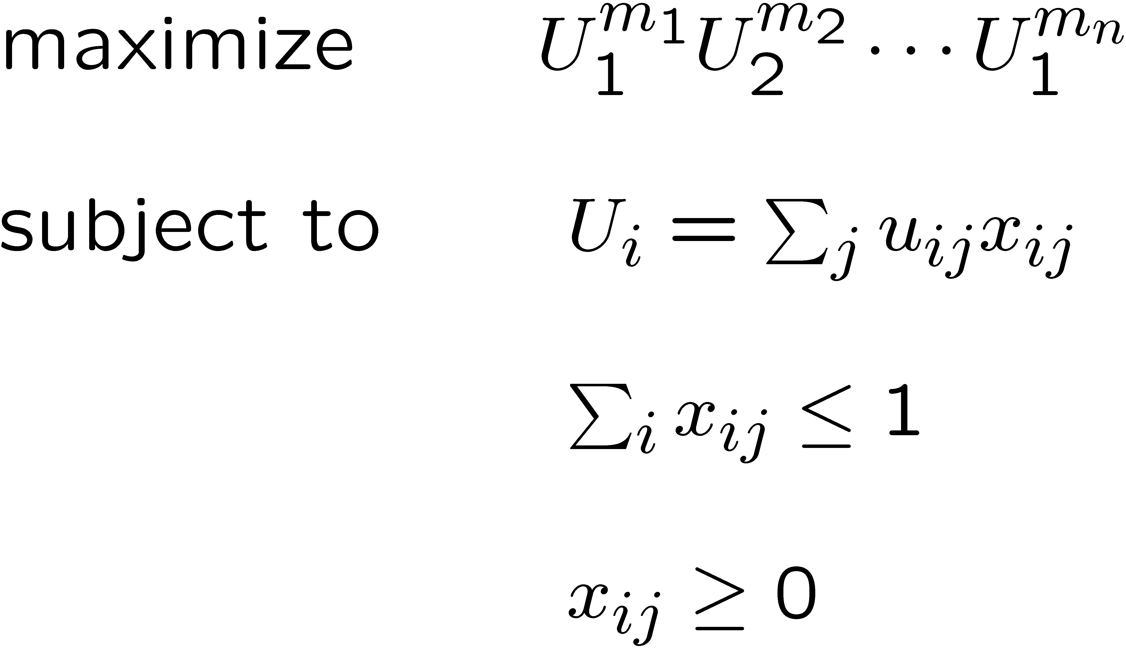
Market Equilibrium

Slide 12
Devanur, Papadimitriou, S., Vazirani ‘03: A combinatorial (primal-dual) algorithm for finding the prices in polynomial time.

Slide 13
Devanur, Papadimitriou, S., Vazirani ‘03: A combinatorial (primal-dual) algorithm for finding the prices in polynomial time.
Start with small prices so that only buyers have surplus gradually increase prices until surplus is zero
Primal-dual scheme:
Allocation Prices

Slide 14
Devanur, Papadimitriou, S., Vazirani ‘03: A combinatorial (primal-dual) algorithm for finding the prices in polynomial time.
Start with small prices so that only buyers have surplus gradually increase prices until surplus is zero
Primal-dual scheme:
Allocation Prices
Measure of progress:
l₂-norm of the surplus vector.

Slide 15
Equality Subgraph
Buyers Goods
10
20
4
2
$20 10/20
$40 20/40
$10 4/10
$60 2/60
Bang per buck: utility of worth $1 of a good.

Slide 16
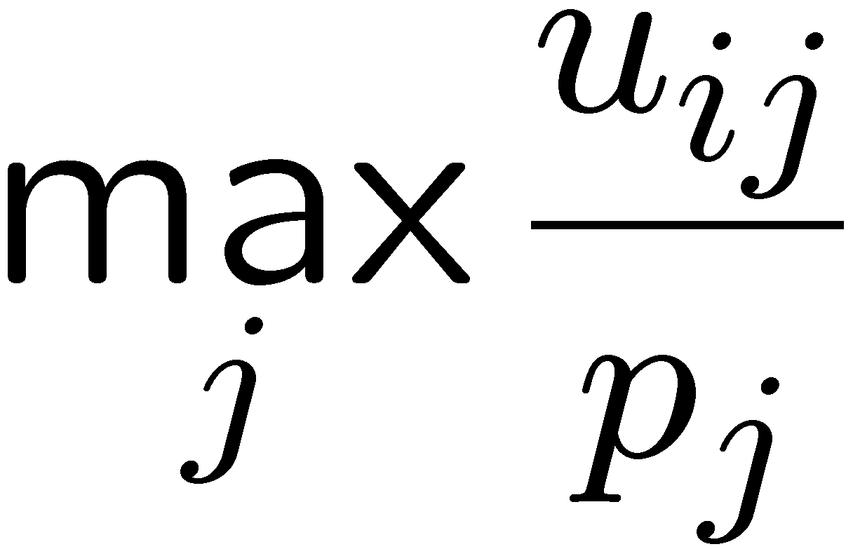
Equality Subgraph
Buyers Goods
10
20
4
2
$20 10/20
$40 20/40
$10 4/10
$60 2/60
Bang per buck: utility of worth $1 of a good.
Buyers will only buy the goods with highest bang per buck:

Slide 17
Equality Subgraph
Buyers Goods
Bang per buck: utility of worth $1 of a good.
Buyers will only buy the goods with highest bang per buck:

Slide 18
Equality Subgraph
Buyers Goods
Buyers Goods
$100
$60
$20
$140
$20
$40
$10
$60
How do we compute the sales in equality subgraph ?

Slide 19
Equality Subgraph
Buyers Goods
100
60
20
140
20
40
10
60
How do we compute the sales in equality subgraph ?
maximum flow!

Slide 20
Equality Subgraph
Buyers Goods
100
60
20
140
How do we compute the sales in equality subgraph ?
maximum flow!
always saturated (by invariant)

Slide 21
Equality Subgraph
Buyers Goods
How do we compute the sales in equality subgraph ?
maximum flow!
buyers may have always saturated surplus (by invariant)

Slide 22
Example
20
100
60
40
10
20
60
140

Slide 23
Example
20
20/20
20/100
20
40/40
20/60
20
10/10
20/20
10
70/140
60/60
60

Slide 24
Example
20
20/20
20/100
20
40/40
20/60
20
10/10
20/20
10
70/140
60/60
60
Surplus vector = (80, 40, 0, 70)

Slide 25
Balanced Flow
Balanced Flow: the flow that minimizes the l₂-norm of the surplus vector.
tries to make surplus of buyers as equal as possible
Theorem: Flow f is balanced iff there is no path from i to j with surplus(i) < surplus(j) in the residual graph corresponding to f .

Slide 26
Example
20
20/20
20/100
20
40/40
20/60
20
10/10
20/20
10
70/140
60/60
60
Surplus vector = (80, 40, 0, 70)

Slide 27
Example
20
20/20
50/100
30
10
40/40
10/60
10/10
0/20
10
70/140
70/140
60/60
60
(80, 40, 0, 70) (50, 50, 20, 70)

Slide 28
How to raise the prices?
Raise prices proportionately
Which goods ?
goods connected to the buyers with
the highest surplus
j
i
l

Slide 29
Algorithm
Buyers Goods
l₂-norm of the surplus vector decreases:
total surplus decreases
Flow becomes more balanced
Number of max-flow computations:

Slide 30
Algorithm
Buyers Goods
l₂-norm of the surplus vector decreases:
total surplus decreases
Flow becomes more balanced
Number of max-flow computations:

Slide 31
Further work, extensions
Jain, Mahdian, S. (‘03): people can sell and buy at the same time
Kakade, Kearns, Ortiz (‘03): Graphical economics
Kapur, Garg (‘04): Auction Algorithm
Devanur, Vazirani (‘04): Spending Constraint
Jain (‘04), Ye (‘04): Non-linear program for a general case
Chen, Deng, Sun, Yao (‘04): Concave utility functions

Slide 32
Congestion Control
Primal-dual scheme (Kelly, Low, Tan, …): primal: packet rates at sources dual: congestion measures (shadow prices)
A market equilibrium in a distributed setting!

Slide 33
Next step: dealing with integral goods
Approximate equilibria:
Surplus or deficiency unavoidable
Minimize the surplus: NP-hard (approximation algorithm)
Fair allocation:
Max-min fair allocation (maximize minimum happiness)
Minimize the envy (Lipton, Markakis, Mossel, S. ‘04)

Slide 34
Core of a Game
N
•
V(S): the total gain of playing the game within subset S
Core: Distribute the gain such that no subset has an incentive to secede:
•
•
S
•
•
•
•
•

Slide 35
Stability in Routing
•
•
Node i has capacity C_{i}
Demand d_{ij} between nodes i and j
Total gain of subset S, V(S): maximum amount of flow you can route in the graph induced by S. (solution of multi-commodity flow LP)
•
•
•
•
S

Slide 36
Stability in Routing
•
•
•
•
Markakis, S. (‘03): The core of this game is nonempty i.e. there is a way to distribute the gain s.t.:
For all S:
Proof idea: Use the dual of the multi-commodity flow LP.
•
•
•
•
•
•
•
•
S

Slide 37
Optimal Auction Design
Queries from oracle
Oracle
Bids
Buyer 1 Buyer 2
.
.
Buyer n
Probability distribution
Auction
Design an auction:
truthful
maximizes the expected revenue
Notes:
Apriori
Bargaining positions
Strategic opportunity

Slide 38
Optimal Auction Design
History:
Independent utilities: characterization (Myerson, 1981)
General case: factor ½-approximation (Ronen , ‘01)
Ronen & S. (‘02): Hardness of approximation
Idea: Probabilistic construction; polynomial number of queries does not provide enough information!
Notes:
Apriori
Bargaining positions
Strategic opportunity

Slide 39
Computer Science Applications:
networking: algorithms and protocols
E–commerce
Game Theory Applications:
modeling, simulation
intrinsic complexity
bounded rationality
Notes:
Apriori
Bargaining positions
Strategic opportunity

Slide 40
Outline
Game Theory and Algorithms efficient algorithms for game theoretic notions
Complex networks and performance of basic algorithms

Slide 41
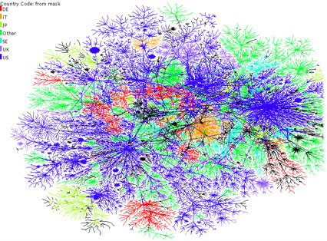
The Internet Graph
Power Law Random Graphs Bollobas 80’s, Molloy&Reed 90’s, Chung 00’s.
Preferential Attachment
Simon 55, Barabasi-Albert 99, Kumar et al 00, Bollobas-Riordan 00, Bollobas et al 03.
Power Law:
Notes:
Anarchic
Formed from ad hoc interaction of independent agents

Slide 42
The Internet Graph
Power Law Random Graphs Bollobas 80’s, Molloy&Reed 90’s, Chung 00’s.
Preferential Attachment
Simon 55, Barabasi-Albert 99, Kumar et al 00, Bollobas-Riordan 00, Bollobas et al 03.
Power Law:
What is the impact of the structure on the performance of the system ?
Notes:
Anarchic
Formed from ad hoc interaction of independent agents

Slide 43
Conductance and Eigenvalue gap
In both models conductance a.s.
Power-law Random Graphs: when min degree ≥ 3. (Gkantisidis, Mihail, S. ‘03) Preferential attachment: when d ≥ 2 (Mihail, Papadimitriou, S. ‘03)
Main Implication: a.s.
improving Cooper-Frieze
for d large

Slide 44
Conductance
# Cut edges

Slide 45
Algorithmic Applications
Routing with low congestion: We can route d_{i} d_{j} flow between all vertices i and j with maximum congestion at most O(n log n). (by approx. multicommodity flow Leighton-Rao ‘88)

Slide 46
Algorithmic Applications
Bounds on mixing time, hitting time and cover time (searching and crawling)
Random walks for search and construction in P2P networks (Gkantsidis, Mihail, S. ‘04)
Search with replication in P2P networks generalizing the notion of cover time (Mihail, Tetali, S., in preparation)

Slide 47
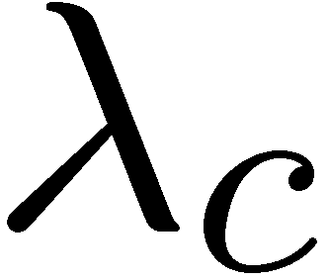
Recent work
Absence of epidemic threshold in scale-free graphs (Berger, Borgs, Chayes, S., ‘04)
infected healthy at rate 1
healthy infected at rate ( )
Epidemic threshold :
In scale-free graphs, this threshold is zero!
#infected neighbors
Notes:
(Pastorras, Vespignani ‘01),

Slide 48
THE END !

