Slide 1
Possible Algorithmic Problems Related to Phase Change Memory
Kirk Pruhs
University of Pittsburgh

Slide 2
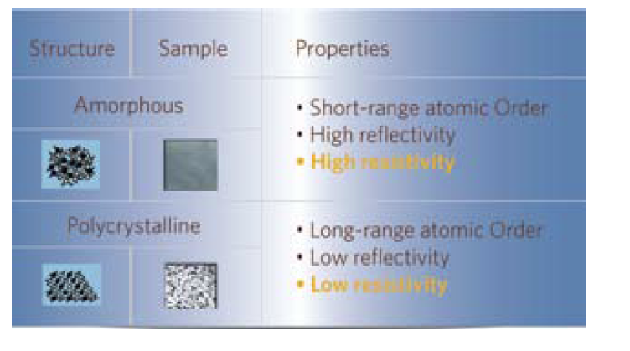
Phase Change Memory (PCM)
Uses the resistivity of two states (amorphous and polycrystalline) of chalcogenide glass
States changed by heating
Writeable CDs and DVDs use reflexivity differences of the states
Invented circa 1970

Slide 3
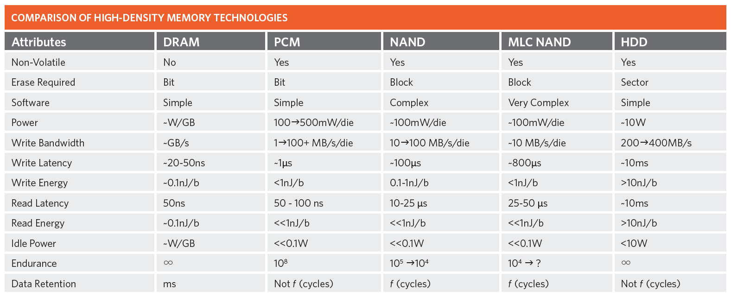
PCM vs. other Memory Technology
Writes are much slower than reads
Wear-out is an issue

Slide 4
Writes are much slower than reads
Maybe when you want to write a new word to memory, you should write to a word with many bits in common.
Data structure problem
Competitiveness of an online algorithm for the objective of minimizing bit writes
Online weighted matching on a hypercube
O(log² n) randomized upper bound using HSTs
Ω(log n) randomized lower bound

Slide 5
Wear-Out
Algorithms for wear leveling? How do you formalize the problem?
One Possibility: Online Problem.
Over time you have blocks of various sizes that must be place in memory
The online decision is where to place the blocks in memory (kind of like a 1-dimensional bin packing)
Overtime blocks blocks are deallocated in unpredictable fashion
There is an a priori known time that memory can last
Objective: How long can you go until you can’t handle a block due to wearout or fragmentation

Slide 6
Acknowledgment
Some figures ripped off from white papers by Numonyx aka Micron
http://www.numonyx.com/en-us/MemoryProducts/PCM/Pages/PCM.aspx

Slide 7
