Slide 1
Application of Ensemble Models in Web Ranking
Homa B. Hashemi
Nasser Yazdani
Azadeh Shakery
Mahdi Pakdaman Naeini
School of Electrical and Computer Engineering
University of Tehran

Slide 2
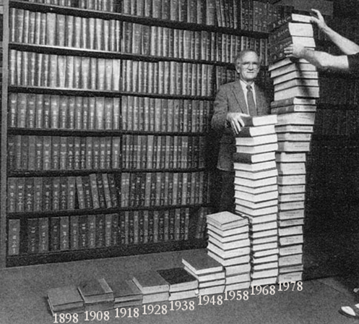
Information Explosion

Slide 4
Web Challenges
Huge size of information
25 billion pages
Proliferation and dynamic nature
Creation of New pages
New links are created at rate 25% per week
Heterogeneous contents
HTML/Text/Audio/…

Slide 5
Search Engine as A Tool
http://seo-related.com/

Slide 6
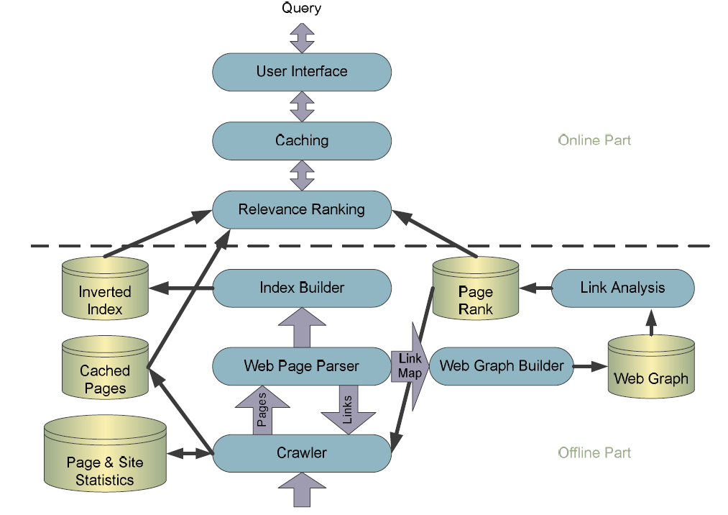
Inside Search Engine
Crawling
Indexing
Ranking

Slide 7
Inside Search Engine
Crawling
Indexing
Ranking

Slide 8
Ranking Approaches
Content-based (query dependent)
TF, IDF
BM25
Classical IR
…
Connectivity based (web)
PageRank
HITS
…

Slide 9
Our General Framework
Query
Retrieval Model
List 1
List
2
List N
…
Ensemble Model
Final List

Slide 10
Simple Ensemble Models
Sum rule
Add (normalized) values of different methods
Product rule
Multiply (normalized) values of different methods
Borda rule
Combination of ranking

Slide 11
Complicated Ensemble Models
OWA (Ordered Weighted Averaging)
Click-Through Data
SVM
Use the distance from discriminating hyper plane as the measure for relevancy of a page to a specific query

Slide 12
OWA operator
the weights of each vector

Slide 13
Simulated Click-Through Data
How can we use the user behavior?
80% of user clicks are related to query
Click-through data

Slide 14
Simulated Click-Through Data (example)
L(a)
D1
D3
D2
D4
D5
d6
L(b)
D1
D4
D7
D9
D2
d8

Slide 15
Simulated Click-Through Data (example)
L(a)
D1
D3
D2
D4
D5
d6
Interleaved results L(a,b)
D1
D4
D3
D7
D2
D9
D5
D8
D6
L(b)
D1
D4
D7
D9
D2
d8

Slide 16
Simulated Click-Through Data (example)
L(a)
D1
D3
D2
D4
D5
d6
Interleaved results L(a,b)
D1  First
D4
D3
D7
D2  Second
D9
D5  Third
D8
D6
L(b)
D1
D4
D7
D9
D2
d8

Slide 17
Simulated Click-Through Data (example)
L(a)
D1
D3
D2
D4
D5
d6
Interleaved results L(a,b)
D1  First
D4
D3
D7
D2  Second
D9
D5  Third
D8
D6
L(b)
D1
D4
D7
D9
D2
d8

Slide 18
Experimental Datasets
LETOR benchmark (English)
Microsoft Research Asia, 2007
DotIR benchmark (Persian)
Iran Telecommunication Research Center (ITRC),2009

Slide 19
LETOR Benchmark – p@k

Slide 20
LETOR Benchmark – MAP

Slide 21
DotIR Benchmark – p@k

Slide 22
DotIR Benchmark – MAP

Slide 23
Summary
Motivation:
Important role of Ranking algorithms
Low precision of content and connectivity algorithms
Solution:
Use different Ensemble models to combine Ranking algorithms based on Learning
Results:
LETOR benchmark has been used for evaluation
More research needed to be done on newly built DotIR collection

Slide 24
LABS

Slide 25
Reference
Ali Mohammad Zareh Bidoki, Pedram Ghodsnia, Nasser Yazdani, “A3CRank: An Adaptive Ranking method based on Connectivity, Content and Click-through data”, Information Processing and Management, 2010.
Ali Mohammad Zareh Bidoki, “Combination of Documents Features Based on Simulated Click-through Data”, ECIR 2009.

Slide 26
Thank You
Any Questions?

