Slide 1
Comparable Corpus
Creating a
Persian-English
Homa B. Hashemi
Azadeh Shakery
Heshaam Faili
University of Tehran

Slide 2
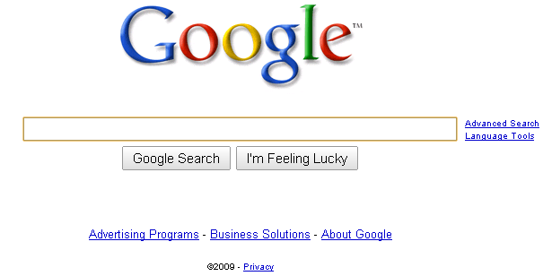

Slide 3
Cross-Language Information Retrieval
is the answer
поиск информации
recupero dell'informazione
بازیابی اطلاعات
信息检索
tiedonhaku
information retrieval

Slide 4
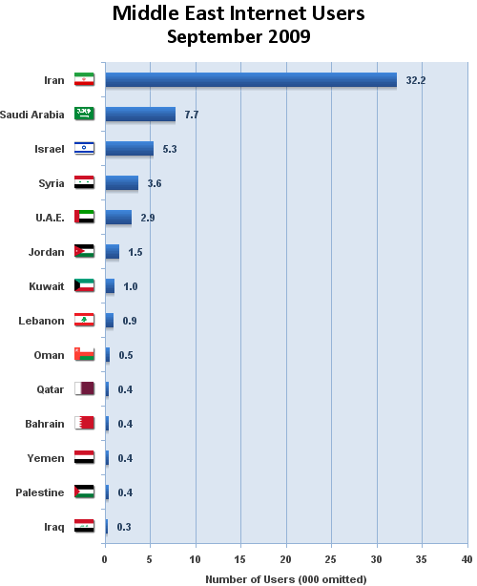
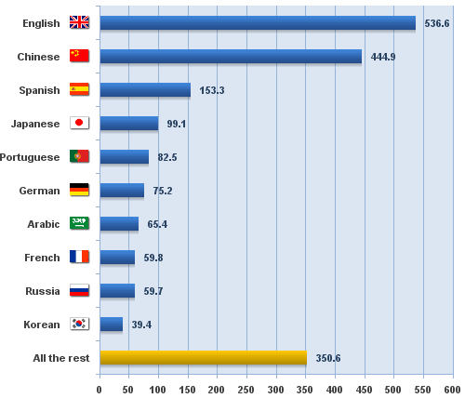
Needs for Persian CLIR – Some Statistics
Top 10 Internet Languages-2010
Persian:
52.5% of
total users
English:
Only 27.3% of
total usage
Rest of Languages:
17.8% of total usage
Source: Internet World Stats, http://internetworldstats.com/

Slide 5
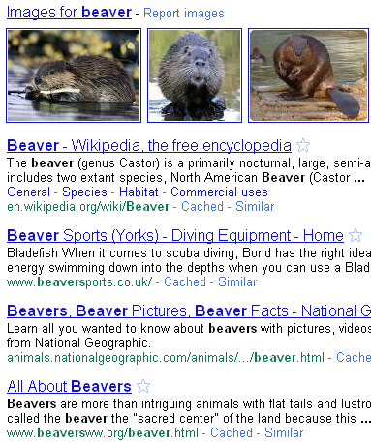
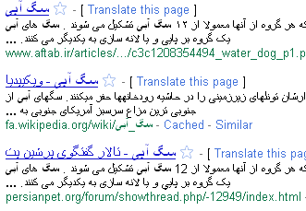

Slide 6
CLIR
Query
translation
Document
translation
Query & Document translation
Comparable Corpora
Dictionary
based
Machine
translation
Parallel Corpora

Slide 7
CLIR
Query
translation
Document
translation
Query & Document translation
Comparable Corpora
Dictionary
based
Machine
translation
Parallel Corpora

Slide 8
CLIR
Document
translation
Query & Document translation
Comparable Corpora
Dictionary
based
Machine
translation
Parallel Corpora
Query
translation

Slide 9
Query Translation Using MT
machine translators produce the best translation
Disadvantages:
Queries are list of keywords
MT only return “the most likely” translation

Slide 10
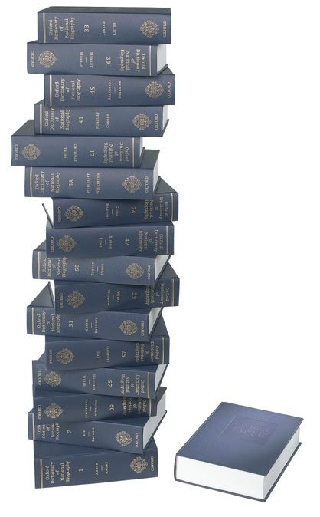
Query Translation Using Dictionary
No dictionary is complete
Translation ambiguity
“Goal” & “Goal”

Slide 11
Query Translation Using Parallel Corpora
ا ب پ ت
س ش
A B C D
S T
ا ب پ ت
س ش
A B C D
S T
ا ب پ ت
س ش
A B C D
S T

Slide 12
Query Translation Using Comparable Corpora
ا ب پ ت
س ش
A B C D
S T
ا ب پ ت
س ش
ا ب پ ت
س ش
ا ب پ ت
س ش
A B C D
S T
ا ب پ ت
س ش
A B C D
S T
ا ب پ ت
س ش

Slide 13
CLIR
Document
translation
Query & Document translation
Comparable Corpora
Dictionary
based
Machine
translation
Parallel Corpora
Query
translation

Slide 14
Roadmap
Motivation
Persian Corpora
Creating a Persian-English Comparable Corpus
Evaluate Comparable Corpora
Assessed Quality of Alignments in one month
Extracting Word Associations
CLIR with Comparable Corpora

Slide 15
Persian Corpora
Monolingual
Hamshahri corpus IR
Bijankhan corpus NLP
Persian-English
Miangah parallel corpus 4,860,000 words
TEP parallel corpus 612,086 sentences
Karimi semi-parallel corpus 1100 documents
No Persian-English Comparable Corpus
15

Slide 16
Roadmap
Motivation
Persian Corpora
Creating a Persian-English Comparable Corpus
Evaluate Comparable Corpora
Assessed Quality of Alignments in one month
Extracting Word Associations
CLIR with Comparable Corpora

Slide 17
Our Comparable Corpus

Slide 18
Source Doc
Source language query
Target language query
Alignment
Matching
Target
Docs
Index

Slide 19
Source Doc
Source language query
Target language query
TF, RATF
Survivors of Hurricane Katrina in the southern US are being taken to safety in what is being called the largest airlift in US history.
Up to 40 aircraft are operating round-the-clock to move thousands who had been stranded in New Orleans. On Saturday President Bush announced the deployment of thousands of extra troops in affected areas, amid criticism of the rescue effort. Survivors have been telling harrowing tales of violence. On Saturday more than 10,000 people were removed from flood-ravaged New Orleans.
Alignment
Matching
Target
Docs
Index

Slide 20
Source Doc
Source language query
Target language query
TF, RATF
people | brown
Orleans | emerge
new | Katrina
survivor | flood
thousand | relief
rescue | urgency
Saturday | hurricane
Alignment
Matching
Target
Docs
Index

Slide 21
Source Doc
Source language query
Target language query
خلق جمعيت قوم ملت اخيرا نوين شخص زنده باقيمانده بازمانده روز شنبه پديدار بيرون تندباد طوفان گردباد اجتماع قهوه سرخ قهوه کاترينا سيل طوفان دريا غرق سيل گرفتن طغيان راحتي اعانه امداد رفع نگراني برجسته خط فوريت ضرورت كنار دريا
Alignment
Matching
Target
Docs
Index

Slide 22
Source Doc
Source language query
Target language query
Alignment
Matching
Target
Docs
Index

Slide 23
خلق جمعيت قوم ملت اخيرا نوين شخص زنده باقيمانده بازمانده روز شنبه پديدار بيرون تندباد طوفان گردباد اجتماع قهوه سرخ قهوه کاترينا سيل طوفان دريا غرق سيل گرفتن
Source Docs
Source language queries
Target language query
Alignment
عمليات گسترده تخليه بازماندگان کاترينا نورمن مينتا وزير حمل و نقل امريکا گفت هواپيماها و هلي کوپترها ساعته در حال کار هستند و تا کنون بيش از هزار نفر را از مناطقي در نيواورليان که بيشترين اسيب را ديده اند تخليه کرده اند اتوبوس ها نيز به بيرون بردن مردم از شهر ادامه مي دهند و اولين قطار شهر را ترک کرده است مقامات نظامي مي گويند تاکنون هزار نفر از توفان زدگان اين شهر ويران نجات يافته اند
Matching
Target
Docs
Index

Slide 24
Survivors of Hurricane Katrina in the southern US are being taken to safety in what is being called the largest airlift in US history.
Up to 40 aircraft are operating round-the-clock to move thousands who had been stranded in New Orleans.
Source Doc
Source language query
Target language query
عمليات گسترده تخليه بازماندگان کاترينا نورمن مينتا وزير حمل و نقل امريکا گفت هواپيماها و هلي کوپترها ساعته در حال کار هستند و تا کنون بيش از هزار نفر را از مناطقي در نيواورليان که بيشترين اسيب را ديده اند تخليه کرده اند اتوبوس ها نيز به بيرون بردن مردم از شهر ادامه مي دهند و اولين قطار شهر را ترک کرده است مقامات نظامي مي گويند تاکنون هزار نفر از توفان زدگان اين شهر ويران نجات يافته اند
Alignment
Matching
Target
Docs
Index
Two basic criteria:
Similarity score
Publication dates

Slide 25
Roadmap
Motivation
Persian Corpora
Creating a Persian-English Comparable Corpus
Evaluate Comparable Corpora
Assessed Quality of Alignments in one month
Extracting Word Associations
CLIR with Comparable Corpora

Slide 26
Comparable Corpora Evaluation
Quality of Alignments
Same story
Related story
Shared aspect
Common terminology
Unrelated
Use “Multilingual information retrieval based on document alignment techniques” method [Braschler et.al., 1998]

Slide 27
CC Evaluation: Language Model
 | All dictionary |  | Top 3 translations
 |  |  | No Transliteration |  | Transliteration
 | # of Aligns | %of Aligns | # of Aligns | %of Aligns | # of Aligns | %of Aligns
Class 1 | 4 | 11.8 % | 3 | 6.9 % | 5 | 9.4 %
Class 2 | 4 | 11.8 % | 17 | 39.5 % | 24 | 45.3 %
Class 3 | 7 | 20.6 % | 14 | 32.5 % | 14 | 26.4 %
Class 4 | 11 | 32.3 % | 8 | 18.6 % | 8 | 15.1 %
Class 5 | 8 | 23.5 % | 1 | 2.3 % | 2 | 3.8 %
Total | 34 | 100 | 43 | 100 | 53 | 100

Slide 28
CC Evaluation: Okapi
 | Top 3 translations
 | No Transliteration |  | Transliteration
 | # of Aligns | %of Aligns | # of Aligns | %of Aligns
Class 1 | 11 | 13.5 % | 13 | 14.9 %
Class 2 | 46 | 56.8 % | 51 | 58.6 %
Class 3 | 20 | 24.7 % | 19 | 21.8 %
Class 4 | 4 | 4.9 % | 4 | 4.6 %
Class 5 | 0 | 0 % | 0 | 0 %
Total | 81 | 100 | 87 | 100

Slide 29
Source Docs
53697
7580
Alignment
Target
Docs
191440

Slide 30
Roadmap
Motivation
Persian Corpora
Creating a Persian-English Comparable Corpus
Evaluate Comparable Corpora
Assessed Quality of Alignments in one month
Extracting Word Associations
CLIR with Comparable Corpora

Slide 31
CC Evaluation: Word Associations
Use “Focused web crawling in the acquisition of comparable corpora” method [Talvensaari et.al, 2008]
English Word | Persian Word | Google translation | Score
Cancer | سرطان | Cancer | 80
 | بیماری | Disease | 52
 | بدن | Body | 51
 | سلول | Cell | 43
 | مبتلا | Suffering | 41
Iraqi | عراق | Iraq | 39
 | صدام | Saddam | 95
 | عراقي | Iraqi | 83
 | بغداد | Baghdad | 82
 | حسين | Hussein | 75

Slide 32
Roadmap
Motivation
Persian Corpora
Creating a Persian-English Comparable Corpus
Evaluate Comparable Corpora
Assessed Quality of Alignments in one month
Extracting Word Associations
CLIR with Comparable Corpora

Slide 33
Cross-Language Information Retrieval
Persian task of CLEF-2008:
retrieve of Persian documents from English topics
Queries:
50 topic in English and their Persian translations

Slide 34
Construct the Query Language Model
Use the top k translations of each query word
English Query: Cancer Drugs
English Word | Persian translations
Cancer | سرطان | Cancer | 0.077
 | بیماری | Disease | 0.049
 | بدن | Body | 0.049
 | سلول | Cell | 0.041
 | … | … | …
Drugs | درمان | Treatment | 0.050
 | دارو | Drug | 0.049
 | داروهای | Drugs | 0.042
 | بیماری | Disease | 0.042
 | … | …. | …
Persian Query:
سرطان | 0.077
بیماری | 0.049
درمان | 0.050
دارو | 0.049

Slide 35
Cross-Language Information Retrieval
Measure | Monolingual Retrieval | Dictionary | Comparable Corpora
MAP | 0.42153 | 0.153 (36.29%) | 0.14 ( 33.30%)
Prec@5 | 0.62 | 0.224 (36.12%) | 0.244 (39.35%)
Prec@10 | 0.596 | 0.206 (34.56%) | 0.232 (38.92%)

Slide 36
Creating the First Big Persian-English Comparable Corpus
Two independent news collections
Aligned the documents
Assess Quality of Our Corpus
Manually evaluate one month alignments by five-level relevance scale
Extract word associations
Alternatives
Different translation methods
Different retrieval models
Cross-Language Information Retrieval
Publication dates
Topic similarities

Slide 37
Future Work
Focus on CLIR task
Improving quality of extracted word associations
Other linguistic resources (dictionaries, MT, parallel corpora)
Use extracted translation knowledge to improve quality of created corpus

Slide 38
Thank You
Homa B. Hashemi
H.B.Hashemi@ece.ut.ac.ir

Slide 39
References
Talvensaari et al. Creating and exploiting a comparable corpus in cross-language information retrieval. TOIS (2007)
Talvensaari et al. Focused web crawling in the acquisition of comparable corpora. Information Retrieval (2008)

Slide 40
CC Evaluation: Extract Word Associations
weight of Source word:
weight of Target word:

Slide 41
CC Evaluation: Extract Word Associations
Similarity score between a Source and Target word:
“Focused web crawling in the acquisition of comparable corpora” [Talvensaari et.al, 2008]

Slide 42
CLIR with Comparable Corpora
Aligned
Documents in
L1 and L2
Documents in
L1 and L2
Query in L1
(1)
Extract Word Similarities
(2)
Estimate Word Translation Probabilities
(3)
Construct Query Language Model in L2
(4)
Use KL-Divergence to Rank Documents

Slide 43
Step 2: Estimate Word Translation Probabilities
Use normalized raw correlation scores
Raw correlation
scores

Slide 44
Estimate Word Translation Probabilities
Use normalized raw correlation scores
English Word | Persian Word | Google translation | Raw Score | Translation Probability
Cancer | سرطان | Cancer | 80.7 | 0.077
 | بیماری | Disease | 52 | 0.049
 | بدن | Body | 51.2 | 0.049
 | سلول | Cell | 43.7 | 0.041
 | مبتلا | Suffering | 41.6 | 0.039
 | درمان | Treatment | 36.9 | 0.038
 | تحقيقات | Research | 35.2 | 0.034
Raw correlation
scores

