Slide 1
SQL Based Knowledge Representation And Knowledge Editor
UMAIR ABDULLAH
AFTAB AHMED
MOHAMMAD JAMIL SAWAR
(Presented by Lei Jiang)

Slide 2
Introduction
Rule Based System (RBS)
Automates problem-solving know-how
Captures and refines human expertise
Becomes commercially viable
SQL in RBS
RBS may be costly in normally computing environment
A simple rule language → SQL queries
Knowledge Editor
UI interface
Generates SQL by itself

Slide 3
Outline
Data vs. Knowledge
Basic Concept on Rule Based Systems
Medical Billing as an Application domain
RBS Architecture for Medical Billing
Design of a Rule Based Engine
Knowledge Base of the System
Knowledge Editor with UI
Evaluation and Results
Conclusion

Slide 4
Data vs. Knowledge
Data
Collection of raw facts and figures
Knowledge
Processed data
Example
Page Pieces vs. Book
Semantic Web
Difference
Usability
Rule = Knowledge

Slide 5
Basic Concept Behind Rule Based Systems
Three components of a typical RBS
Rule-base (collection of production rules)
Working memory (data structure to hold data items)
Rule engine (interpreter which apply rules on given data)
Difference from If – else – then and Trigger in Database
RBS – DATA
Flexible
If-else-then and trigger are CONTROL
Need high Control Privileges

Slide 6
Medical Billing as an Application domain
Many systems were designed to treat patients
MYCIN, Post Operative Expert Medical System
Medical billing
Submitting medical claims to insurances for the purpose of reimbursement to healthcare provides for the services rendered to the patients
Medical Billing System Complexity
30% of claims are rejected, 35% are rejected again.

Slide 7
Architecture of a Rule Based System for Medical Billing
Billing executive
Inserts, update, and delete medical claims and their related data from the database
Team leads & managers
Manage all medical billing related activities like claim follow up, payment posting, claim aging
Domain users
Use medical billing related software like EMR etc, to interact with operational database

Slide 8
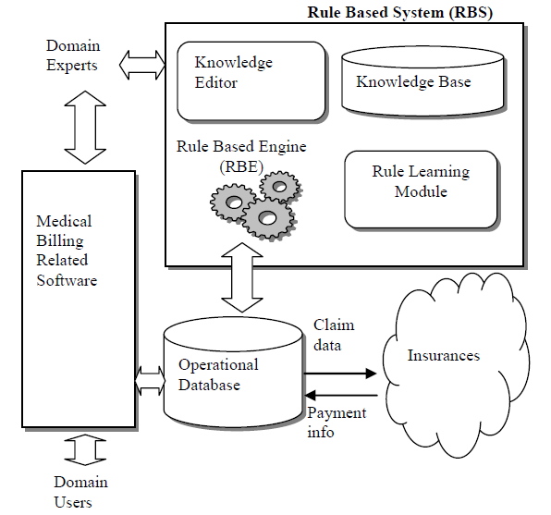
Architecture of a Rule Based System for Medical Billing

Slide 9
Architecture of a Rule Based System for Medical Billing
Operational database
Stores all the information of medical claims, patients, providers, practices, insurance payers, procedures, diagnosis, claim follow up information etc.
Rule based engine
Applies medical billing compliance related rules on a claim when it is saved by the domain user into the database.
It exams the claim to remove any potential medical billing related errors. Claim data is then submitted to insurance payers over the internet

Slide 10
Architecture of a Rule Based System for Medical Billing
Domain experts
Have in depth knowledge medical claim processing.
Do research on web sites of government and private medical billing related organizations
Extract updated medical billing knowledge.
Use medical billing related software to obtain various reports from data and to perform analysis.
Also use knowledge/ rule editor to update RBS rules defined in knowledge base of our rule based system.

Slide 11
Architecture of a Rule Based System for Medical Billing

Slide 12
Design of a Rule Based Engine Using Structured Query Language
RBE has been implemented in structured query language to do claim scrubbing.
RBE processes the claim in two phases.
Selection/ activation of applicable rules is done.
Those rules are selected which have priority 25 or 75.
Meta-rules are executed one by one. When a Meta rule returns true then rules associated to it are activated.

Slide 13
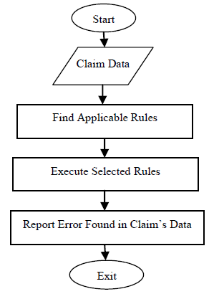
Design of a Rule Based Engine Using Structured Query Language
RBE processes the claim in two phases.
Executing Rules: Rule engine applies
all the selected rules one by one on
a given claim and identifies data
inconsistencies and errors.
Each rule is like a check with
some action part associated to
it, implemented as “where”
clause of a SQL query.

Slide 14
Design of a Rule Based Engine Using Structured Query Language
Knowledge is represented by production rules
suitable for representing task specific knowledge
In our system production, rules are implemented in the form of SQL queries. In order to gain efficiency, a common condition from a group of rules is separated and defined as meta-rule.
For example, suppose there are ten rules which belong to a practice X. A meta-rule will be defined performing the check that claim under processing belongs to practice X. During the processing of rule engine, if this meta-rule returns true on a claim, only then those ten rules, which are associated to it, will be activated

Slide 15
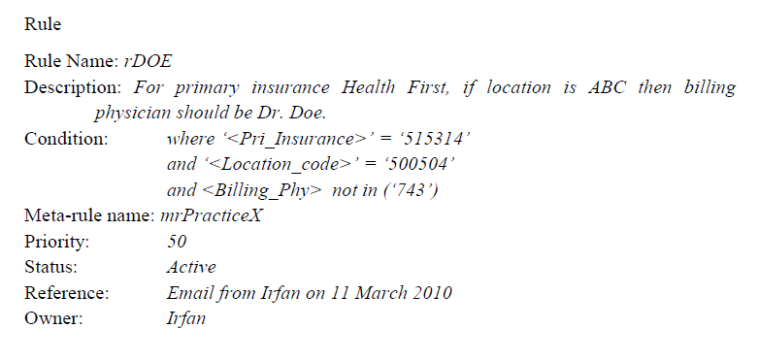
Knowledge Base of the System

Slide 16
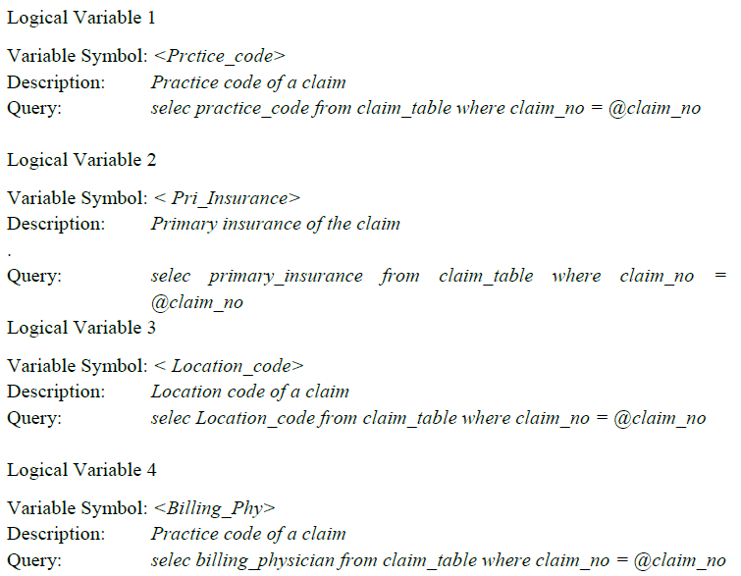
Knowledge Base of the System

Slide 17
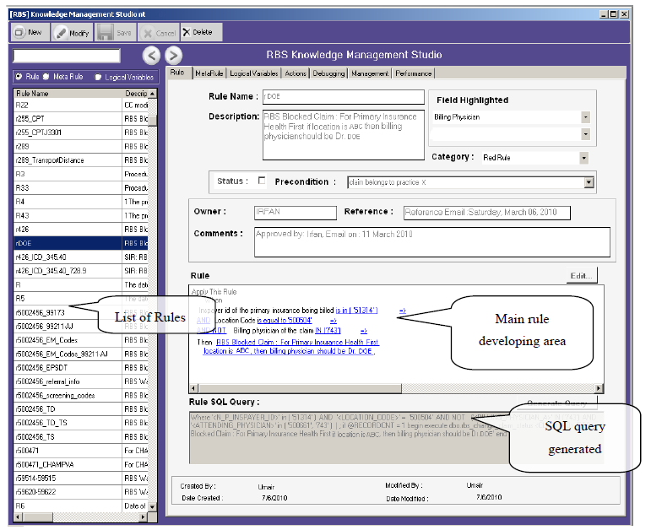
Knowledge (Rule) Editor of the System

Slide 18
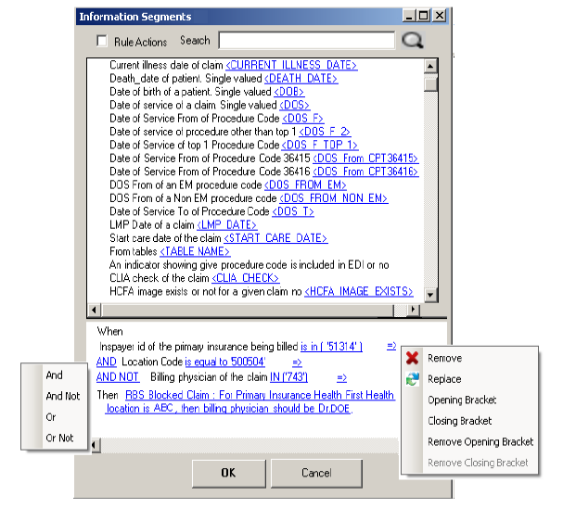
Knowledge (Rule) Editor of the System
Click Edit
Condition
Operator

Slide 19
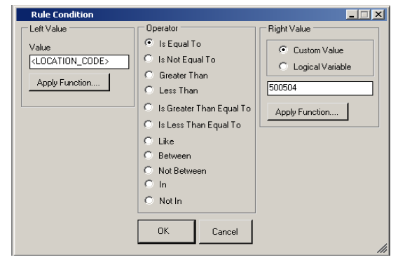
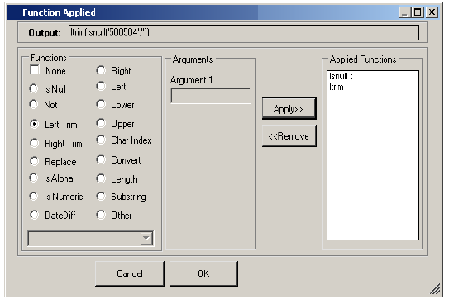
Knowledge (Rule) Editor of the System
Add Condition
Apply Function

Slide 20
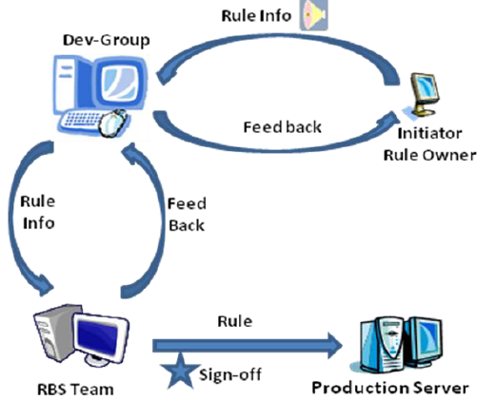
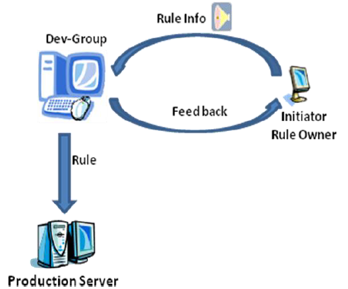
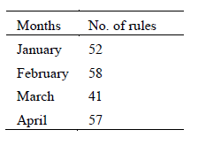
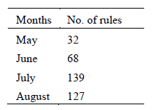
Rule Development Process

Slide 21
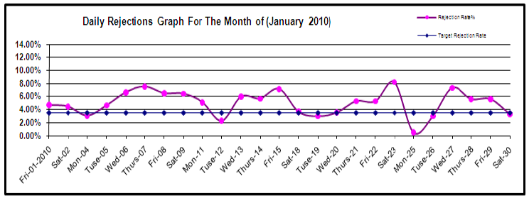
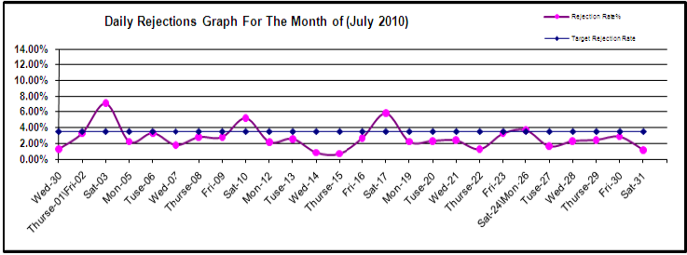
Results and discussion

Slide 22
Conclusion and future directions
Building a knowledge base of production rules in the form of SQL queries help in applying domain knowledge more efficiently
RBS also facilitates to keep production rules as part of data (instead of code)
Further improvement in effectiveness and efficiency has been achieved by developing knowledge editor for the system

Slide 23
Reference
SQL Based Knowledge Representation And Knowledge Editor International Journal of Software Engineering and Knowledge Engineering 2011
Enhanced Design of a Rule Based Engine Implemented using Structured Query Language Proceedings of the World Congress on Engineering Vol I 2010
Software Architecture of a Learning Apprentice System in Medical Billing Proceedings of the World Congress on Engineering Vol I 2010

