Slide 1
An Architecture for Home Service Retrieval
Based on Function Concept Ontology
Wei M., Xu J., Yun H., Xu L.
Presented by Jiannan Ouyang
CS Department
Notes:
Instructions for editing school and department titles:
Select from menu: View > Master > Slide Master
Click on each text area you wish to edit. Text will become editable.

Slide 2
Outline
Background
The Sematic of Home Service
Function Concept Ontology
Case Study

Slide 3
Smart Home
Smart home is different than the traditional home on its ability to perform function by integrating appropriate appliances automatically.
To facilitate integrating services for households intelligently, ontologies are essential, as they act as the format explicit specification for describing the services provided by networked devices, sensors, and other appliances.
The ontology-based semantic approaches could integrate services according to the specification automatically

Slide 4
Concepts
Ontology: formally represents knowledge as a set of concepts within a domain, and the relationships between those concepts.
Domain Ontology: models a specific domain, which represents part of the world.

Slide 5
Context of Service Ontology
Define context as the situational information of entities
Concepts: device, person, time, place, etc
Take action according to the states of context automatically
Lack sematic information of service
Failure, new similar device, etc.

Slide 6
QoS-Related Service Ontology
Model non-functional properties of a service
Cost, performance, reliability, etc
Does not present functional information for each service hosted on the device
Minimal unit in smart home: device
Not suitable for versatile device with ulti-functions

Slide 7
Proposal
Treat service as one logic device with specific function, and provides functional information for each atomic service hosted on device
One device with multiply services
One service implemented by multi-device

Slide 8
Proposal, Cont.
Construct home service ontology
Analysis the context of home service
Abstract service-related concepts
Formalize the relations among the concepts
Construct function concept ontology

Slide 9
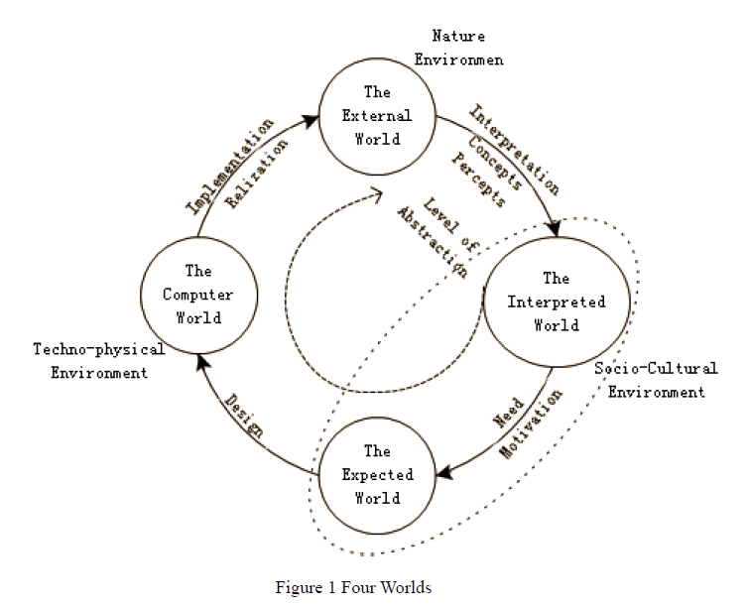
Context of Home Service
External world
Interpreted world
Expected world
Computer world
Interpretation process
Motivation process
Design process
Process of implementation

Slide 10
Home Service Ontology
Seven service related concepts
Need, context, device, function ,way, content, service
Need motivated by context
A service satisfies a need
A need satisfied by various service

Slide 11
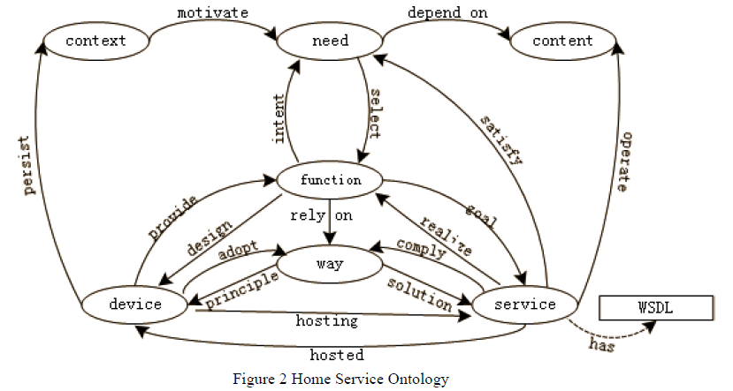
Home Service Ontology, Cont

Slide 12
Home Service Ontology, Cont
To satisfy a need
Select a function
Search service annotated by the function
Operate relevant content

Slide 13
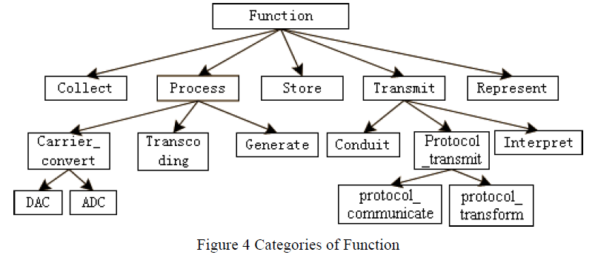
Categories of Service Function

Slide 14
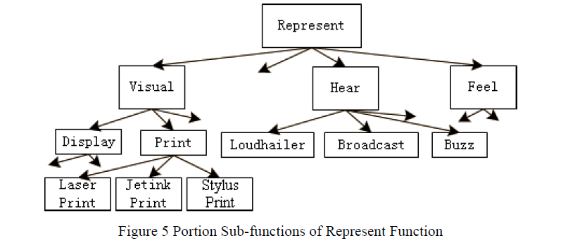
Refinement of Function

Slide 15
Case Study
Audible alarm of gas detective
gasDetectiveService()
Gas security device
Audio services
gasAlarmService on gas security device
FMService on radio
playService() Bludetooth loudspeaker

Slide 16
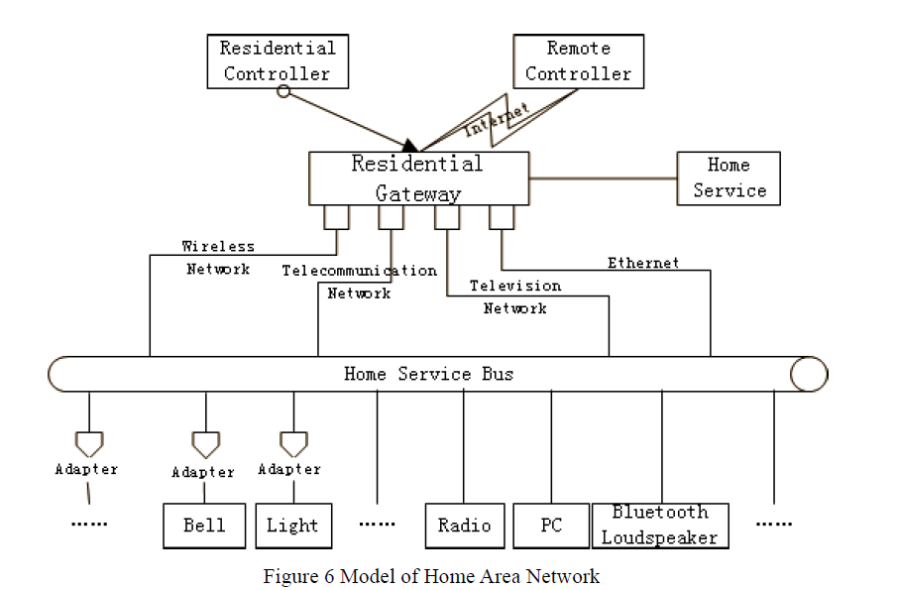
Home Area Network (HAN)

Slide 17
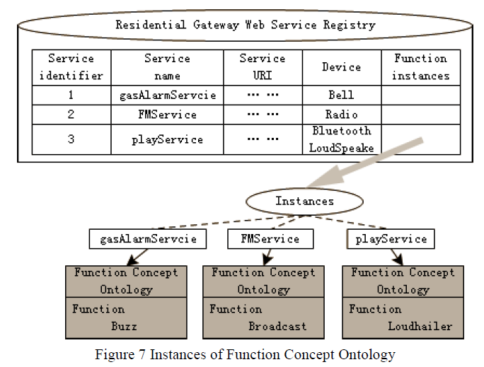
Service Register

Slide 18
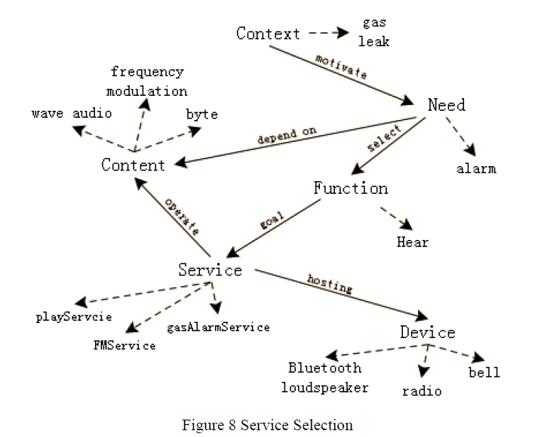
Service Rtrieval

Slide 19
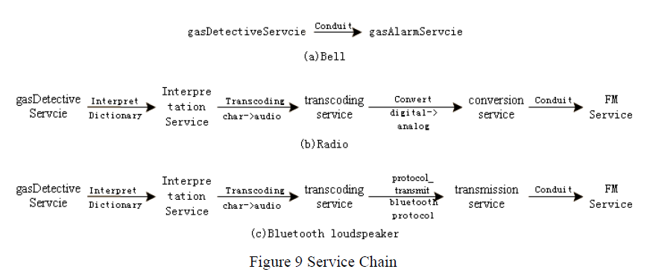
Service Invocation
With format translatation

Slide 20
Conclusion
Goal: automate the process from need motivation to service retrieval and invocation
Proposes home service ontology to explicate the relations among concepts based on home service context analysis
Construct function concept ontology by refining function concept to annotate the semantic of service

Slide 21
References
An Architecture for Home Service Retrieval Based on Function Concept Ontology Wei Moji, Xu Jianliang, Yun Hongyan, Xu Linlin
Ontology Based Service Modelling for Composability in Smart Home Environments Ioanna Roussaki, etl
An Ontology-Based Context Model in a Smart Home Eunhoe Kim and Jaeyoung Choi

Slide 22
Thank you!
Q & A

