Slide 1
MIMAC Auto Generator
By: Justin Kramer

Slide 2
Top-View
MIMAC
Micro-Macro Components
Utility for microservice creation
Organization, efficiency, ease of use
Templated coding solutions
Our current tool
Java Spring Boot auto generator
Creates basic microservice structure
Allows for basic flexibility
Not a hands-off product

Slide 3
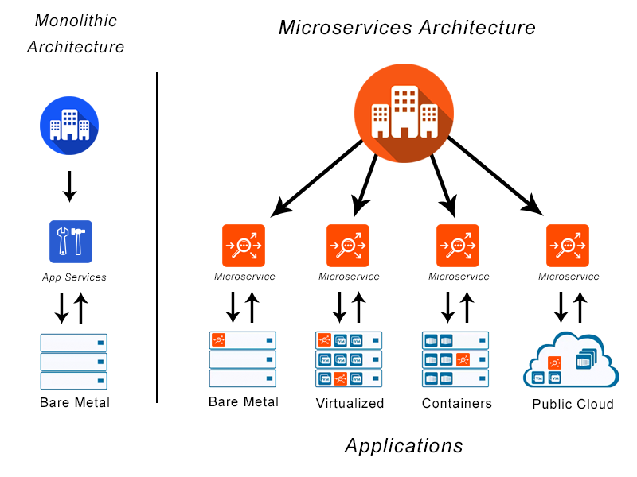
Microservice
Self contained code
High cohesion
Low coupling
Works with other code
Doesn’t need other code to run
Self contained data
Each microservice has own data
Create abstractions on top to combine them
Each code + database is a microservice

Slide 4
Java Spring Boot
Relatively new tech
Last 10 years
Popular Microservice Framework
Microservices employed at 30% of large companies
Expected to grow to 70% in the next few years
Works with Java
Familiar, popular language
Easy to use and very functional
Object-oriented
Advanced
Developed partially by Netflix
Complex microservice possibilities

Slide 5
Data Generated
New service
Entity class
Testing classes
Web controller classes
Web view templates
Registration classes
The general flow
Test that it works
Register with registration
Entity holds methods
Web controller calls methods
Web view displays controller info

Slide 6
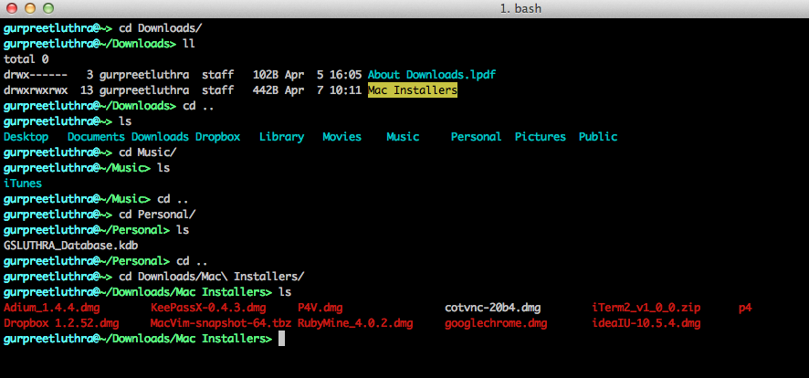
How to Use
Command line interface
Navigate to auto generator
In generator file
Adjust top constants
Adjust current project name
Adjust your xml from icms
Run the python file
Make adjustments

Slide 7
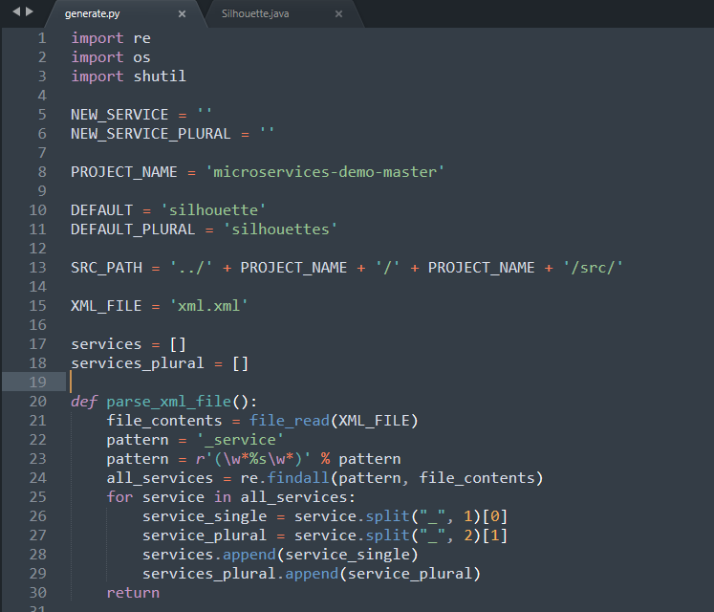
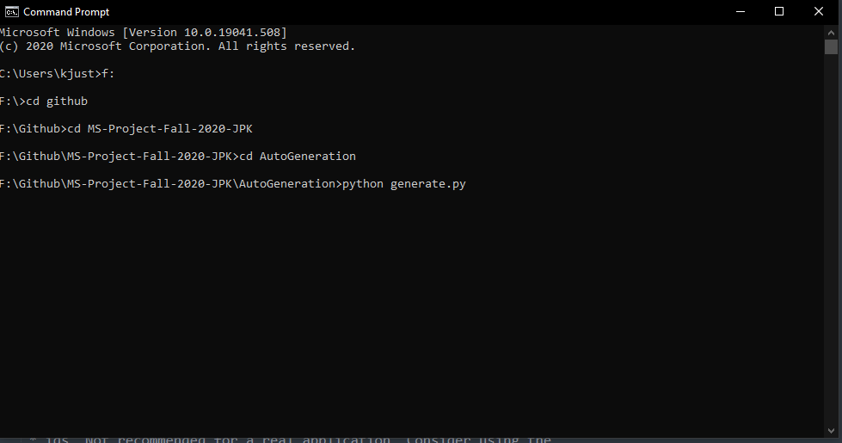

Slide 8
How to Use (example)
Layout of program files
Template files
Generator file
Running the program
Simple command
Files generated
Service files
Controller files
Html templates
Registration

Slide 9
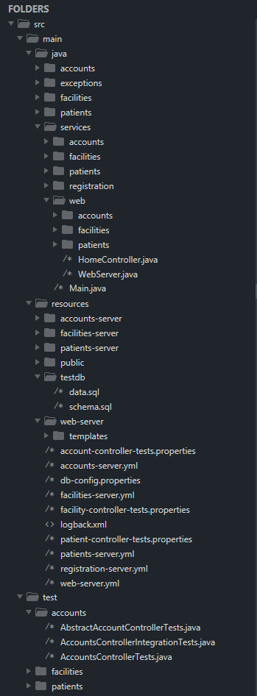
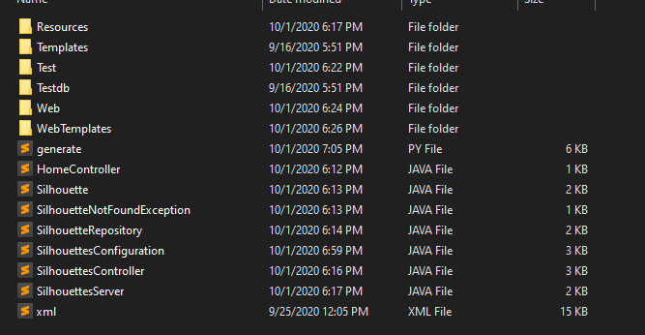

Slide 10
How to Use (add your info)
What to adjust
Service
Database
Testing
Additional table columns
Port to run on

Slide 11
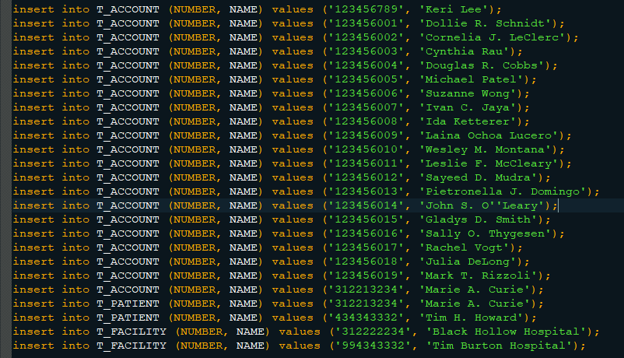
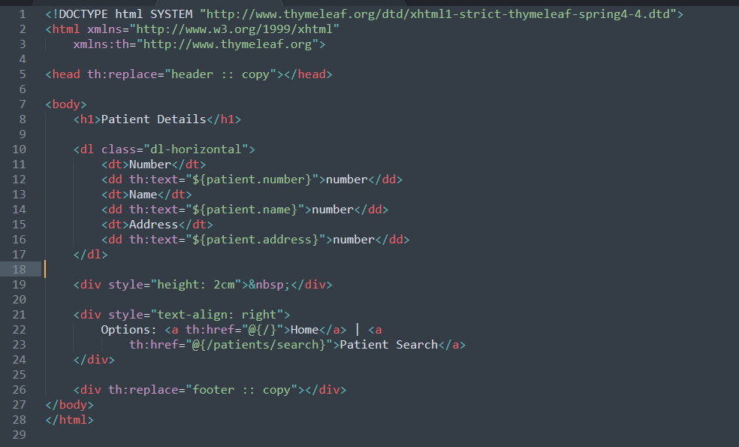

Slide 12
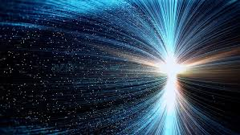
Future
More flexibility
Less customization in code for user
Easier changes, run through graphical interface
More features
Create microservice in several microservice frameworks
Create more than just a service
Updated icms
More options for xml specification
Creating controller classes

Slide 13
Thank you!

