Slide 1

CS2510
Fault Tolerance and Privacy in Wireless Sensor Networks
partially based on presentation by Sameh Gobriel

Slide 2
Agenda
Introduction to Wireless Sensor Networks (WSNs)
Challenges and constraints in WSNs
In-network Aggregation
RideSharing fault tolerance protocol
Secure RideSharing, privacy-preserving and fault tolerance protocol

Slide 3
Conventional Wireless Networks
Typical conventional wireless networks are
  Infrastructure-based (access point).
  Single hop communication
  Uses a contention-based MAC access protocol

Slide 4
Adhoc and Sensor Wireless Networks
No Backbone infrastructure.
Multihop wireless communication.
Nodes are mobile and network topology is dynamic.

Slide 5
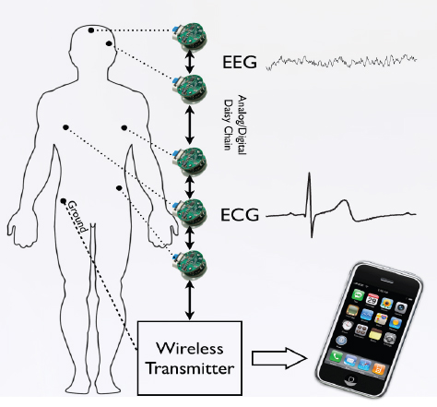
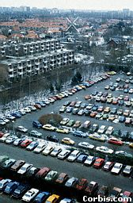
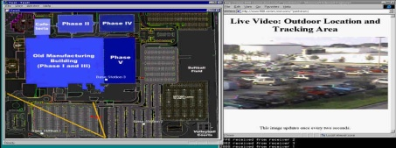
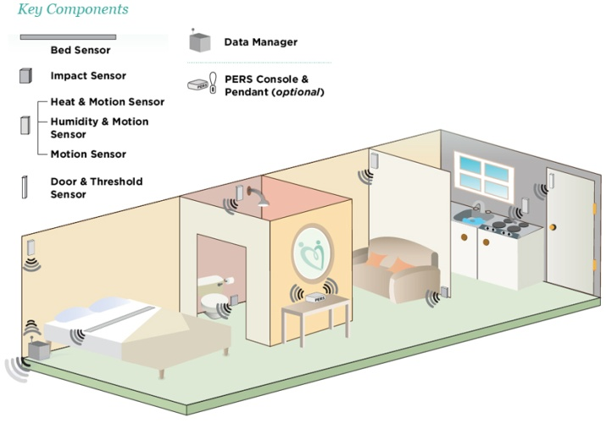
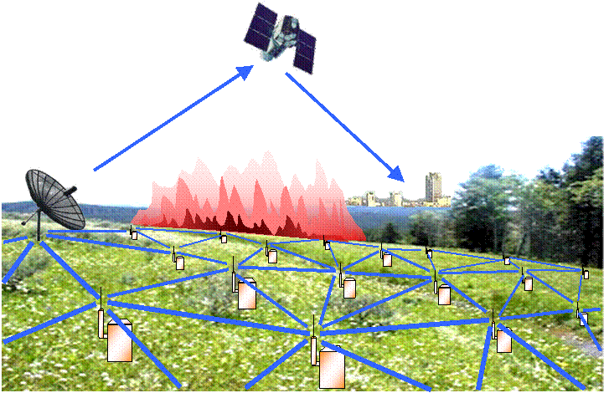
Adhoc and Sensor Wireless Networks
SPARC/Solaris Systems
Applications are countless
Health Monitoring Body Embedded Network
Parking lot monitoring
Participatory sensing
Military
.
.
.
Professional Care giving for seniors
Habitat and environmental monitoring

Slide 6
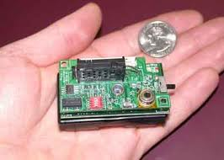
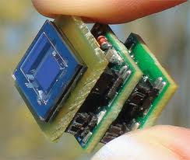
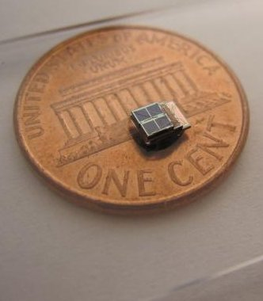
Challenges
Nodes are low power, low cost devices.
Very limited supply energy.
Required Lifetime of months or even years.
It may be hard (or undesirable) to retrieve the nodes to change or recharge the batteries.
Considerable challenge on the “Energy Consumption”.
Notes:
Challenges contraint the protocols that can be deployed

Slide 7
Constraints
These challenges induce constraints on the protocols developed to achieve:
  Communication
  Data Fusion
  Fault Tolerance
  Security

Slide 8
Energy Consumption
20
15
Power (mW)
10
5
0
Sensing
CPU
TX
RX
IDLE
SLEEP

Slide 9
In-network Aggregation
In-network aggregation → Energy Efficient data fusion in WSNs
Each sensor monitors the area around it
Sensor is supposed to send its data to the end user.

Slide 10
In-network Aggregation
End user is not interested in individual sensor readings
Global system information.

Slide 11
Tree-Construction and Data Reporting

Slide 12
Tree-Construction and Data Reporting
Sending raw data is expensive
Data aggregation (in-network processing) can save a lot of overhead
What are potential problems that you can think of with in-network aggregation?

Slide 13
Frequent Errors
When an error occurs
  A subtree of values is lost
  Incorrect result reported to the user
Wireless links are unreliable
Nodes energy depleted
Hazardous environment
Objective:
Fault-tolerant aggregation and routing scheme for WSN

Slide 14
Fault Tolerant aggregation: Retransmission
When an error occurs, retransmit the lost value
Delayed Query response:
Each level has to wait for possible retransmissions before its own
Packet Overhead:
Packet overhead because some handshake is required

Slide 15
Fault Tolerant aggregation:
Multipath Routing
A node attached itself to all parents it can hear from.
When a link fails, the node value is not lost.
What could be the problem with this scheme ?

Slide 16
Duplicate Sensitive Aggregation
Duplicate insensitive aggregation:
Max(5, 7, 10, 4, 10)
RideSharing:
Fault-tolerant duplicate sensitive aggregation and routing scheme for WSN
Duplicate sensitive aggregation:
Sum, Avg, Count, …

Slide 17
RideSharing: General Idea
Node selects a primary parents and backup parents
If error free:
  Child broadcasts value to all parents
  Only primary aggregates it

Slide 18

RideSharing: General Idea
When a link error occurs between child and primary
  Backup parent detects it
  (small bit vector 2 bit per child)
  Backup parent aggregates the
  missed child value in its message
  (if it has not sent its
  own yet)
In case of error → value of a node rideshares with the backup parent’s value

Slide 19
RS Detection: Bit Vector

Slide 20
RS Correctness
Parents have to be in communication range
Primary has to send before backup
Backup overhears primary error-free

Slide 21
RideSharing Overhead
Child broadcast to all parents (no overhead).
Primary (or backup) aggregates the value and broadcast one message to parents (no overhead).
No overhead for error correction but only for error detection:
  Parents listen to children
  Detection of primary link failure [small bit vector]

Slide 22
Cascaded RideSharing
Error free case, primary aggregates child value
In case of one link error, child value rideshares with
first backup parent
In case of two link errors
2nd backup handles it

Slide 23


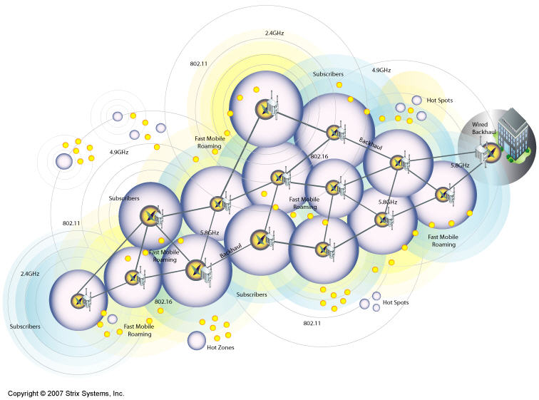




What about Privacy ?!
Applications
Collaborative sensing over shared infrastructure
text
Monitoring
Sensors

Slide 24

Attack Model
                stealthily infiltrate the network to eavesdrop
Honest-but-Curious
                correctly aggregate, but eavesdrop
Quiet infiltrators

Slide 25
New Privacy-Preserving Fault Tolerant Protocol for in-network aggregation in WSN
Additively homomorphic
stream ciphers
Cascaded Ridesharing
Privacy Preservation
Robustness

Slide 26



Secure RideSharing Protocol
Protocol
Receiver
Each sensor n_{i} encrypts its value v_{i} as c_{i} = v_{i} + g_{i}(k_{i}) mod M, and sets its corresponding bit in the P-Vector.
2. The resulting c_{i} values are aggregated using the Cascaded RideSharing protocol, which results in the sink receiving the value C = ∑_{i} c_{i} mod M.
3. The sink computes the aggregate
key value K = ∑_{i} g_{i}(k_{i}) mod M for
each i ϵ P- Vector.
The sink extracts the final aggregate value V = ∑_{i} v_{i} = C − K mod M.
P₃
P₁
ERROR
OK “Got it”
P₂
n_{i}
c_{i} = v_{i} + g_{i}(k_{i}) mod M
P-Vector[i] = 1
n_{i}
n₁
n₂
…
n_{n}
L-Vector
e-bit =1
r-bit = 0

Slide 27

Secure RideSharing Protocol
Now I can recover the plain aggregate value given the P-vector
Receiver
c_{j ;} P-Vector[j] = 1
P₃
P₁
c_{i} ; P-Vector[i] = 1
P₂
n_{i}
n_{j}
n₁
n_{i}
n_{j}
n₂
…
n_{n}
P-Vector
1 .. 1

Slide 28
Evaluation
Comparison of four protocols using the CSIM simulator
Spanning-tree: no fault tolerance, but efficient for power!
Cascaded RideSharing
Our confidentiality-preserving fault-tolerant aggregation protocol
Our protocol with state compression
Comparison metrics:
Average relative RMS error in aggregated results
Average energy consumed per node per epoch
Average message size transmitted per node per epoch
SIMULATION PARAMETERS
Parameter | Value Ranges
Total number of nodes | 300, 400, 500, . . . ,1000
Link error rate | 0.05, 0.10, . . . , 0.35
Number of primary + backup parents | max(3)
Participation level (% of nodes reporting values) | 1.5%, 2.5%, 5%, . . . , 25%

Slide 29
More Simulation Parameters
SIMULATION PARAMETERS -- cont
Parameter | Possible values
Square area | 320×320 ft² grid
Radio range of each node | 30 ft
Simulations | 10 simulation runs each 30 epochs
Sensor Nodes | Mica2
Data Transmission power consumption | 65 mW
Listening and reception power consumption | 21 mW
Network Bandwidth | 38.4 Kbps
Crypto used | RC4 stream cipher
Optimization (Compression) | RLE standard compression

Slide 30

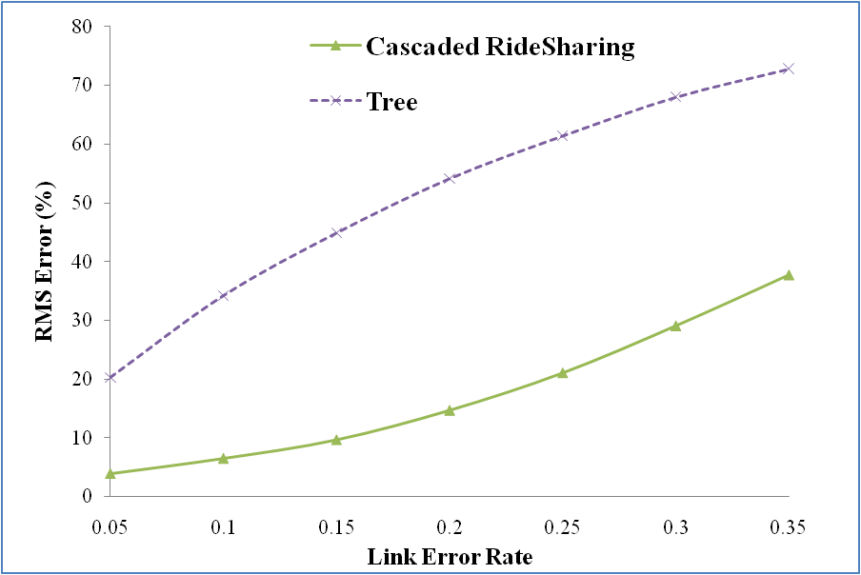

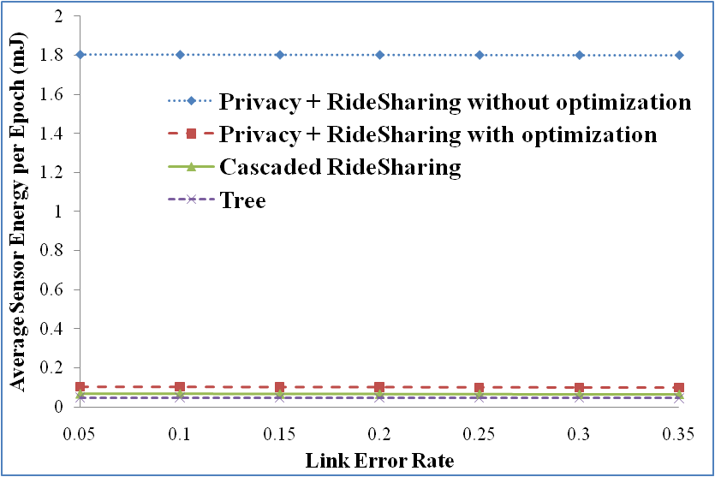
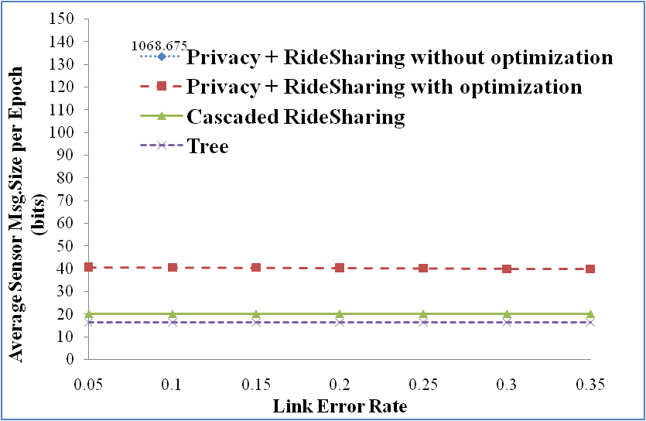
1- Effect of Link Error Rate
48.2% improvement in RMS
Constant overhead
Constant overhead

Slide 31
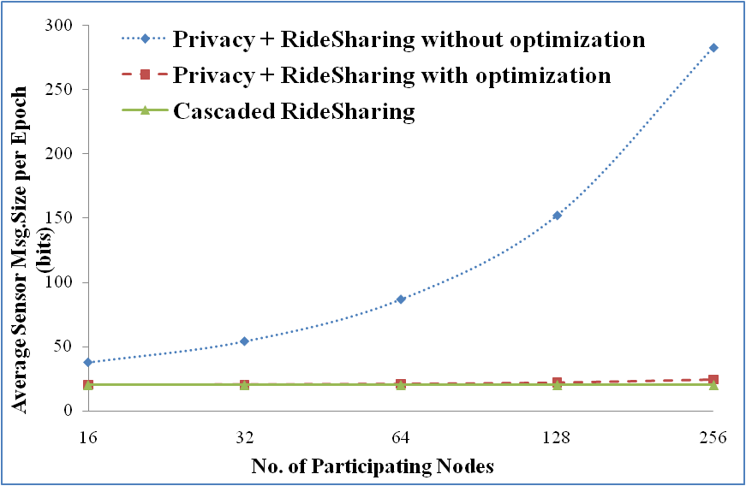
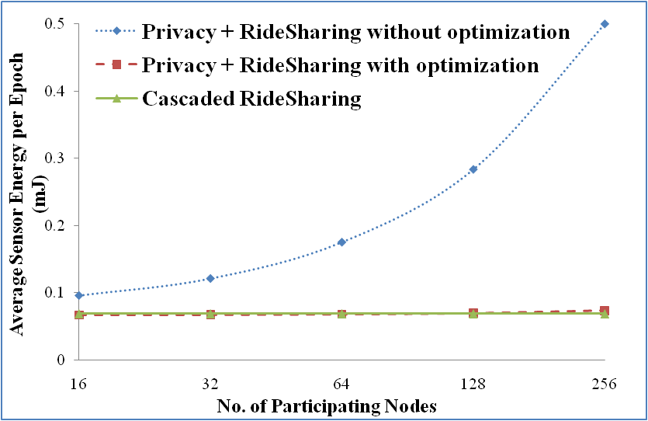
2- Effect of Participation Level
Only
7.1% increase
Only
3.6% increase

Slide 32
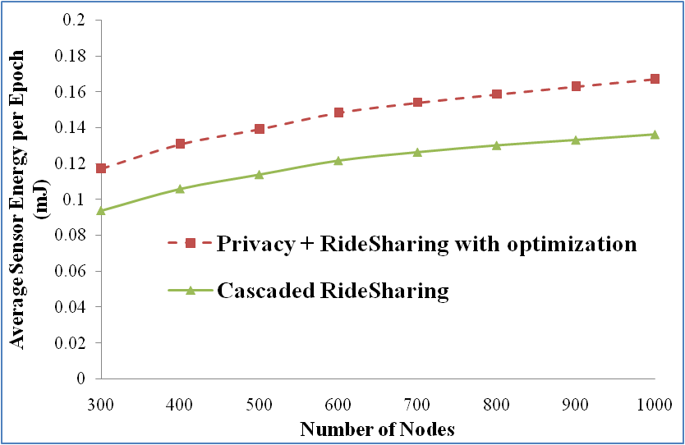
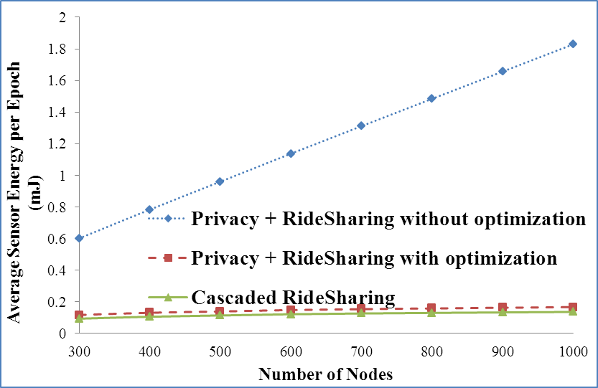
3- Effect of Network Density
90.2% improvement using optimization

Slide 33

Thank you

