Slide 1
Chapter 26: Conversational Agents

Slide 2
Conversational Agents
AKA Dialog Agents
Phone and voice based personal assistants
SIRI, Alexa, Cortana, Google Assistant
Talking to your car
Communicating with robots
Clinical uses for mental health
Chatting for fun

Slide 3
Two classes of systems
Chatbots
(Goal-based) Dialog agents
  - SIRI, interfaces to cars, robots,
  - booking flights or restaurants
The word "chatbots" is sometimes used in the popular press for both. We'll use it only for #1.

Slide 4
Spoken Dialogue Systems
Computer systems that can engage in extended human-machine conversations
Benefits of speech as an interface
  Highly intuitive
  Eyes and hands free
  Small devices
  Rich communication channel

Slide 5
Dialogue Systems: A Brief History
Computer Interactive Devices
Prototypes Telephone (e.g. smartphones)
1960 1970 1980 1990 2000 2010 2015
Notes:
Eliza 1966, Shrdlu 1970, Voyager 1990, Nuance 1994, Siri 2011

Slide 6
Dialogue Systems: A Brief History
ELIZA
(Chatbots)
Men are all alike.
IN WHAT WAY
They’re always bugging us about something or other.
CAN YOU THINK OF A SPECIFIC EXAMPLE [Weizenbaum, 1966]
Notes:
Eliza 1966, Shrdlu 1970, Voyager 1990, Nuance 1994, Siri 2011

Slide 7
Dialogue Systems: A Brief History
ELIZA
(Chatbots)
SHRDLU
(Artificial Intelligence)
Pick up a big red block.
OK
Grasp the pyramid.
I DON’T UNDERSTAND WHICH PYRAMID YOU MEAN
[Winograd, 1971]
Notes:
Eliza 1966, Shrdlu 1970, Voyager 1990, Nuance 1994, Siri 2011

Slide 8
Dialogue Systems: A Brief History
ELIZA
(Chatbots)
SHRDLU
(Artificial Intelligence)
VODIS, VOYAGER
(Speech)
How many hotels are there in Cambridge.
I KNOW OF SIX HOTELS IN CAMBRIDGE
[Glass et al., 1995]
Notes:
Eliza 1966, Shrdlu 1970, Voyager 1990, Nuance 1994, Siri 2011

Slide 9
Dialogue Systems: A Brief History
ELIZA
(Chatbots)
SHRDLU
(Artificial Intelligence)
VODIS, VOYAGER
(Speech)
Startups
Notes:
Eliza 1966, Shrdlu 1970, Voyager 1990, Nuance 1994, Siri 2011

Slide 10
Dialogue Systems: A Brief History
ELIZA
(Chatbots)
SHRDLU
(Artificial Intelligence)
SIRI
(hybrid approach)
VODIS, VOYAGER
(Speech)
Startups
Notes:
Eliza 1966, Shrdlu 1970, Voyager 1990, Nuance 1994, Siri 2011

Slide 11
Dialogue Systems: A Brief History
ELIZA
(Chatbots)
SHRDLU
(Artificial Intelligence)
SIRI Alexa Challenge
(hybrid approach) (social bots)
VODIS, VOYAGER
(Speech)
Startups
Notes:
Eliza 1966, Shrdlu 1970, Voyager 1990, Nuance 1994, Siri 2011

Slide 12
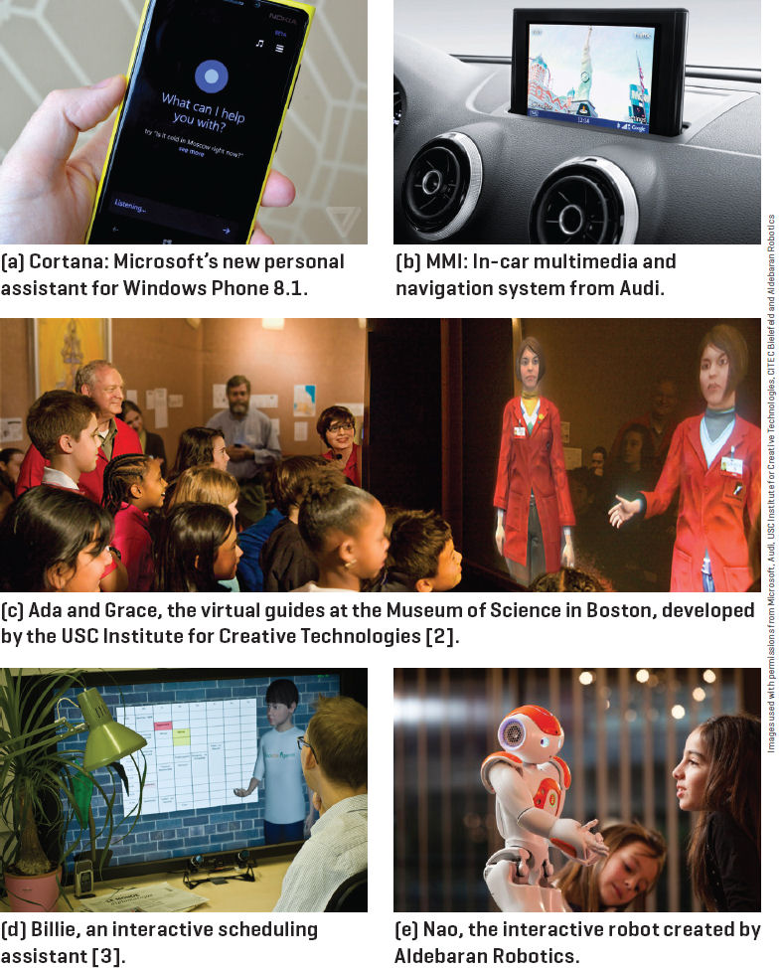
Spoken Dialogue Systems: Examples
[Lison and Meena,
2014]

Slide 13
Are we done yet?
The Future Directions of Dialogue-Based Intelligent Personal Assistants (SIGdial 2016 panel)
Yes (one of the panelists)
  no bottleneck but privacy!
No (audience members - especially senior NLPers)
  pragmatics, social dimensions, …

Slide 14

Typical Architecture
Speech
recognition
Natural language
understanding
Backend
Dialogue
manager
Text-to-speech
or recording
Natural language
generation
Notes:
DB-1338
Db-1337

Slide 15

Typical Architecture
Speech
recognition
I am looking for a place with allendale area
I am looking for a place with annandale area
I am looking for a place with the annandale area
….
I am looking for a place with a annandale area
Notes:
DB-1338

Slide 16
Typical Architecture
Speech
recognition
I am looking for a place with allendale area
Natural language
understanding
System Beliefs
Name | - | .999
Area | allendale | .997
Food | - | .999
Area Code | - | .999
Requestable | - | .053
Notes:
DB-1338
Db-1337

Slide 17
Typical Architecture
Speech
recognition
Natural language
understanding
Area=allendale
Backend
Dialogue
manager
Offer(name=argo tea)
Notes:
DB-1338
Db-1337

Slide 18
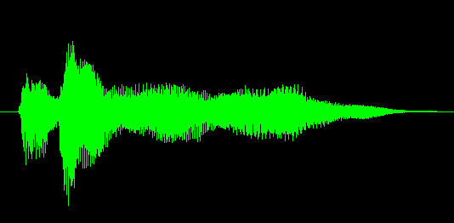
Typical Architecture
Speech
recognition
Natural language
understanding
Backend
Dialogue
manager
Text-to-speech
or recording
Offer(name=argo tea)
Natural language
generation
Argo tea is in the Allendale area
Notes:
DB-1338
Db-1337

Slide 19
Challenges
Input errors
  Hello, what kind of laptop are you after?
  SPEECH RECOGNITION: I WANT IT FOR OF IS THAT
  What product family do you have in mind …
Notes:
Towards open domains

Slide 20
Statistical Speech Recognition
Let’s assume
  X is the entire sequence of speech data (features) you observe
  W is one possible word sequence that it corresponds to
  … then the most likely word sequence would maximize the probability of occurrence of that sequence (among all possible word sequences) given that you observed the speech data X
  P(W | X) = (P(X|W)P(W)) / P(X) (Bayes Rule)
  ArgmaxW P(X|W) P(W) (acoustic model and language model)

Slide 21
Speech Recognition, continued
Acoustic models predict the probability of observing a given speech feature stream assuming it was generated by a particular word sequence
  P(X|W)
Language models help disambiguate by capture the relative probability of different word sequences, e.g. recognize speech vs. wreck a beach
  P(W)

Slide 22
Challenges
Input errors
  Speech recognition (and turn-taking – time-out, barge-in)
  Adverse acoustic conditions (speaker phone, background noise)
  Natural language understanding (out of vocabulary)
Other limitations
  Restricted domains and tasks
  Behave naturally (back-channel)
  System components are typically ‘hand-crafted’
    costly, don’t easily transfer
A ‘big data’ alternative: statistical systems
  System components are trained from data
  “Deploy, Collect Data and Improve” [Young, 2014]
Notes:
Towards open domains

Slide 23
Part I: Chatbots!
ELIZA (1966)
PARRY (1968)
  The first system to pass the Turing test?
ALICE
CLEVER
Microsoft Little Bing 小冰

Slide 24
Chatbot Architectures
Rule-based
  Pattern-action rules (Eliza)
  + a mental model (Parry)
Corpus-based (from large chat corpus)
  Information Retrieval
  Neural network encoder-decoder

Slide 25
Chatbots
Sometimes for fun
But originally designed as a testbed for clinical therapy
(And still used that way!)

Slide 26
Eliza: Weizenbaum (1966)
Men are all alike.
IN WHAT WAY
They're always bugging us about something or other.
CAN YOU THINK OF A SPECIFIC EXAMPLE
Well, my boyfriend made me come here.
YOUR BOYFRIEND MADE YOU COME HERE
He says I'm depressed much of the time.
I AM SORRY TO HEAR YOU ARE DEPRESSED
...
WHO ELSE IN YOUR FAMILY TAKES CARE 0F YOU?
My father
YOUR FATHER

Slide 27
You are like my father in some ways.
WHAT RESEMBLANCE DO YOU SEE
You are not very aggressive but I think you don’t want me to notice that.
WHAT MAKES YOU THINK I AM NOT AGGRESSIVE
You don’t argue with me.
WHY DO YOU THINK I DON’T ARGUE WITH YOU
You are afraid of me.
DOES IT PLEASE YOU TO BELIEVE I’M AFRAID OF YOU
My father is afraid of everybody.
WHAT ELSE COMES TO MIND WHEN YOU THINK OF YOUR FATHER
Bullies.
DOES THAT HAVE ANYTHING TO DO WITH THE FACT THAT YOUR BOYFRIEND MADE YOU COME HERE

Slide 28
How does it work?
Eliza uses this one weird trick

Slide 29
That trick: be a Rogerian psychologist
Draw the patient out by reflecting patient’s statements back at them
Rare type of conversation in which one can “assume the pose of knowing almost nothing of the real world”

Slide 30
Rogerian psychologist
  Patient: "I went for a long boat ride”
  Psychiatrist: "Tell me about boats”
You don’t assume she didn’t know what a boat is
You assume she had some conversational goal
Chatbots trying to pass the Turing test usually choose some such domain

Slide 31
Eliza pattern/transform rules
(0 YOU 0 ME) [pattern]
(WHAT MAKES YOU THINK I 3 YOU) [transform]
0 means Kleene *
The 3 is the constituent # in pattern
You hate me
WHAT MAKES YOU THINK I HATE YOU

Slide 33
Keywords are ranked from specific to general
  I know everybody laughed at me
“I” is a very general keyword:
  I: (I *) -> (You say you 2)
  YOU SAY YOU KNOW EVERYBODY LAUGHED AT YOU
“Everybody” is much more interesting (someone using universals like everybody/always is probably “referring to some quite specific event or person”)
  WHO IN PARTICULAR ARE YOU THINKING OF?
Implementation: keywords stored with their rank
  Everybody 5 (transformation rules)
  I 0 (transformation rules)

Slide 34
NONE
PLEASE GO ON
THAT’S VERY INTERESTING
I SEE

Slide 35
Memory
(MEMORY MY
(0 YOUR 0 = LETS DISCUSS FURTHER WHY YOUR 3)
(0 YOUR 0 = EARLIER YOU SAID YOUR 3)
Whenever “MY” is highest keyword
  Randomly select a transform on the MEMORY list
  Apply to sentence
  Store on a stack
Later, if no keyword matches a sentence
  Return the top of the MEMORY queue instead
A hierarchical model of discourse

Slide 36
Other Eliza stuff
Rules can refer to classes of words
  Family = mother, father, brother, sister
  NOUN = …
Don’t reuse transforms in the same conversation
  Whenever we use a transform associated with a pattern
  We increment a counter for that rule
  So the next time we use the next ranked transform
Some basic transforms happen during input processing
  I -> YOU
  YOU -> I

Slide 37
Some implications
People became deeply emotionally involved with the program
Weizenbaum tells the story of his secretary who would ask Weizenbaum to leave the room when she talked with ELIZA
When he suggested that he might want to store all the ELIZA conversations for later analysis, people immediately pointed out the privacy implications
  Suggesting that they were having quite private conversations with ELIZA

Slide 38
Woebot
Fitzpatrick, Darcy, Vierhile, 2017. Delivering Cognitive Behavior Therapy to Young Adults with Symptoms of Depression and Anxiety Using a Fully Automated Conversational Agent (Woebot): A Randomized Controlled Trial. JMIR Ment Health 4:2.
Chatbot for delivering Cognitive Behavior Therapy via brief daily conversations
  Little decision tree of language and menu responses
  "What's going on in your world right now?"
  "How are you feeling?"
  In response to endorsed loneliness:
    "I'm so sorry you're feeling lonely. I guess we all feel a little lonely sometimes"
In a 2-week experiment seemed to reduce depression, but not anxiety

Slide 39
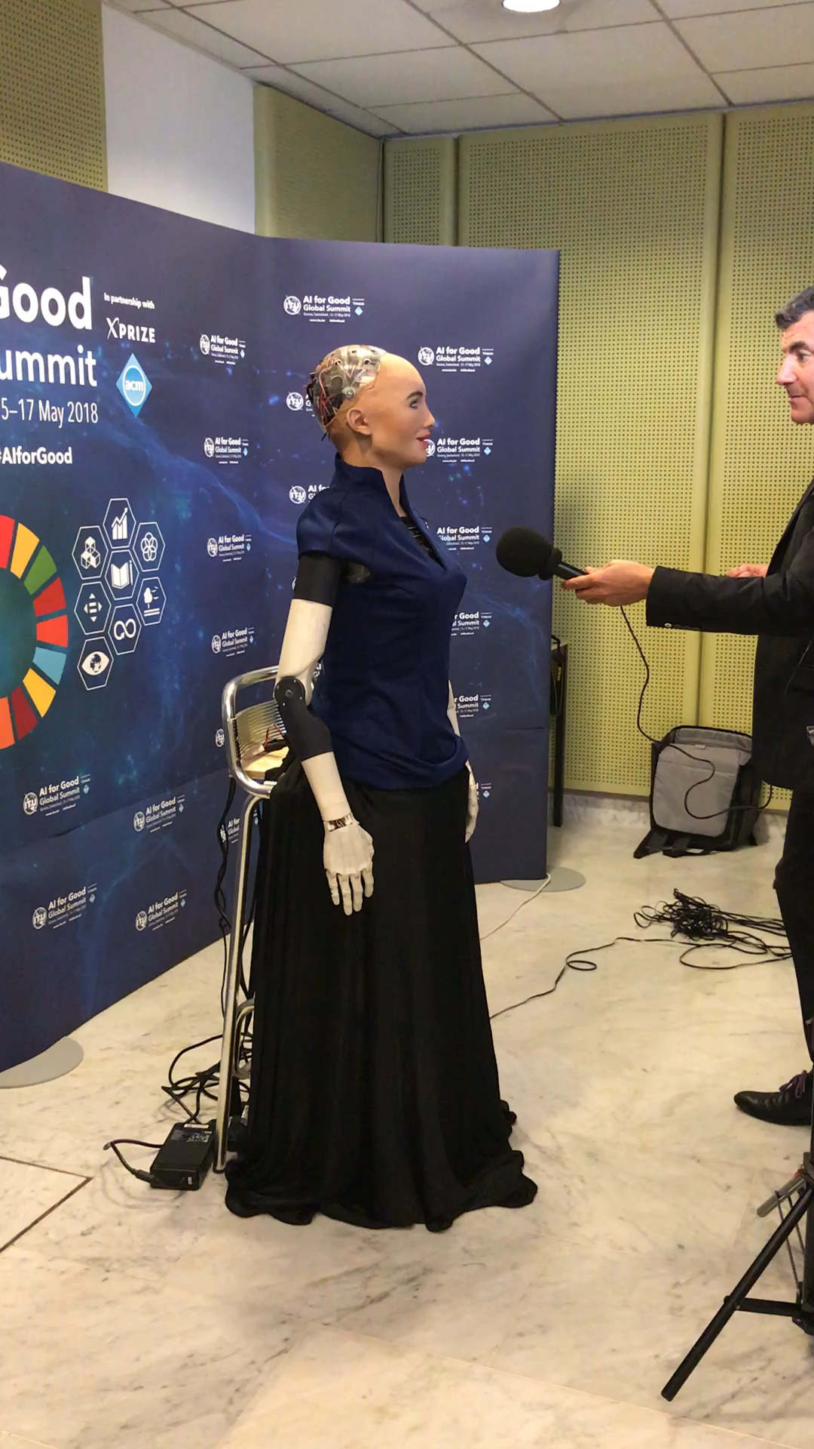
Loebner Prize
Sofia

Slide 40
IR-based chatbots
Idea: Mine conversations of human chats or human-machine chats
  Microblogs: Twitter or Weibo (微博)
  Movie dialogs
Cleverbot (Carpenter 2017 http://www.cleverbot.com)
Microsoft XiaoIce
Microsoft Tay

Slide 41
A Cleverbot conversation
User: | Do you like Doctor Who?
Cleverbot: | Yes, so funny
User: | What's your favorite show?
Cleverbot: | I don't have one
User: | What's your name?
Cleverbot: | Jason I already told you.
User: | No your real name.
Cleverbot: | Stephanie IS my real name.
User: | I thought it was Jason?
Cleverbot: | How did you come to that conclusion.
User: | Because you said so.
Cleverbot: | I have to do my homework.

Slide 42
Two IR-based chatbot architectures
Return the response to the most similar turn
  Take user's turn (q) and find a (tf-idf) similar turn t in the corpus C
  q = "do you like Doctor Who"
  t' = "do you like Doctor Strangelove"
  Grab whatever the response was to t.
Return the most similar turn
Yes, so funny
Do you like Doctor Strangelove

Slide 43
IR-based models of chatbots
Also fine to use other features like user features, or prior turns
Or non-dialogue text
  COBOT chatbot (Isbell et al., 2000)
    sentences from the Unabomber Manifesto by Theodore Kaczynski, articles on alien abduction, the scripts of “The Big Lebowski” and “Planet of the Apes”.
  Wikipedia text

Slide 44
Neural chatbots
Think of response generation as a task of transducing from the user’s prior turn to the system’s turn (like machine translation, ML version of Eliza)
Train on:
  movie dialogue databases
  Twitter conversations
Train a deep neural network
  map from user1 turn to user2 response

Slide 45
Sample neural chatbot output

Slide 46
Chatbots: pro and con
Pro:
  Fun
  Applications to counseling
  Good for narrow, scriptable applications
Cons:
  They don't really understand
  Rule-based chatbots are expensive and brittle
  IR-based chatbots can only mirror training data
    The case of Microsoft Tay
      (or, Garbage-in, Garbage-out)
The future: combining chatbots with frame-based agents

Slide 47
II: Frame-based dialog agents

Slide 48
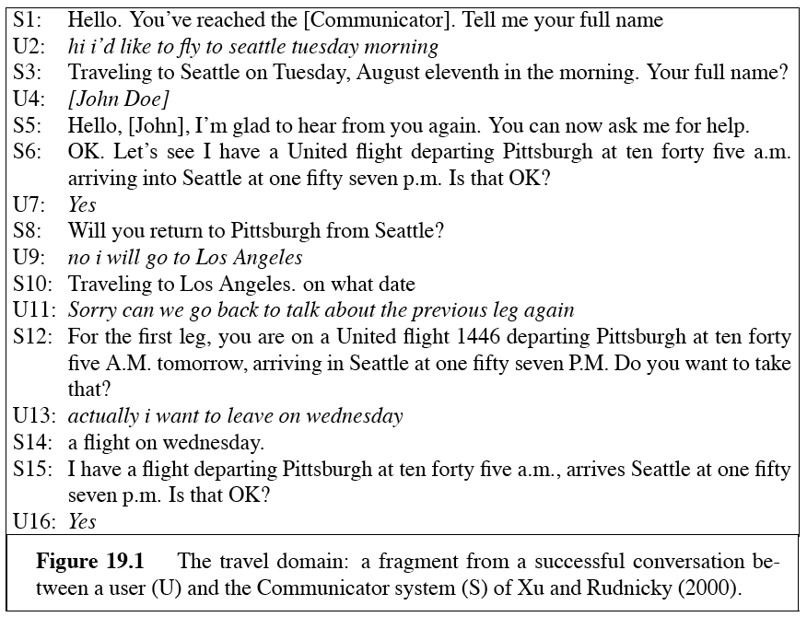
A travel dialog: Communicator

Slide 49
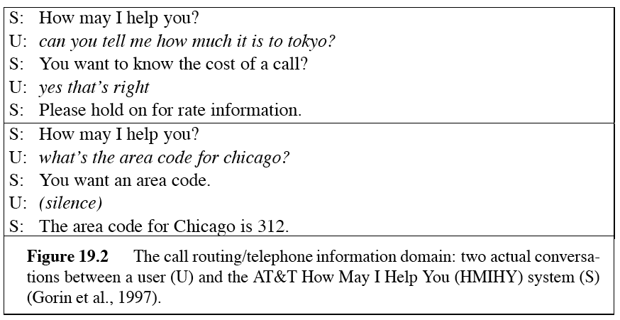
Call routing: ATT HMIHY

Slide 50
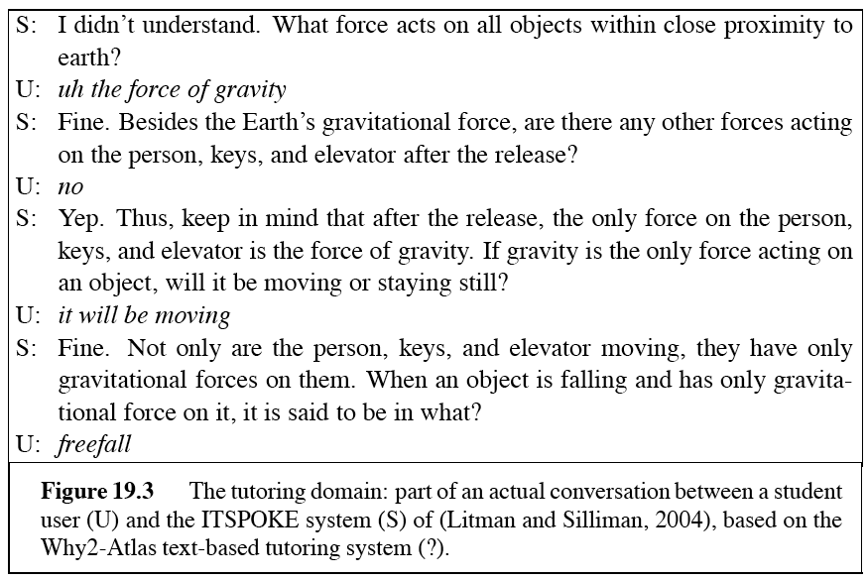
A tutorial dialogue: ITSPOKE

Slide 51
SIRI around 2014

Slide 52
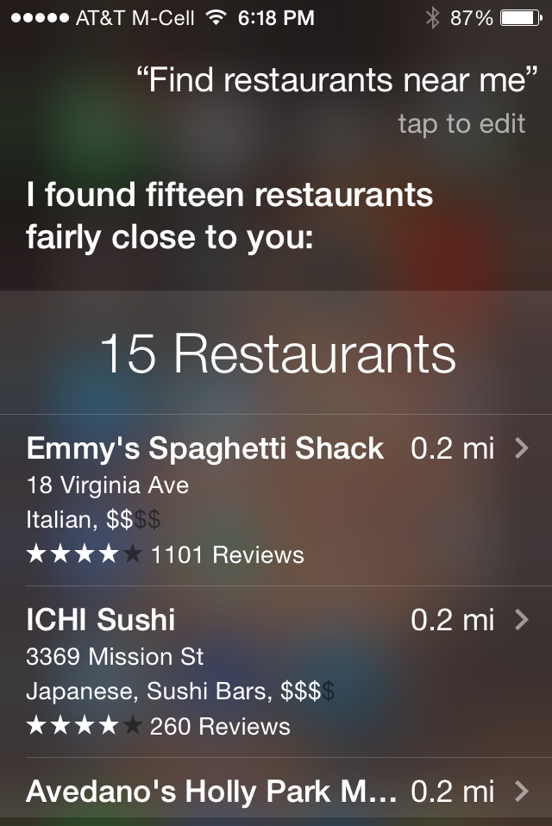
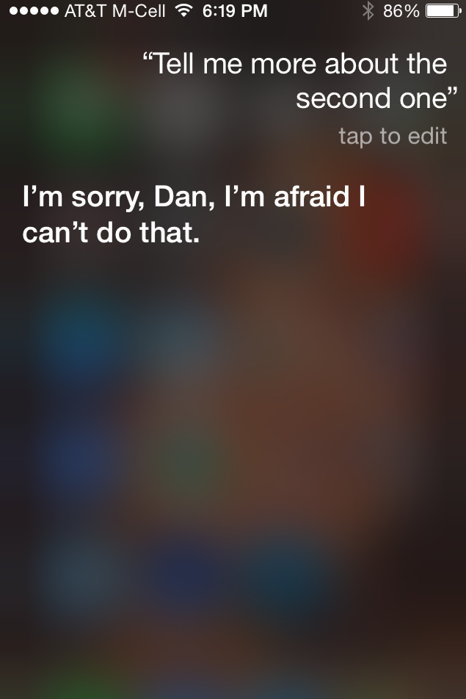

Slide 53
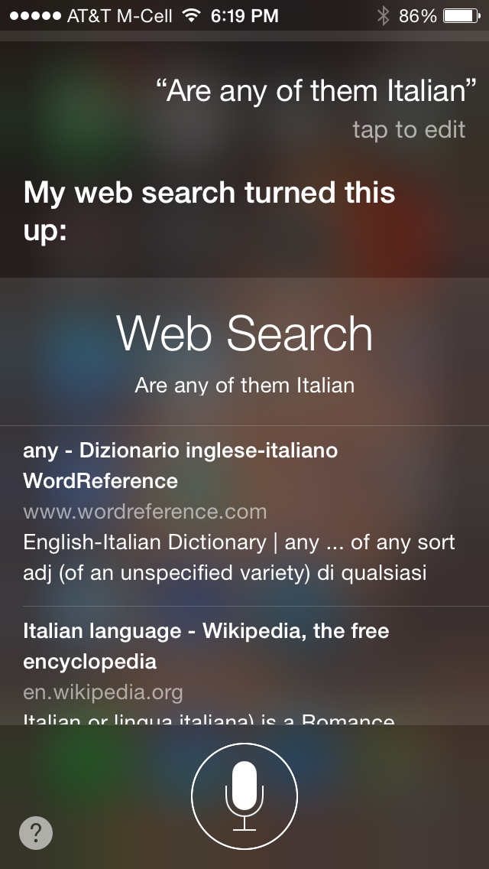

Slide 54
SIRI in February 2017

Slide 55
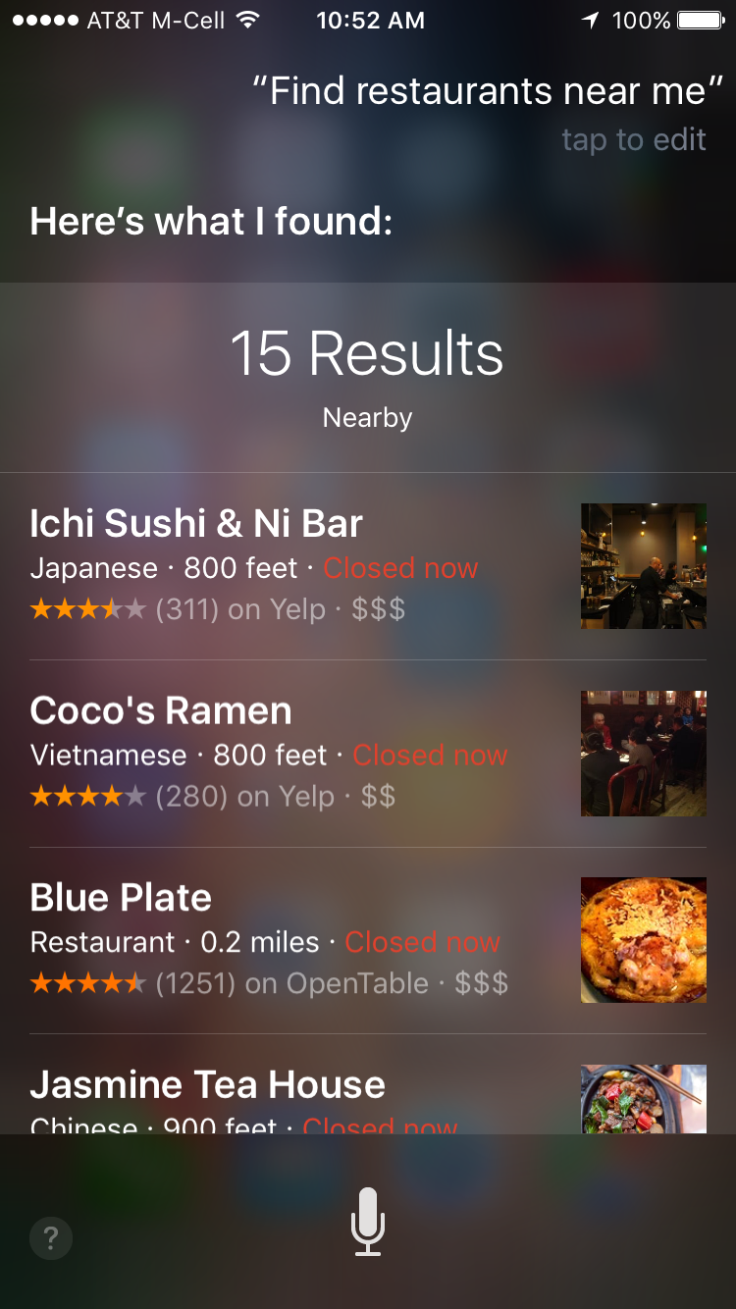
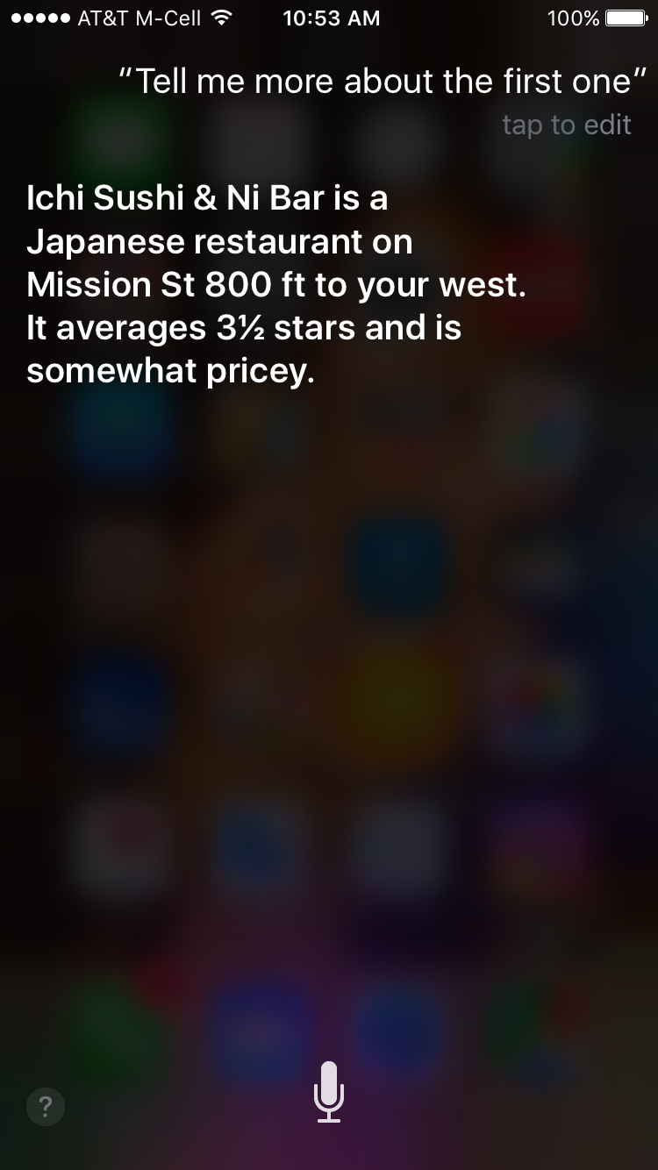

Slide 56
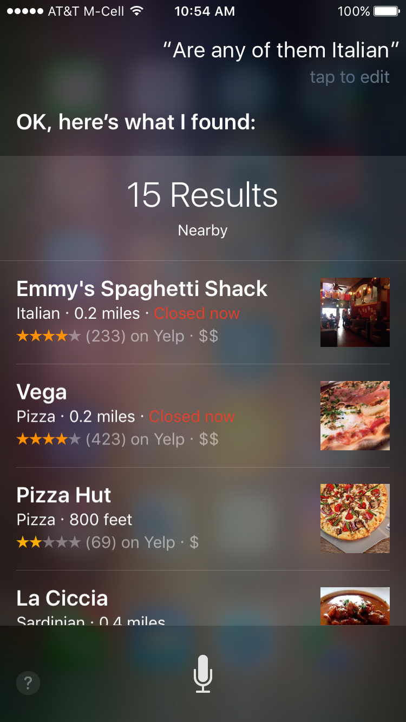

Slide 57
Frame-based dialog agents
Sometimes called "task-based dialog agents"
Based on a "domain ontology"
  A knowledge structure representing user intentions
One or more frames
  Each a collection of slots
  Each slot having a value

Slide 58
The Frame
A set of slots, to be filled with information of a given type
Each associated with a question to the user
  Slot Type Question
  ORIGIN city What city are you leaving from?
  DEST city Where are you going?
  DEP DATE date What day would you like to leave?
  DEP TIME time What time would you like to leave?
  AIRLINE line What is your preferred airline?

Slide 59
Frame-based dialogue agents
1977:
Still the industrial state of the art
  SIRI based on GUS architecture
Artificial Intelligence Journal, 1977

Slide 60
The state of the art in 1977 !!!!

Slide 61
Slot types can be complex
The type DATE

Slide 62
Control structure for frame-based dialog
Consider a trivial airline travel system:
  Ask the user for a departure city
  Ask for a destination city
  Ask for a time
  Ask whether the trip is round-trip or not

Slide 63
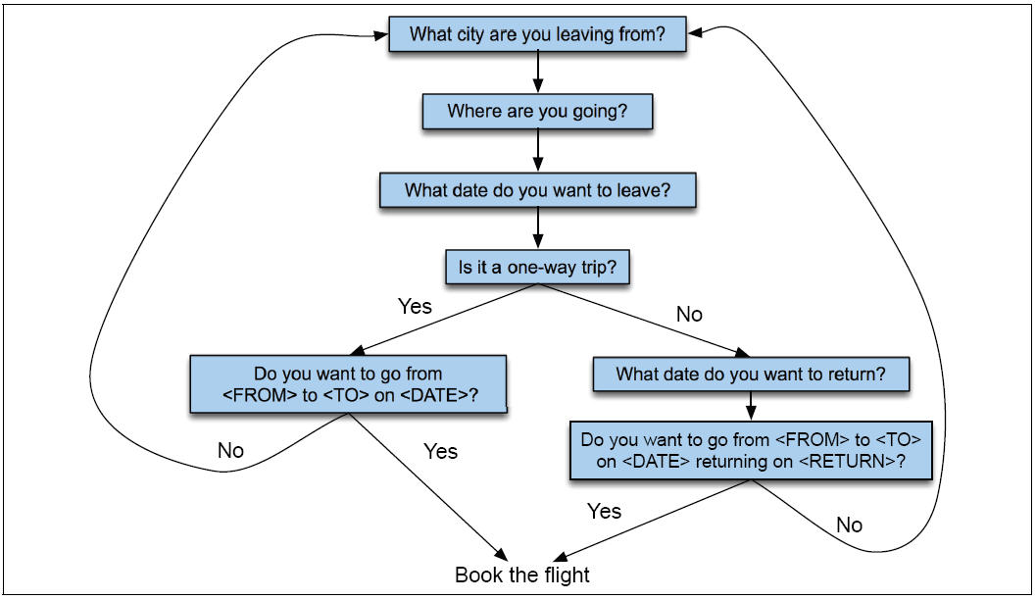
Finite State Dialog Manager

Slide 64
Finite-state dialog managers
System completely controls the conversation with the user.
It asks the user a series of questions
Ignoring (or misinterpreting) anything the user says that is not a direct answer to the system’s questions

Slide 65
Summary
State of the art:
  Chatbots:
    Simple rule-based systems
    IR or Neural networks: mine datasets of conversations.
  Frame-based systems:
    hand-written rules for slot fillers
    ML classifiers to fill slots
What’s the future?
  Key direction: Integrating goal-based and chatbot-based systems

