Slide 1
Word Senses and WordNet
(Word Sense Disambiguation)

Slide 2
Midterm
Minimum Value | 54.00
Maximum Value | 100.00
Average | 83.325
Median | 84.50
90 - 100 | 11
80 - 89 | 19
70 - 79 | 5
60 - 69 | 4
50 - 59 | 1

Slide 3
Review
Lexical Semantics / Relationships
WordNet
Word Similarity via WordNet Thesaurus

Slide 4
Word Sense Disambiguation (WSD)
Given
  A word in context,
  A fixed inventory of potential word senses
Decide which sense of the word this is
What set of senses?
  English-to-Spanish MT: set of Spanish translations
  Speech Synthesis: homographs like bass and bow
  In general: the senses in a thesaurus like WordNet

Slide 5
TheWordNet entry for the noun bat has the following distinct senses.
Cluster these senses by using the definitions of homonymy and polysemy.
bat#1: nocturnal mouselike mammal
bat#2: (baseball) a turn trying to get a hit
bat#3: a small racket. . . for playing squash
bat#4: the club used in playing cricket
bat#5: a club used for hitting a ball in various games

Slide 6
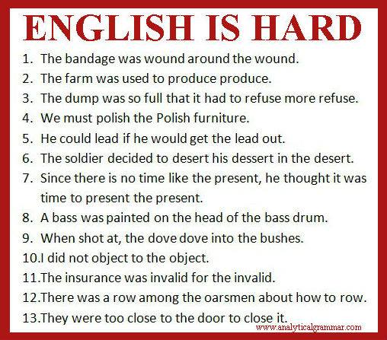

Slide 7
Two Variants of WSD
Lexical Sample task
  Small pre-selected set of target words
  And inventory of senses for each word
  Typically supervised ML: classifier per word
All-words task
  Every word in an entire text
  A lexicon with senses for each word
  Data sparseness: can’t train word-specific classifiers
  ~Like part-of-speech tagging
    Except each lemma has its own tagset
    Less human agreement so upper bound is lower

Slide 8
Word-in-Context (Simpler) Task

Slide 10
Approaches
Supervised machine learning
“Unsupervised”
  Thesaurus/Dictionary-based techniques
  (Selectional Association, next chapter)
Lightly supervised
  Bootstrapping

Slide 11
Supervised Machine Learning Approaches
Supervised machine learning approach
  Training corpus depends on task
  Train a classifier that can tag words in new text
  Just as we saw for part-of-speech tagging
What do we need?
  Tag set (“sense inventory”)
  Training corpus (words tagged in context with sense)
  Embeddings or set of features extracted from the training corpus
  A classifier

Slide 12
Supervised WSD: WSD Tags
What’s a tag?
  A dictionary sense?
For example, for WordNet an instance of “bass” in a text has 8 possible tags or labels (bass1 through bass8).

Slide 13
Bass in WordNet
The noun bass has 8 senses in WordNet
  bass - (the lowest part of the musical range)
  bass, bass part - (the lowest part in polyphonic music)
  bass, basso - (an adult male singer with the lowest voice)
  sea bass, bass - (flesh of lean-fleshed saltwater fish of the family Serranidae)
  freshwater bass, bass - (any of various North American lean-fleshed freshwater fishes especially of the genus Micropterus)
  bass, bass voice, basso - (the lowest adult male singing voice)
  bass - (the member with the lowest range of a family of musical instruments)
  bass -(nontechnical name for any of numerous edible marine and freshwater spiny-finned fishes)

Slide 14
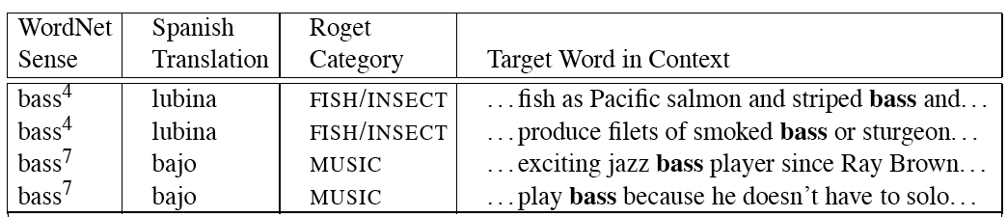
Sense Tags for Bass

Slide 15
What kind of Corpora?
Lexical sample task:
  Line-hard-serve corpus - 4000 examples of each
  Interest corpus - 2369 sense-tagged examples
All words:
  Semantic concordance: a corpus in which each open-class word is labeled with a sense from a specific dictionary/thesaurus.
    SemCor: 234,000 words from Brown Corpus, manually tagged with WordNet senses
    SENSEVAL-3 competition corpora - 2081 tagged word tokens
Notes:
Line of people, chalk line; hard as difficult or solid

Slide 16
SemCor
<wf pos=PRP>He</wf>
<wf pos=VB lemma=recognize wnsn=4 lexsn=2:31:00::>recognized</wf>
<wf pos=DT>the</wf>
<wf pos=NN lemma=gesture wnsn=1 lexsn=1:04:00::>gesture</wf>
<punc>.</punc>

Slide 17
(Contextual) Embedding Algorithms

Slide 18
Contextual Embedding Algorithms (continued)
Training
Embed each token in a sense-labeled training corpus
Average each token of each sense of each word to produce a sense embedding
  See arxiv article linked in syllabus for Contextual extension of embeddings
Testing
Compare test embedding with training embeddings
Return sense of nearest neighbor based on a similarity metric such as cosine

Slide 19
What about unseen test words?
Backoff via most frequent sense (first sense in WordNet)
Imputation via WordNet taxonomy and supersenses

Slide 20
Frequency-based WSD
WordNet first sense heuristic, about 60-70% accuracy
To improve, need context
  Selectional restrictions
  “Topic”

Slide 21
Imputation

Slide 22
Review
Project comments
  Code formats
  Paper formats
  Baselines, measuring progress (can’t compare to published paper)
  Provided data (no negative sampling needed)
  GPU
ArXiv and NYTimes links
Last class
  Tasks
  Embedding approach to WSD

Slide 23
Combining Embeddings/Thesaurus
Addressing problem of antonyms
E.g., counterfitting
  After embeddings are trained, use a thesaurus to learn a second mapping that shifts antonyms apart and synonyms closer

Slide 24
Non-Neural: What Kind of Features?
Weaver (1955) “If one examines the words in a book, one at a time as through an opaque mask with a hole in it one word wide, then it is obviously impossible to determine, one at a time, the meaning of the words. […] But if one lengthens the slit in the opaque mask, until one can see not only the central word in question but also say N words on either side, then if N is large enough one can unambiguously decide the meaning of the central word. […] The practical question is : `What minimum value of N will, at least in a tolerable fraction of cases, lead to the correct choice of meaning for the central word?’”

Slide 25
S: (n) dish (a piece of dishware normally used as a container for holding or serving food) "we gave them a set of dishes for a wedding present“
S: (n) dish (a particular item of prepared food) "she prepared a special dish for dinner"
….

Slide 26
dishes
  washing dishes he
  simple dishes including
  convenient dishes to
  of dishes and
bass
  free bass with
  pound bass of
  and bass player
  his bass while

Slide 27
dishes
  includes washing dishes he says
  several simple dishes including braised
  and convenient dishes to fix
  variety of dishes and regional
bass
  the free bass with ease
  52 pound bass of a
  guitar and bass player stand
  caught his bass while fishing

Slide 28
“In our house, everybody has a career and none of them includes washing dishes,” he says.
In her tiny kitchen at home, Ms. Chen works efficiently, stir-frying several simple dishes, including braised pig’s ears and chcken livers with green peppers.
Post quick and convenient dishes to fix when you’re in a hurry.
Japanese cuisine offers a great variety of dishes and regional specialties

Slide 29
We need more good teachers – right now, there are only a half a dozen who can play the free bass with ease.
Though still a far cry from the lake’s record 52 pound bass of a decade ago, “you could fillet these fish again, and that made people very, very happy.” Mr. Paulson says.
An electric guitar and bass player stand off to one side, not really part of the scene, just as a sort of nod to gringo expectations again.
Lowe caught his bass while fishing with pro Bill Lee of Killeen, Texas, who is currently in 144th place with two bass weighing 2-09.

Slide 30
Feature Vectors
A simple representation for each observation (each instance of a target word)
  Vectors of sets of feature/value pairs
    I.e. files of comma-separated values
  These vectors should represent the window of words around the target
  How big should that window be?

Slide 31
What sort of Features?
Collocational features and bag-of-words features
  Collocational
    Features about words at specific positions near target word
      Often limited to just word identity and POS
  Bag-of-words
    Features about words that occur anywhere in the window (regardless of position)
      Typically limited to frequency counts
Notes:
Start here.

Slide 32
Example
Example text (WSJ)
  An electric guitar and bass player stand off to one side not really part of the scene, just as a sort of nod to gringo expectations perhaps
  Assume a window of +/- 2 from the target

Slide 33
Collocations
Position-specific information about the words in the window
guitar and bass player stand
  [guitar, NN, and, CC, player, NN, stand, VB]
  Word_{n-2,} POS_{n-2,} word_{n-1,} POS_{n-1,} Word_{n+1} POS_{n+1}…
  In other words, a vector consisting of
  [position n word, position n part-of-speech…]

Slide 34
Bag of Words
Information about what words occur within the window
First derive a set of terms to place in the vector
Then note how often each of those terms occurs in a given window

Slide 35
Co-Occurrence Example
Assume we’ve settled on a possible vocabulary of 12 words in “bass” sentences:
[fishing, big, sound, player, fly, rod, pound, double, runs, playing, guitar, band]
The vector for:
  guitar and bass player stand

Slide 36
Co-Occurrence Example
Assume we’ve settled on a possible vocabulary of 12 words in “bass” sentences:
[fishing, big, sound, player, fly, rod, pound, double, runs, playing, guitar, band]
The vector for:
  guitar and bass player stand
[0,0,0,1,0,0,0,0,0,0,1,0]

Slide 37
Classifiers
Once we cast the WSD problem as a classification problem, many techniques possible
  Naïve Bayes
  Decision lists
  Decision trees
  Neural nets
  Support vector machines
  Nearest neighbor methods…

Slide 38
Classifiers
Choice of technique, in part, depends on the set of features that have been used
  Some techniques work better/worse with features with numerical values
  Some techniques work better/worse with features that have large numbers of possible values
    For example, the feature the word to the left has a fairly large number of possible values

Slide 39
Classification Methods:
Supervised Machine Learning
Input:
  a word w in a text window d (which we’ll call a “document”)
  a fixed set of classes C = {c₁, c₂,…, c_{J}}
  A training set of m hand-labeled text windows again called “documents” (d₁,c₁),....,(d_{m},c_{m})
Output:
  a learned classifier γ:d → c

Slide 40
Naïve Bayes
ŝ = p(s|V), or
Where s is one of the senses S possible for a word w and V the input vector of feature values for w
Assume features independent, so probability of V is the product of probabilities of each feature, given s, so
p(V) same for any ŝ
Then

Slide 41
How do we estimate p(s) and p(v_{j}|s)?

Slide 42
How do we estimate p(s) and p(v_{j}|s)?
  p(s_{i}) is max. likelihood estimate from a sense-tagged corpus (count(s_{i},w_{j})/count(w_{j})) – how likely is bank to mean ‘financial institution’ over all instances of bank?
  P(v_{j}|s) is max. likelihood of each feature given a candidate sense (count(v_{j},s)/count(s)) – how likely is the previous word to be ‘river’ when the sense of bank is ‘financial institution’
Calculate for each possible sense and take the highest scoring sense as the most likely choice

Slide 43
 | Doc | Words | Class
Training | 1 | fish smoked fish | f
 | 2 | fish line | f
 | 3 | fish haul smoked | f
 | 4 | guitar jazz line | g
Test | 5 | line guitar jazz jazz | ?
Priors:
P(f)=
P(g)=
V = {fish, smoked, line, haul, guitar, jazz}
3
4
1
Choosing a class:
P(f|d5)
P(g|d5)
4
  3/4 * 2/14 * (1/14)² * 1/14
  ≈ 0.00003
Conditional Probabilities:
P(line|f) =
P(guitar|f) =
P(jazz|f) =
P(line|g) =
P(guitar|g) =
P(jazz|g) =
(1+1) / (8+6) = 2/14
(0+1) / (8+6) = 1/14
  1/4 * 2/9 * (2/9)² * 2/9
  ≈ 0.0006
(0+1) / (8+6) = 1/14
(1+1) / (3+6) = 2/9
(1+1) / (3+6) = 2/9
(1+1) / (3+6) = 2/9

Slide 44
WSD Evaluations and Baselines
Intrinsic versus Extrinsic evaluation
  Exact match accuracy
    % of words tagged identically with manual sense tags
Baselines: most frequent sense, one sense per discourse, Lesk algorithm

Slide 45
Naïve Bayes Evaluation
On a corpus of examples of uses of the word line, naïve Bayes achieved about 73% correct
Is this good?

Slide 46
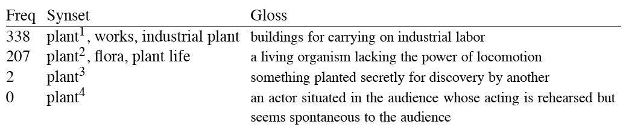
Most Frequent Sense
Wordnet senses are ordered in frequency order
So “most frequent sense” in WordNet = “take the first sense”
Sense frequencies come from SemCor

Slide 47
Ceiling
Human inter-annotator agreement
  Compare annotations of two humans
  On same data
  Given same tagging guidelines
Human agreements on all-words corpora with WordNet style senses
  75%-80%

Slide 48
Way to easily get training data?
Wikipedia
  Link ambigious words to different articles
  Then map articles to sense inventory
  BabelNet
    live.babelnet.org

Slide 49
Unsupervised Methods: Dictionary/Thesaurus Methods
The Lesk Algorithm

Slide 50
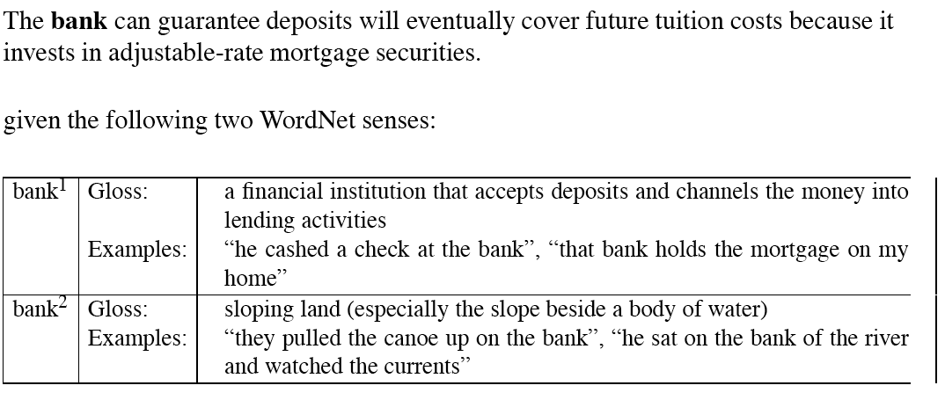
Simplified Lesk
Match dictionary entry of sense that best matches context

Slide 51
Simplified Lesk
Match dictionary entry of sense that best matches context: bank1 (deposits, mortgage)

Slide 52
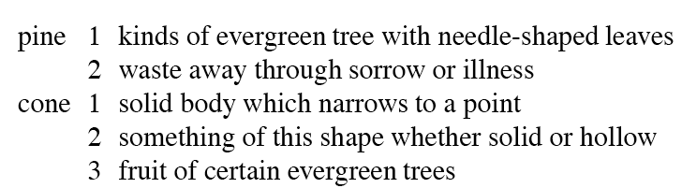
Original Lesk: pine cone
Compare entries for each context word for overlap

Slide 53
Original Lesk: pine cone
Compare entries for each context word for overlap
Cone3 selected: evergreen, tree

Slide 54
“Time flies like an arrow” – what are the correct senses?
time#n#5 (the continuum of experience in which events pass from the future through the present to the past)
time#v#1 (measure the time or duration of an event or action or the person who performs an action in a certain period of time) “he clocked the runners”
flies#n#1 (two-winged insects characterized by active flight)
flies#v#8 (pass away rapidly) “Time flies like an arrow”; “Time fleeing beneath him”
like#v#4 (feel about or towards; consider, evaluate, or regard) “How did you like the President’s speech last night?”
like#a#1 (resembling or similar; having the same or some of the same characteristics; often used in combination) “suits of like design”; “a limited circle of likeminds”; “members of the cat family have like dispositions”; “as like as two peas in a pod”; “doglike devotion”; “a dreamlike quality”

Slide 55
Try the original algorithm on “Time flies like an arrow” using WordNet senses below. Assume that the words are to be disambiguated one at a time, from left to right,
and that the results from earlier decisions are used later in the process.
time#n#5 (the continuum of experience in which events pass from the future through the present to the past)
time#v#1 (measure the time or duration of an event or action or the person who performs an action in a certain period of time) “he clocked the runners”
flies#n#1 (two-winged insects characterized by active flight)
flies#v#8 (pass away rapidly) “Time flies like an arrow”; “Time fleeing beneath him”
like#v#4 (feel about or towards; consider, evaluate, or regard) “How did you like the President’s speech last night?”
like#a#1 (resembling or similar; having the same or some of the same characteristics; often used in combination) “suits of like design”; “a limited circle of likeminds”; “members of the cat family have like dispositions”; “as like as two peas in a pod”; “doglike devotion”; “a dreamlike quality”

Slide 56
“Time flies like an arrow”
time#n#5 (the continuum of experience in which events pass from the future through the present to the past)
time#v#1 (measure the time or duration of an event or action or the person who performs an action in a certain period of time) “he clocked the runners”
flies#n#1 (two-winged insects characterized by active flight)
flies#v#8 (pass away rapidly) “Time flies like an arrow”; “Time fleeing beneath him”
like#v#4 (feel about or towards; consider, evaluate, or regard) “How did you like the President’s speech last night?”
like#a#1 (resembling or similar; having the same or some of the same characteristics; often used in combination) “suits of like design”; “a limited circle of likeminds”; “members of the cat family have like dispositions”; “as like as two peas in a pod”; “doglike devotion”; “a dreamlike quality”
Time WSD : tie, backoff to most frequent, but can’t because POS differ

Slide 57
“Time flies like an arrow”
time#n#5 (the continuum of experience in which events pass from the future through the present to the past)
time#v#1 (measure the time or duration of an event or action or the person who performs an action in a certain period of time) “he clocked the runners”
flies#n#1 (two-winged insects characterized by active flight)
flies#v#8 (pass away rapidly) “Time flies like an arrow”; “Time fleeing beneath him”
like#v#4 (feel about or towards; consider, evaluate, or regard) “How did you like the President’s speech last night?”
like#a#1 (resembling or similar; having the same or some of the same characteristics; often used in combination) “suits of like design”; “a limited circle of likeminds”; “members of the cat family have like dispositions”; “as like as two peas in a pod”; “doglike devotion”; “a dreamlike quality”
Flies WSD: select verb

Slide 58
Corpus Lesk
Add corpus examples to glosses and examples
The best performing variant

Slide 59
The Corpus Lesk algorithm
Assumes we have some sense-labeled data (like SemCor)
Take all the sentences with the relevant word sense:
  These short, "streamlined" meetings usually are sponsored by local banks¹, Chambers of Commerce, trade associations, or other civic organizations.
Now add these to the gloss + examples for each sense, call it the “signature” of a sense.
Choose sense with most word overlap between context and signature.

Slide 60
Corpus Lesk: IDF weighting
Instead of just removing function words
  Weigh each word by its `promiscuity’ across documents
  Down-weights words that occur in every `document’ (gloss, example, etc)
  These are generally function words, but is a more fine-grained measure
Weigh each overlapping word by inverse document frequency

Slide 61
Graph-based methods
First, WordNet can be viewed as a graph
  senses are nodes
  relations (hypernymy, meronymy) are edges
  Also add edge between word and unambiguous gloss words

Slide 62
How to use the graph for WSD
Insert target word and words in its sentential context into the graph, with directed edges to their senses
“She drank some milk”
Now choose the
most central sense
Add some probability to
“drink” and “milk” and
compute node with
highest “pagerank”

Slide 63
Semi-Supervised Bootstrapping
What if you don’t have enough data or hand-built resources to train a system…
Bootstrap
  Pick a word that you as an analyst think will co-occur with your target word in particular sense
  Grep through your corpus for your target word and the hypothesized word
  Assume that the target tag is the right one
  Generalize from a small hand-labeled seed set

Slide 64
Bootstrapping
For bass
  Assume play occurs with the music sense and fish occurs with the fish sense

Slide 65
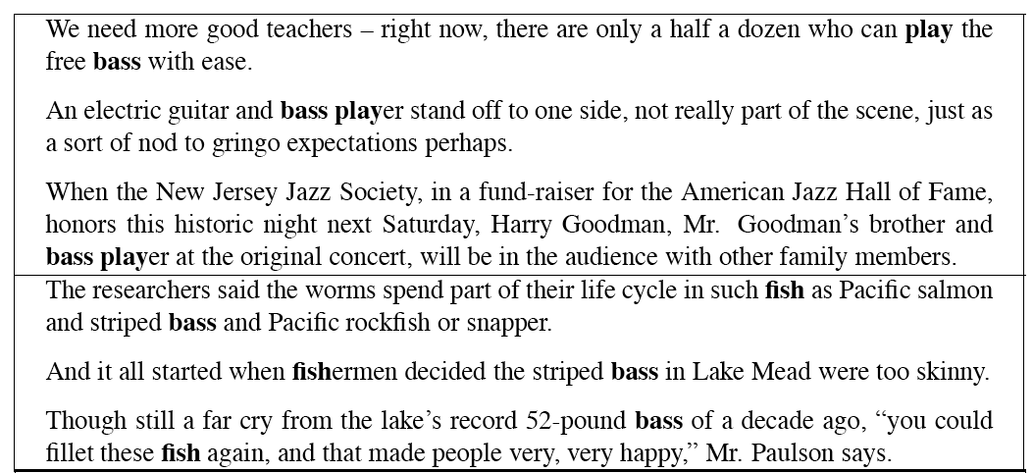
Sentences Extracts for bass and player

Slide 66
Where do the seeds come from?
Hand labeling
“One sense per discourse”:
  The sense of a word is highly consistent within a document - Yarowsky (1995)
  True for topic-dependent words
  Not so true for other POS like adjectives and verbs, e.g. make, take
  Krovetz (1998) “More than one sense per discourse” not true at all once you move to fine-grained senses
One sense per collocation:
  A word recurring in collocation with the same word will almost surely have the same sense

Slide 67
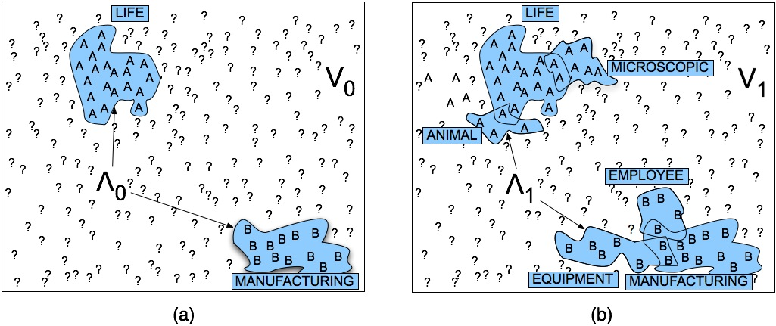
Stages in Yarowsky Bootstrapping Algorithm

Slide 68
Issues
Given these general ML approaches, how many classifiers do I need to perform WSD robustly
  One for each ambiguous word in the language
How do you decide what set of tags/labels/senses to use for a given word?
  Depends on the application

Slide 69
WordNet ‘bass’
Tagging with this set of senses is an impossibly hard task that’s probably overkill for any realistic application
bass, bass part - (the lowest part in polyphonic music)
bass, basso - (an adult male singer with the lowest voice)
sea bass, bass - (flesh of lean-fleshed saltwater fish of the family Serranidae)
freshwater bass, bass - (any of various North American lean-fleshed freshwater fishes especially of the genus Micropterus)
bass, bass voice, basso - (the lowest adult male singing voice)
bass - (the member with the lowest range of a family of musical instruments)
bass -(nontechnical name for any of numerous edible marine and
bass - (the lowest part of the musical range)
freshwater spiny-finned fishes)

Slide 70
Word Sense Induction
Training
Testing on token t of word w

Slide 71
History of Senseval
ACL-SIGLEX workshop (1997)
SENSEVAL-I (1998)
  Lexical Sample for English, French, and Italian
SENSEVAL-II (Toulouse, 2001)
  Lexical Sample and All Words
SENSEVAL-III (2004)
SENSEVAL-IV -> SEMEVAL (2007)
Newer: SEM, First Joint Conference on Lexical and Computational Semantics

Slide 72
2012
SEM: 1st Conf. on Lexical & Computational Semantics
SemEval: International Workshop on Semantic Evaluations
  1. English Lexical Simplification
  2. Measuring Degrees of Relational Similarity
  3. Spatial Role Labeling
  4. Evaluating Chinese Word Similarity
  5. Chinese Semantic Dependency Parsing
  6. Semantic Textual Similarity
  7. COPA: Choice Of Plausible Alternatives An evaluation of
  common-sense causal reasoning
  8. Cross-lingual Textual Entailment for Content Synchronization

Slide 73
WSD Performance
Varies widely depending on how difficult the disambiguation task is
Accuracies of over 90% are commonly reported on some of the classic, often fairly easy, WSD tasks (pike, star, interest)
Senseval brought careful evaluation of difficult WSD (many senses, different POS)
Senseval 1: more fine grained senses, wider range of types:
  Overall: about 75% accuracy
  Nouns: about 80% accuracy
  Verbs: about 70% accuracy

Slide 74
Summary
Word Sense Disambiguation: choosing correct sense in context
Applications: MT, QA, etc.
Three classes of Methods
  Supervised Machine Learning: Naive Bayes classifier
  Thesaurus/Dictionary Methods
  Semi-Supervised Learning
Main intuition
  There is lots of information in a word’s context
  Simple algorithms based just on word counts can be surprisingly good

