Slide 1
Word Senses and WordNet
(Thesaurus-based)
Notes:
Also incorporated Chapter18_introandsimilarity from 3rd edition

Slide 2
Word Senses and Relations
Homonymy, Polysemy, Synonymy, and more
Online Resources
Thesaurus methods for word similarity

Slide 3
Lexical Semantics
Focus on word meanings:
  Relations of meaning among words
    Similarities & differences of meaning in similar context
  Internal meaning structure of words
    Basic internal units combine for meaning

Slide 4
Word Definitions
What’s a word?
  Definitions so far: Types, tokens, stems, roots, inflected forms, etc...
  Lexeme: An entry in a lexicon consisting of a pairing of a form with a single meaning representation
  Lexicon: A collection of lexemes

Slide 5
I. Possible Word Relations
Homonymy
Polysemy
Synonymy
Antonymy
Hypernomy
Hyponomy
Meronomy

Slide 6
Homonymy
Lexemes share a form
    Phonological, orthographic or both
  But have unrelated, distinct meanings
Clear examples
    Bat (wooden stick-like thing) vs. bat (flying scary mammal thing)
    Bank (financial institution) versus bank (riverside)
Can be homophones, homographs:
    Homophones:
      Write/right, piece/peace, to/too/two
    Homographs:
      Desert/desert
      Bass/bass

Slide 7
Issues for NLP Applications
Text-to-Speech
  Same orthographic form but different phonological form
    bass vs. bass
Information retrieval
  Different meanings same orthographic form
    QUERY: bat care
Machine Translation (English -> Spanish)
  bat: murciélago (animal) or bate (for baseball)

Slide 8
Polysemy
The bank is constructed from red brick
I withdrew the money from the bank
  Are these the same sense? Different?
Or consider the following WSJ example
  While some banks furnish sperm only to married women, others are less restrictive
  Which sense of bank is this?
    Is it distinct from the river bank sense?
    The savings bank sense?

Slide 9
Polysemy
A single lexeme with multiple related meanings (bank the building, bank the financial institution)
Most non-rare words have multiple meanings
  Number of meanings related to word frequency
  Verbs tend more to polysemy
  Distinguishing polysemy from homonymy isn’t always easy (or necessary)

Slide 10
Metonymy or Systematic Polysemy:
A systematic relationship between senses
Lots of types of polysemy are systematic
  School, university, hospital
  All can mean the institution or the building.
A systematic relationship:
  Building Organization
Other such kinds of systematic polysemy:
Author (Jane Austen wrote Emma)
Works of Author (I love Jane Austen)
Tree (Plums have beautiful blossoms)
Fruit (I ate a preserved plum)

Slide 11
Metaphor vs. Metonymy
Metaphor: two different meaning domains are related
  Citibank claimed it was misrepresented.
  Corporation as person
Metonymy: use of one aspect of a concept to refer to other aspects of entity or to entity itself
  The Citibank is on the corner of Main and State.
  Building stands for organization

Slide 12
How Do We Identify Words with Multiple Senses?
ATIS examples
  Which flights serve breakfast?
  Does America West serve Philadelphia?
The “zeugma” test: conjoin two potentially similar/dissimilar senses
  ?Does United serve breakfast and San Jose?
  Does United serve breakfast and lunch?

Slide 13
Synonymy
Word that have the same meaning in some or all contexts.
  filbert / hazelnut
  couch / sofa
  big / large
  automobile / car
  vomit / throw up
  Water / H₂0
Two lexemes are synonyms if they can be successfully substituted for each other in all situations
  If so they have the same propositional meaning

Slide 14
Few Examples of Perfect Synonymy
Even if many aspects of meaning are identical
  Still may not preserve the acceptability based on notions of politeness, slang, register, genre, etc.
E.g, water and H₂0, coffee and java

Slide 15
Terminology
Lemmas and wordforms
  A lexeme is an abstract pairing of meaning and form
  A lemma or citation form is the grammatical form that is used to represent a lexeme.
    Carpet is the lemma for carpets
  Specific surface forms carpets, sung are called wordforms
The lemma bank has two senses:
  Instead, a bank can hold the investments in a custodial account in the client’s name.
  But as agriculture burgeons on the east bank, the river will shrink even more.
A sense is a discrete representation of one aspect of the meaning of a word

Slide 16
Synonymy Relates Senses not Words
Consider big and large
Are they synonyms?
  How big is that plane?
  Would I be flying on a large or a small plane?
How about:
  Miss Nelson, for instance, became a kind of big sister to Benjamin.
  ?Miss Nelson, for instance, became a kind of large sister to Benjamin.
Why?
  big has a sense that means being older, or grown up
  large lacks this sense

Slide 17
Antonyms
Senses that are opposites with respect to one feature of their meaning
Otherwise, they are very similar
  dark / light
  short / long
  hot / cold
  up / down
  in / out
More formally: antonyms can
  Define a binary opposition or an attribute at opposite ends of a scale (long/short, fast/slow)
  Be reversives: rise/fall, up/down

Slide 18
Hyponyms
A sense is a hyponym of another if the first sense is more specific, denoting a subclass of the other
  car is a hyponym of vehicle
  dog is a hyponym of animal
  mango is a hyponym of fruit
Conversely
  vehicle is a hypernym/superordinate of car
  animal is a hypernym of dog
  fruit is a hypernym of mango
superordinate | vehicle | fruit | furniture | mammal
hyponym | car | mango | chair | dog

Slide 19
Hypernymy Defined
Extensional
  The class denoted by the superordinate
  Extensionally includes class denoted by the hyponym
Entailment
  A sense A is a hyponym of sense B if being an A entails being a B
Hyponymy is usually transitive
  (A hypo B and B hypo C entails A hypo C)
Another name: the IS-A hierarchy
  A IS-A B (or A ISA B)
  B subsumes A

Slide 20
Meronymy
The part-whole relation
  A leg is part of a chair; a wheel is part of a car.
Wheel is a meronym of car, and car is a holonym of wheel.

Slide 21
II. WordNet
Category | Unique Forms
Noun | 117,798
Verb | 11,529
Adjective | 22,479
Adverb | 4,481
A hierarchically organized lexical database
On-line thesaurus + aspects of a dictionary
    Versions for other languages are under development
Notes:
here

Slide 22
Hyponyms and Instances
WordNet has both classes and instances.
An instance is an individual, a proper noun that is a unique entity
    San Francisco is an instance of city
  But city is a class
    city is a hyponym of municipality...location...

Slide 23
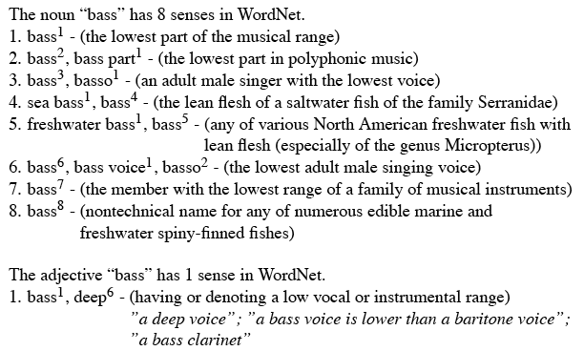
WordNet Entries

Slide 24
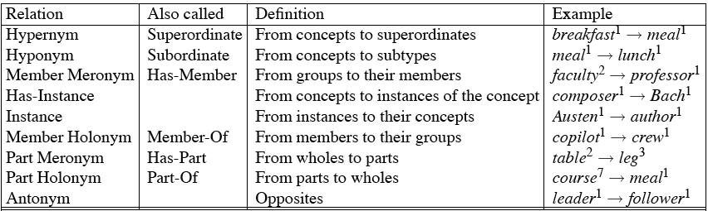
WordNet Noun Relations

Slide 25
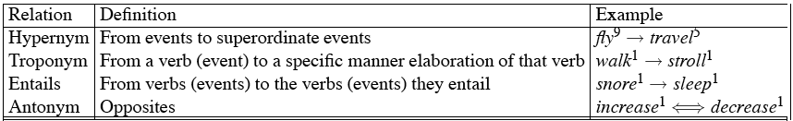
WordNet Verb Relations

Slide 26
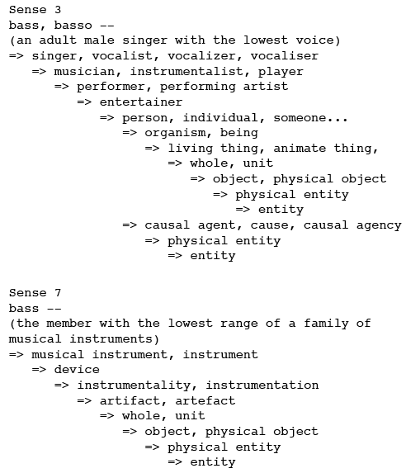
WordNet Hierarchies

Slide 27
How is ‘Sense’ Defined in WordNet?
The set of near-synonyms for a WordNet sense is called a synset (synonym set); their version of a sense or a concept
Example: chump as a noun to mean ‘a person who is gullible and easy to take advantage of’
Each of these senses share this same gloss (but not every sense)
For WordNet, the meaning of this sense of chump is this list.

Slide 28
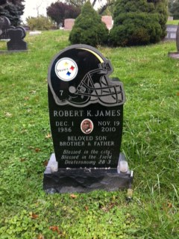

Slide 29
S: (n) field (a piece of land cleared of trees and usually enclosed)
S: (n) battlefield, battleground, field of battle, field of honor, field (a region where a battle is being (or has been) fought)
S: (n) field (somewhere (away from a studio or office or library or laboratory) where practical work is done or data is collected)
S: (n) discipline, subject, subject area, subject field, field, field of study, study, bailiwick (a branch of knowledge)
S: (n) field, field of force, force field (the space around a radiating body within which its electromagnetic oscillations can exert force on another similar body not in contact with it)
S: (n) field, field of operation, line of business (a particular kind of commercial enterprise)
S: (n) sphere, domain, area, orbit, field, arena (a particular environment or walk of life)
S: (n) playing field, athletic field, playing area, field (a piece of land prepared for playing a game)

Slide 30
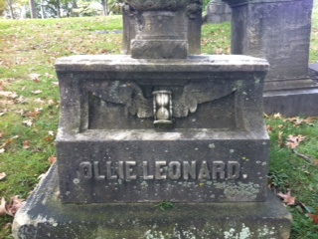
Time flies.
(thanks to Dr. Wiebe for Allegheny Cemetery photos)

Slide 31
S: (v) fly, wing (travel through the air; be airborne) "Man cannot fly"
S: (v) fly (move quickly or suddenly) "He flew about the place"
S: (v) fly, aviate, pilot (operate an airplane) "The pilot flew to Cuba"
S: (v) fly (transport by aeroplane) "We fly flowers from the Caribbean to North America"
S: (v) fly (cause to fly or float) "fly a kite"
S: (v) fly (be dispersed or disseminated) "Rumors and accusations are flying"
S: (v) fly (change quickly from one emotional state to another) "fly into a rage"
S: (v) fly, fell, vanish (pass away rapidly) "Time flies like an arrow"; "Time fleeing beneath him"

Slide 32
WordNet: Viewed as a graph

Slide 33
“Supersenses”
The top level hypernyms in the hierarchy
A word’s supersense can be a useful coarse-grained representation of word meaning for NLP tasks (counts from Schneider and Smith 2013’s Streusel corpus)

Slide 34
WordNet 3.1
Where it is:
  http://wordnetweb.princeton.edu/perl/webwn
Libraries
  Python: WordNet from NLTK
    http://www.nltk.org/search.html?q=wordnet
  Java:
    JWNL, extJWNL on sourceforge

Slide 35
Other (domain specific) thesauri

Slide 36
MeSH: Medical Subject Headings thesaurus from the National Library of Medicine
MeSH (Medical Subject Headings)
  177,000 entry terms that correspond to 26,142 biomedical “headings”
Hemoglobins
  Entry Terms: Eryhem, Ferrous Hemoglobin, Hemoglobin
  Definition: The oxygen-carrying proteins of ERYTHROCYTES. They are found in all vertebrates and some invertebrates. The number of globin subunits in the hemoglobin quaternary structure differs between species. Structures range from monomeric to a variety of multimeric arrangements
Synset

Slide 37
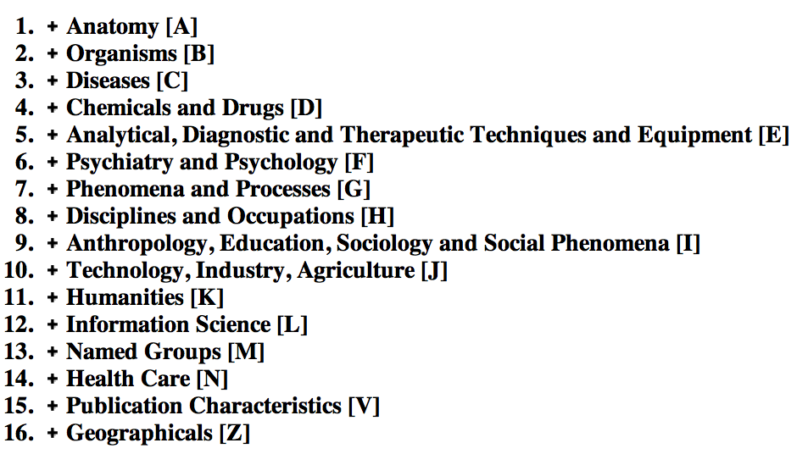
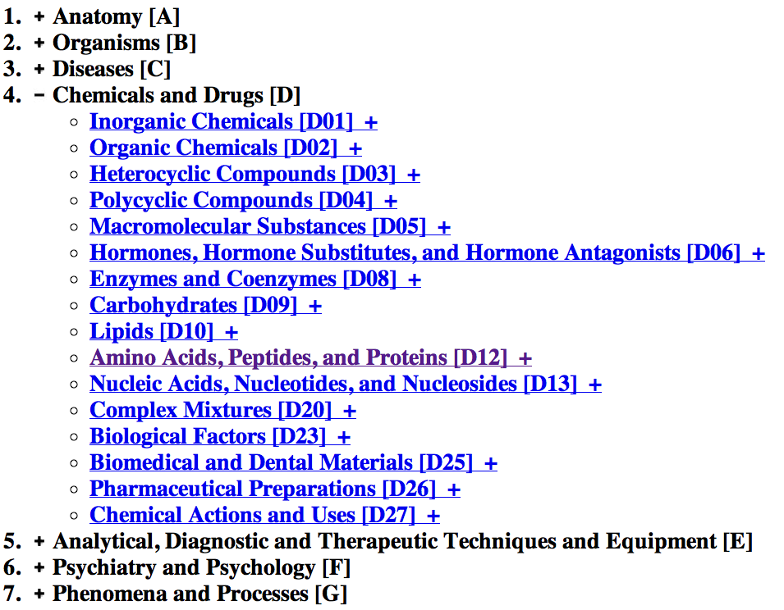
The MeSH Hierarchy

Slide 38
Uses of the MeSH Ontology
Provide synonyms (“entry terms”)
  E.g., glucose and dextrose
Provide hypernyms (from the hierarchy)
  E.g., glucose ISA monosaccharide
Indexing in MEDLINE/PubMED database
  NLM’s bibliographic database:
    20 million journal articles
    Each article hand-assigned 10-20 MeSH terms

Slide 39
III. Word Similarity
Synonymy: a binary relation
  Two words are either synonymous or not
Similarity (or distance): a looser metric
  Two words are more similar if they share more features of meaning
Similarity is properly a relation between senses
  The word “bank” is not similar to the word “slope”
  Bank¹ is similar to fund³
  Bank² is similar to slope⁵
But we’ll compute similarity over both words and senses

Slide 40
Why word similarity
A practical component in lots of NLP tasks
  Question answering
  Natural language generation
  Automatic essay grading
  Plagiarism detection
A theoretical component in many linguistic and cognitive tasks
  Historical semantics
  Models of human word learning
  Morphology and grammar induction

Slide 41
Word similarity and word relatedness
We often distinguish word similarity from word relatedness
  Similar words: near-synonyms
  Related words: can be related any way
    car, bicycle: similar
    car, gasoline: related, not similar

Slide 42
Two classes of similarity algorithms
Thesaurus-based algorithms
  Are words “nearby” in hypernym hierarchy?
  Do words have similar glosses (definitions)?
Distributional algorithms
  Do words have similar distributional contexts?
  Distributional (Vector) semantics (prior classes)

Slide 43
Path based similarity
Two concepts (senses/synsets) are similar if they are near each other in the thesaurus hierarchy
  =have a short path between them
  concepts have path 1 to themselves

Slide 44
Refinements to path-based similarity
pathlen(c₁,c₂) = 1 + number of edges in the shortest path in the hypernym graph between sense nodes c₁ and c₂
simpath(c₁,c₂) =
wordsim(w₁,w₂) = max sim(c₁,c₂)
c₁∈senses(w₁),c₂∈senses(w₂)

Slide 45
Example: path-based similarity simpath(c₁,c₂) = 1/pathlen(c₁,c₂)
simpath(nickel,coin) = 1/2 = .5
simpath(fund,budget) = 1/2 = .5
simpath(nickel,currency) = 1/4 = .25
simpath(nickel,money) = 1/6 = .17
simpath(coinage,Richter scale) = 1/6 = .17

Slide 46
Which pair of words exhibits the greatest similarity?
  1. Deer-elk
  2. Deer-horse
ungulate
even-toed ungulate
odd-toed ungulate
ruminant
equine
okapi
deer
giraffe
mule
horse
zebra
elk
wapiti
caribou
pony

Slide 47
Problem with basic path-based similarity
Assumes each link represents a uniform distance
  But nickel to money seems to us to be closer than nickel to standard
  Nodes high in the hierarchy are very abstract
We instead want a metric that
  Represents the cost of each edge independently
  Words connected only through abstract nodes
    are less similar

Slide 48
Information content similarity metrics
Resnik 1995
Let’s define P(c) as:
  The probability that a randomly selected word in a corpus is an instance of concept c
  Formally: there is a distinct random variable, ranging over words, associated with each concept in the hierarchy
    for a given concept, each observed noun is either
      a member of that concept with probability P(c)
      not a member of that concept with probability 1-P(c)
  All words are members of the root node (Entity)
    P(root)=1
  The lower a node in hierarchy, the lower its probability

Slide 49
Information content similarity
entity
…
geological-formation
natural elevation
cave
shore
hill
ridge
grotto
coast
Train by counting in a corpus
  Each instance of hill counts toward frequency
  of natural elevation, geological formation, entity, etc
  Let words(c) be the set of all words that are children of node c
    words(“geo-formation”) = {hill,ridge,grotto,coast,cave,shore,natural elevation}
    words(“natural elevation”) = {hill, ridge}

Slide 50
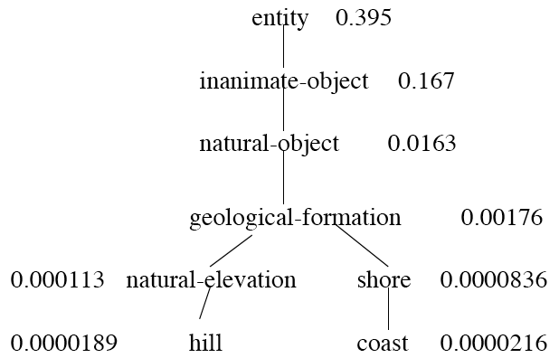
Information content similarity
WordNet hierarchy augmented with probabilities P(c)
D. Lin. 1998. An Information-Theoretic Definition of Similarity. ICML 1998

Slide 51
Information content and probability
The self-information of an event, also called its surprisal:
  how surprised we are to know it; how much we learn by knowing it.
  The more surprising something is, the more it tells us when it happens
  We’ll measure self-information in bits.
  I(w)= -log2 P(w)
I flip a coin; P(heads)= 0.5
How many bits of information do I learn by flipping it?
  I(heads) = -log2(0.5) = -log2 (1/2) = log2 (2) = 1 bit
I flip a biased coin: P(heads )= 0.8 I don’t learn as much
  I(heads) = -log2(0.8) = -log2(0.8) = .32 bits
Notes:
here

Slide 52
Information content: definitions
1.3 bits
Information content:
  IC(c) = -log P(c)
Most informative subsumer (Lowest common subsumer)
  LCS(c₁,c₂) =
  The most informative (lowest) node in the hierarchy subsuming both c₁ and c₂
5.9 bits
9.1 bits
15.7 bits

Slide 53
Using information content for similarity: the Resnik method
Philip Resnik. 1995. Using Information Content to Evaluate Semantic Similarity in a Taxonomy. IJCAI 1995.
Philip Resnik. 1999. Semantic Similarity in a Taxonomy: An Information-Based Measure and its Application to Problems of Ambiguity in Natural Language. JAIR 11, 95-130.
The similarity between two words is related to their common information
The more two words have in common, the more similar they are
Resnik: measure common information as:
  The information content of the most informative
  (lowest) subsumer (MIS/LCS) of the two nodes
  sim_{resnik}(c₁,c₂) = -log P( LCS(c₁,c₂) )

Slide 54
Dekang Lin method
Dekang Lin. 1998. An Information-Theoretic Definition of Similarity. ICML
Intuition: Similarity between A and B is not just what they have in common
The more differences between A and B, the less similar they are:
  Commonality: the more A and B have in common, the more similar they are
  Difference: the more differences between A and B, the less similar
Commonality: IC(common(A,B))
Difference: IC(description(A,B)-IC(common(A,B))

Slide 55
Dekang Lin similarity theorem
The similarity between A and B is measured by the ratio between the amount of information needed to state the commonality of A and B and the information needed to fully describe what A and B are
Lin (altering Resnik) defines IC(common(A,B)) as 2 x information of the LCS

Slide 56
Lin similarity function

Slide 57
The (extended) Lesk Algorithm
A thesaurus-based measure that looks at glosses
Two concepts are similar if their glosses contain similar words
  Drawing paper: paper that is specially prepared for use in drafting
  Decal: the art of transferring designs from specially prepared paper to a wood or glass or metal surface
For each n-word phrase that’s in both glosses
  Add a score of n²
  Paper and specially prepared for 1 + 2² = 5
  Compute overlap also for other relations
    glosses of hypernyms and hyponyms

Slide 58
Summary: thesaurus-based similarity

Slide 59
Libraries for computing thesaurus-based similarity
NLTK
  http://nltk.github.com/api/nltk.corpus.reader.html?highlight=similarity - nltk.corpus.reader.WordNetCorpusReader.res_similarity
WordNet::Similarity
  http://wn-similarity.sourceforge.net/

Slide 60
Evaluating similarity
Extrinsic (task-based, end-to-end) Evaluation:
  Question Answering
  Essay grading
Intrinsic Evaluation:
  Correlation between algorithm and human word similarity ratings
    Wordsim353: 353 noun pairs rated 0-10. sim(plane,car)=5.77
  Taking TOEFL multiple-choice vocabulary tests
    Levied is closest in meaning to:
    imposed, believed, requested, correlated

Slide 61
Problems with thesaurus-based meaning
Not every language has a thesaurus
Even if we have a thesaurus, recall problems
  Many words are missing
  Most phrases are missing
  Some connections between senses are missing
  Adjectives and verbs have less structured hyponymy

Slide 62
Hyponymy and Other Relations
Could we discover new relationhsips and add them to a taxonomy?
Why – unknown word problem (at one time Microsoft or IBM, but not Google)

Slide 63
Hearst Approach
Based on hand-built patterns
E.g. NP-0 such as NP-1 implies hyponym (NP-1, NP-0)
Corpus-based pattern extraction (Snow, Jurafsky, Ng 2005)

Slide 64
Summary
Lexical Semantics
  Homonymy, Polysemy, Synonymy, etc.
Computational resource for lexical semantics
  WordNet, etc.
Word Similarity
  Thesaurus methods

