Slide 1
Chapter 18:
Information Extraction

Slide 2
Review and Pointers
From logistic regression to neural nets (Chapter 7)
  Each neural unit multiplies input values by a weight vector, adds a bias, and then applies a non-linear activation function (e.g., sigmoid, etc.)
  Early layers learn representations that can be utilized by later layers
More recent developments
  Unassigned chapters 9, 10
    Sequence processing with recurrent networks
    Encoder-decoder models, attention, and contextual embeddings
  From simple word embeddings to BERT (linked article)
    GLUE: A MULTI-TASK BENCHMARK AND ANALYSIS PLATFORM FOR NATURAL LANGUAGE UNDERSTANDING

Slide 3
Machines Beat Humans on a Reading Test. But Do They Understand? (article cont.)
“Before 2018, one of NLP’s main pretraining tools was something like a dictionary. Known as word embeddings, this dictionary encoded associations between words as numbers in a way that deep neural networks could accept as input ….But a neural network pretrained with word embeddings is still blind to the meaning of words at the sentence level. “It would think that ‘a man bit the dog’ and ‘a dog bit the man’ are exactly the same thing,”…
A better method would use pretraining to equip the network with richer rulebooks — not just for vocabulary, but for syntax and context as well — before training it to perform a specific NLP task…
.. Each of these three ingredients — a deep pretrained language model, attention and bidirectionality — existed independently before BERT. But until Google released its recipe in late 2018, no one had combined them in such a powerful way.”

Slide 4
Administrivia
Exam and project
Homework 3

Slide 5
Information Extraction
A “dumbing down” of more lofty goal of true Natural Language Understanding (i.e., semantics)
  more technologically manageable
    often domain and application specific
  useful practical applications

Slide 6
Information Extraction
Information extraction (IE) systems
  Find and understand limited relevant parts of texts
  Gather information from many pieces of text
  Produce a structured representation of relevant information:
    relations (in the database sense)
    a knowledge base
  Goals:
    Organize information so that it is useful to people
    Put information in a semantically precise form that allows further inferences to be made by computer algorithms
                Slides based on Jurafsky and Manning
Notes:
Goal: get semantic information out of documents, esp. web pages
Defined as a dumbing-down of more lofty goal of Natural Language Understanding -- more technologically manageable
we're often interested in learning about particular relations (in DB sense)
e.g. scouring financial news for movements of executives
e.g. [person] [assumes/loses] [role] at [company]
I want to scour through text, find relation instances, suck out, put in DB
you're allowed to do domain- and problem-specific customization
lots of potential applications
- business/financial context
- biomedical context, clinical medicine
there's all this unstructured text data about research and patients -- you'd like to be able to get structured information out of it
could lead to other automated information finding: trends, correlations, drug interactions, impact of some protein on expression of a gene, ...

Slide 7
Information Extraction (IE)
IE systems extract clear, factual information
  Roughly: Who did what to whom when?
E.g.,
  Gathering earnings, profits, board members, headquarters, etc. from company reports
    The headquarters of BHP Billiton Limited, and the global headquarters of the combined BHP Billiton Group, are located in Melbourne, Australia.
    headquarters(“BHP Biliton Limited”, “Melbourne, Australia”)
  Learn drug-gene product interactions from medical research literature

Slide 8
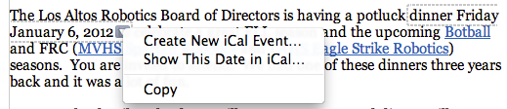
Low-level information extraction
Is now available in applications like Apple or Google mail, and web indexing
Often seems to be based on regular expressions and name lists
Notes:
low-level information extraction:
mail programs extracting times, dates, phone numbers, events
these are specialized kinds of relations
done using regular expressions

Slide 9
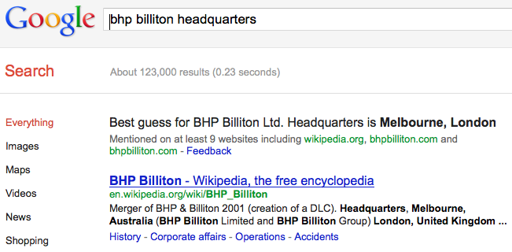
Low-level information extraction

Slide 10
Named Entity Recognition (NER)
A very important sub-task: find and classify names in text, for example:
  The decision by the independent MP Andrew Wilkie to withdraw his support for the minority Labor government sounded dramatic but it should not further threaten its stability. When, after the 2010 election, Wilkie, Rob Oakeshott, Tony Windsor and the Greens agreed to support Labor, they gave just two guarantees: confidence and supply.
Notes:
so let's talk a bit more about NER and how it's evaluated, and then we'll talk about two approaches for doing it
so I already defined NER. you have a piece of text, and you want to:
1. find things that are names: European Commission, John Lloyd Jones, etc.
2. give them labels: ORG, PERS, etc.
note that in this particular example "Thursday" was not labeled

Slide 11
Named Entity Recognition (NER)
A very important sub-task: find and classify names in text, for example:
  The decision by the independent MP Andrew Wilkie to withdraw his support for the minority Labor government sounded dramatic but it should not further threaten its stability. When, after the 2010 election, Wilkie, Rob Oakeshott, Tony Windsor and the Greens agreed to support Labor, they gave just two guarantees: confidence and supply.
Notes:
An entity is a discrete thing like “IBM Corporation”
But often extended in practice to things like dates, instances of products and chemical/biological substances that aren’t really entities…
“Named” means called “IBM” or “Big Blue” not “it” or “the company”
But also used for times, dates, proteins, etc., which aren’t entities – easy to recognize semantic classes
so let's talk a bit more about NER and how it's evaluated, and then we'll talk about two approaches for doing it
so I already defined NER. you have a piece of text, and you want to:
1. find things that are names: European Commission, John Lloyd Jones, etc.
2. give them labels: ORG, PERS, etc.
note that in this particular example "Thursday" was not labeled

Slide 12
Named Entity Recognition (NER)
A very important sub-task: find and classify names in text, for example:
  The decision by the independent MP Andrew Wilkie to withdraw his support for the minority Labor government sounded dramatic but it should not further threaten its stability. When, after the 2010 election, Wilkie, Rob Oakeshott, Tony Windsor and the Greens agreed to support Labor, they gave just two guarantees: confidence and supply.
Person
Date
Location
Organi-
zation
Notes:
Say how this is often a very large part of IE – knowing entity types takes you a long way in IE. Biomedical example.
so let's talk a bit more about NER and how it's evaluated, and then we'll talk about two approaches for doing it
so I already defined NER. you have a piece of text, and you want to:
1. find things that are names: European Commission, John Lloyd Jones, etc.
2. give them labels: ORG, PERS, etc.
note that in this particular example "Thursday" was not labeled

Slide 13
Named Entity Recognition (NER)
The uses:
  Named entities can be indexed, linked off, etc.
  Sentiment can be attributed to companies or products
  A lot of IE relations are associations between named entities
  For question answering, answers are often named entities.
Concretely:
  Many web pages tag various entities, with links to bio or topic pages, etc.
    Reuters’ OpenCalais, Evri, AlchemyAPI, Yahoo’s Term Extraction, …
  Apple/Google/Microsoft/… smart recognizers for document content
Notes:
First, let's define NER!
go through pages, recognize the names of things: "Bill MacCartney", "Stanford University"
the people who came up with this task had a rather precise, philosophically motivated meaning in mind
entity: a discrete, actual thing: Bill MacCartney, but not calcium carbonate or Tuesday or Viagra
named entity: an entity with a name, in a philosophical, Kripke-like sense
(this water bottle is an entity, but not a NAMED entity)
but in practice the definition has been expanded quite a bit in later work
we routinely include dates & times, proteins, drug names
but still, loosely, things that have a name
but NOT references to entities which are not names: "this university", "it”
first task in NER: identifying occurrences of named entities
looking for capital letters is a really good clue! at least in English! but not so much in Hebrew, Chinese, ... non-Latinate alphabets also doesn't really work in German -- all nouns are capitalized!
so that's a pretty useful base-level task -- widely deployed and used
you've probably seen web pages that do this
e.g. financial web sites often mark up stock symbols, names of companies
Microsoft has done work with this, smart tags, entities tagged with metadata
Reuters has web service OpenCalais, you send them docs, they send back NER markup

Slide 14
As usual, the problem of ambiguity!

Slide 15
The Named Entity Recognition Task
Task: Predict entities in a text
Foreign ORG
Ministry ORG
spokesman O
Shen PER
Guofang PER
told O
Reuters ORG
: :
Standard evaluation
is per entity, not per token
}
Notes:
one way to think of task: sequence labeling, label each token with ORG/PER/.../O
one way you could eval is per-token, but that's not satisfactory
any user wants complete entity names
also, it's possible (though rare) to have adjacent entities "showed Sue Bill 's book"
standard eval is, you have subsequences of tokens and assess whether those are right
also, usually most tokens are O (other) -- this example not typical
so it doesn't seem like you should get points for getting O right
so we use the same eval metrics that are typical in IR: precision and recall

Slide 16
Precision/Recall/F1 for IE/NER
Recall and precision are straightforward for tasks where there is only one grain size
The measure behaves a bit funnily for IE/NER when there are boundary errors (which are common):
  First Bank of Chicago announced earnings …
This counts as both a false positive and a false negative
Selecting nothing would have been better
Some other metrics (e.g., MUC scorer) give partial credit (according to complex rules)
Notes:
if you're familiar with P & R from IR, it actually works differently & weirdly for IE
in IR, there's only one unit of scale: documents
but here we're dealing with subsequences
in NER/IE, most common mistake is getting boundaries wrong
"First [Bank of Chicago] ..." -- this is an easy mistake to make, because "First" is also regular word, and many banks are "Bank of X"
but this mistake counts as BOTH FP and FN! two demerits!
would have been better to guess nothing -- would have been just FN
there have been attempts to devise systems for partial credit

Slide 17
The ML sequence model approach to NER
Training
Collect a set of representative training documents
Label each token for its entity class or other (O)
Design feature extractors appropriate to the text and classes
Train a sequence classifier to predict the labels from the data
Testing
Receive a set of testing documents
Run sequence model inference to label each token
Appropriately output the recognized entities

Slide 18
Encoding classes for sequence labeling
IO encoding IOB encoding
(Stanford)
Fred PER B-PER
showed O O
Sue PER B-PER
Mengqiu PER B-PER
Huang PER I-PER
‘s O O
new O O
painting O O
Notes:
c classes: c + 1 labels vs. 2c + 1 labels. Stanford NER uses IO encoding
one way to think of task: sequence labeling, label each token with ORG/PER/.../O
one way you could eval is per-token, but that's not satisfactory
any user wants complete entity names
also, it's possible (though rare) to have adjacent entities "showed Sue Bill 's book"
standard eval is, you have subsequences of tokens and assess whether those are right
also, usually most tokens are O (other) -- this example not typical
so it doesn't seem like you should get points for getting O right
so we use the same eval metrics that are typical in IR: precision and recall

Slide 19
Features for sequence labeling
Words
  Current word (essentially like a learned dictionary)
  Previous/next word (context)
Other kinds of inferred linguistic classification
  Part-of-speech tags
Label context
  Previous (and perhaps next) label

Slide 20
Features: Word substrings
oxa
:
field
Cotrimoxazole
Wethersfield
Alien Fury: Countdown to Invasion

Slide 21
Features: Word shapes
Word Shapes
  Map words to simplified representation that encodes attributes such as length, capitalization, numerals, Greek letters, internal punctuation, etc.
mRNA | xXXX
CPA1 | XXXd

Slide 22
Sequence problems
Many problems in NLP have data which is a sequence of characters, words, phrases, lines, or sentences …
We can think of our task as one of labeling each item
VBG | NN | IN | DT | NN | IN | NN
Chasing | opportunity | in | an | age | of | upheaval
B | B | I | I | B | I | B | I | B | B
而 | 相 | 对 | 于 | 这 | 些 | 品 | 牌 | 的 | 价
POS tagging
Word segmentation
Q
A
Q
A
A
A
Q
A
PERS | O | O | O | ORG | ORG
Murdoch | discusses | future | of | News | Corp.
Text segmen-tation
Named entity recognition

Slide 23
MEMM inference in systems
For a Maximum Entropy Markov Model (MEMM), the classifier makes a single decision at a time, conditioned on evidence from observations and previous decisions
Maximum entropy is an outdated name for logistic regression
Features
Decision Point
Local Context
W₀ | 22.6
W₊₁ | %
W₋₁ | fell
T₋₁ | VBD
T₋₁-T₋₂ | NNP-VBD
hasDigit? | true
… | …
-3 | -2 | -1 | 0 | +1
DT | NNP | VBD | ??? | ???
The | Dow | fell | 22.6 | %
(Ratnaparkhi 1996; Toutanova et al. 2003, etc.)

Slide 24
MEMMs
Turn logistic regression onto a discriminative sequence model
  HMM was generative
    Easier to add arbitrary features into discriminative models
  Logistic regression was not a sequence model
  Optional details in Section 8.5
Run logistic regression on successive words, using the class assigned to the prior word as a feature in the classification of the next word

Slide 25
HMM
MEMM

Slide 27
Features in a MEMM

Slide 28
Example: POS Tagging
Scoring individual labeling decisions is no more complex than standard classification decisions
  We have some assumed labels to use for prior positions
  We use features of those and the observed data (which can include current, previous, and next words) to predict the current label
Features
Decision Point
Local Context
W₀ | 22.6
W₊₁ | %
W₋₁ | fell
T₋₁ | VBD
T₋₁-T₋₂ | NNP-VBD
hasDigit? | true
… | …
-3 | -2 | -1 | 0 | +1
DT | NNP | VBD | ??? | ???
The | Dow | fell | 22.6 | %
(Ratnaparkhi 1996; Toutanova et al. 2003, etc.)

Slide 29
Example: POS Tagging
POS tagging Features can include:
  Current, previous, next words in isolation or together.
  Previous one, two, three tags.
  Word-internal features: word types, suffixes, dashes, etc.
Features
Decision Point
Local Context
W₀ | 22.6
W₊₁ | %
W₋₁ | fell
T₋₁ | VBD
T₋₁-T₋₂ | NNP-VBD
hasDigit? | true
… | …
-3 | -2 | -1 | 0 | +1
DT | NNP | VBD | ??? | ???
The | Dow | fell | 22.6 | %
(Ratnaparkhi 1996; Toutanova et al. 2003, etc.)

Slide 30
Greedy Inference
Greedy inference:
  We just start at the left, and use our classifier at each position to assign a label
  The classifier can depend on previous labeling decisions as well as observed data
Advantages:
  Fast, no extra memory requirements
  Very easy to implement
  With rich features including observations to the right, it may perform quite well
Disadvantage:
  Greedy. We make commit errors we cannot recover from

Slide 31
Beam Inference
Beam inference:
  At each position keep the top k complete sequences.
  Extend each sequence in each local way.
  The extensions compete for the k slots at the next position.
Advantages:
  Fast; beam sizes of 3–5 are almost as good as exact inference in many cases.
  Easy to implement (no dynamic programming required).
Disadvantage:
  Inexact: the globally best sequence can fall off the beam.

Slide 32
CRFs [Lafferty, Pereira, and McCallum 2001]
Another sequence model: Conditional Random Fields (CRFs)
A whole-sequence conditional model rather than a chaining of local models

Slide 33
Recently also Neural Methods

Slide 34
Extracting relations from text
Company report: “International Business Machines Corporation (IBM or the company) was incorporated in the State of New York on June 16, 1911, as the Computing-Tabulating-Recording Co. (C-T-R)…”
Extracted Complex Relation:
        Company-Founding
          Company IBM
          Location New York
          Date June 16, 1911
          Original-Name Computing-Tabulating-Recording Co.
But we will focus on the simpler task of extracting relation triples
        Founding-year(IBM,1911)
        Founding-location(IBM,New York)

Slide 35
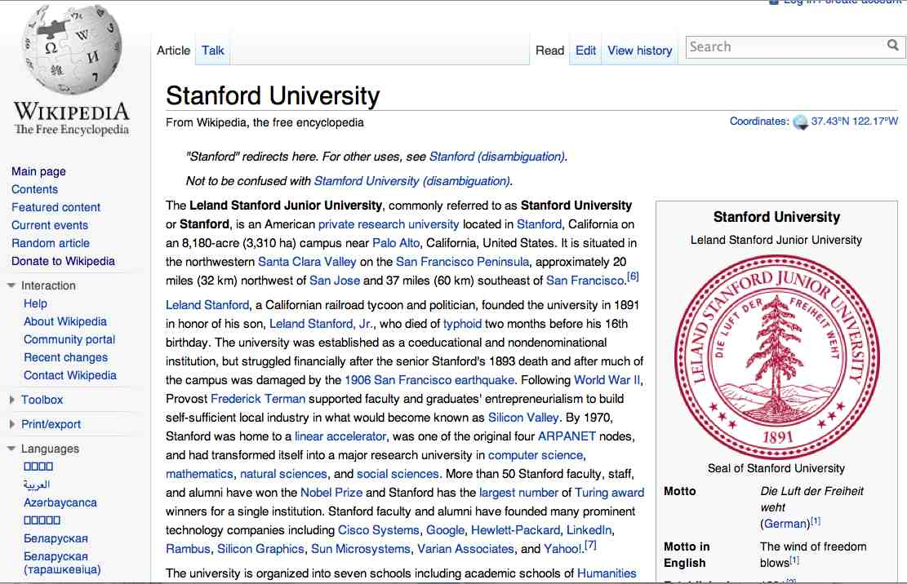
Extracting Relation Triples from Text
The Leland Stanford Junior University, commonly referred to as Stanford University or Stanford, is an American private research university located in Stanford, California … near Palo Alto, California… Leland Stanford…founded the university in 1891
Stanford EQ Leland Stanford Junior University
Stanford LOC-IN California
Stanford IS-A research university
Stanford LOC-NEAR Palo Alto
Stanford FOUNDED-IN 1891
Stanford FOUNDER Leland Stanford

Slide 36
Why Relation Extraction?
Create new structured knowledge bases, useful for any app
Augment current knowledge bases
  Adding words to WordNet thesaurus
But which relations should we extract?

Slide 37
Automated Content Extraction (ACE)
17 relations from 2008 “Relation Extraction Task”

Slide 38
Automated Content Extraction (ACE)
Part-Whole-Subsidiary ORG-ORG
  XYZ, the parent company of ABC
Person-Social-Family PER-PER
  John’s wife Yoko
Org-AFF-Founder PER-ORG
  Steve Jobs, co-founder of Apple…

Slide 39
UMLS: Unified Medical Language System
134 entity types, 54 relations
Injury disrupts Physiological Function
Bodily Location location-of Biologic Function
Anatomical Structure part-of Organism
Pharmacologic Substance causes Pathological Function
Pharmacologic Substance treats Pathologic Function

Slide 40
Extracting UMLS relations from a sentence
Doppler echocardiography can be used to diagnose left anterior descending artery stenosis in patients with type 2 diabetes
⬇
Echocardiography, Doppler DIAGNOSES Acquired stenosis

Slide 41
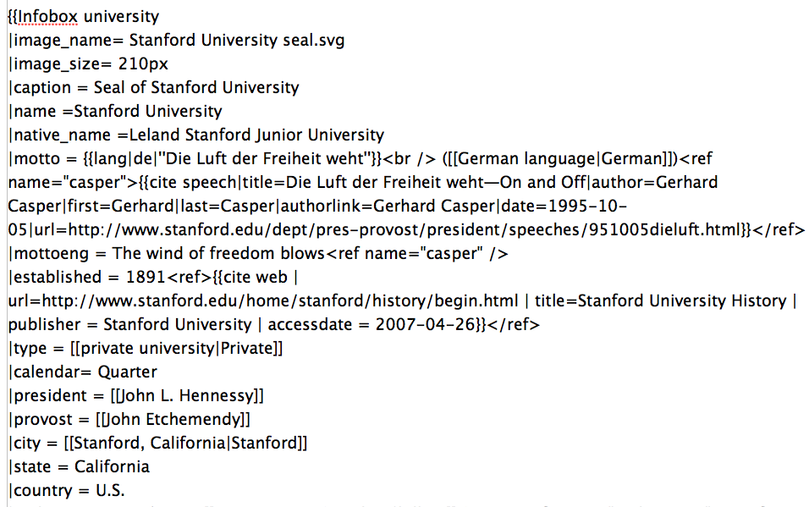
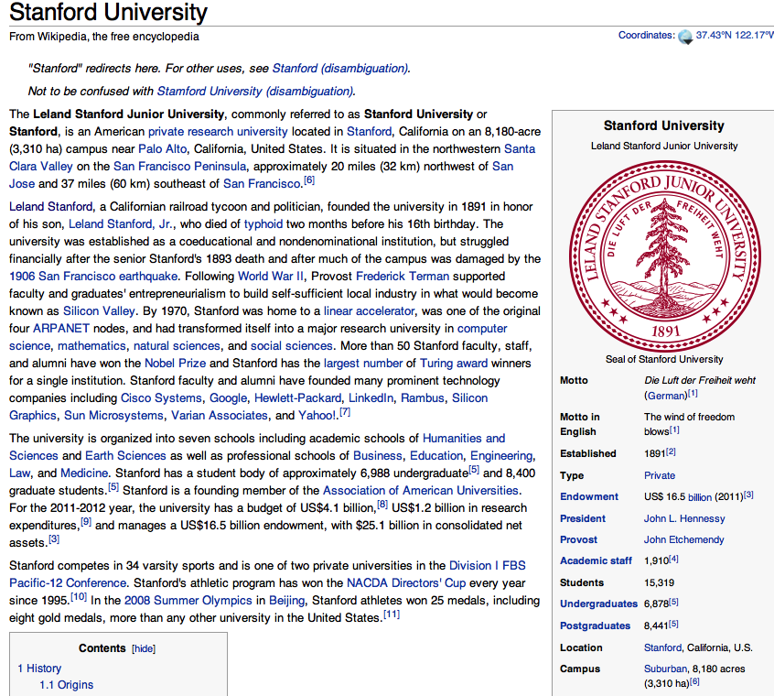
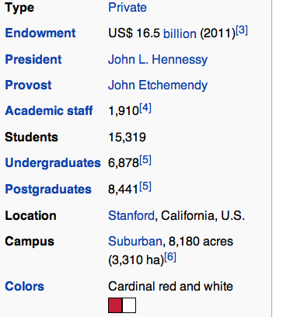
Databases of Wikipedia Relations
Wikipedia Infobox
Relations extracted from Infobox
Stanford state California
Stanford motto “Die Luft der Freiheit weht”
…

Slide 42
Relation databases that draw from Wikipedia
Resource Description Framework (RDF) triples
  subject predicate object
  Golden Gate Park location San Francisco
  dbpedia:Golden_Gate_Park dbpedia-owl:location dbpedia:San_Francisco
DBPedia: 1 billion RDF triples, 385 from English Wikipedia
Frequent Freebase relations:
    people/person/nationality, location/location/contains
    people/person/profession, people/person/place-of-birth
    biology/organism_higher_classification film/film/genre

Slide 43
Ontological relations
Examples from the WordNet Thesaurus
IS-A (hypernym): subsumption between classes
  Giraffe IS-A ruminant IS-A ungulate IS-A mammal IS-A vertebrate IS-A animal…
Instance-of: relation between individual and class
  San Francisco instance-of city

Slide 44
Review
Admin Questions?
  Hw3
  Project (groups, schedule, details)?
Introduction to Information Extraction
Named Entity Recognition
  What?
  How?
Relation Extractors

Slide 45
How to build relation extractors
Hand-written patterns
Supervised machine learning
Semi-supervised and unsupervised
  Bootstrapping (using seeds)
  Distant supervision
  Unsupervised learning from the web

Slide 46
Rules for extracting IS-A relation
Early intuition from Hearst (1992)
  “Agar is a substance prepared from a mixture of red algae, such as Gelidium, for laboratory or industrial use”
What does Gelidium mean?
How do you know?`

Slide 47
Rules for extracting IS-A relation
Early intuition from Hearst (1992)
  “Agar is a substance prepared from a mixture of red algae, such as Gelidium, for laboratory or industrial use”
What does Gelidium mean?
How do you know?`

Slide 48
Hearst’s Patterns for extracting IS-A relations
Hearst pattern | Example occurrences
X and other Y | ...temples, treasuries, and other important civic buildings.
X or other Y | Bruises, wounds, broken bones or other injuries...
Y such as X | The bow lute, such as the Bambara ndang...
Such Y as X | ...such authors as Herrick, Goldsmith, and Shakespeare.
Y including X | ...common-law countries, including Canada and England...
Y , especially X | European countries, especially France, England, and Spain...

Slide 49
Extracting Richer Relations Using Rules
Intuition: relations often hold between specific entities
  located-in (ORGANIZATION, LOCATION)
  founded (PERSON, ORGANIZATION)
  cures (DRUG, DISEASE)
Start with Named Entity tags to help extract relation!
(Maps well to logical representations)

Slide 50


Named Entities aren’t quite enough.
Which relations hold between 2 entities?
Cure?
Prevent?
Drug
Cause?
Disease
Notes:
Drug and disease pictures from Wikimedia Commons
http://commons.wikimedia.org/wiki/File:Gnome-face-sick.svg

Slide 51
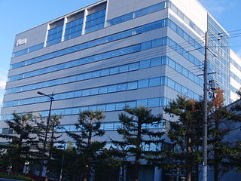

What relations hold between 2 entities?
Founder?
Investor?
Member?
PERSON
ORGANIZATION
Employee?
President?
Notes:
pictures from Wikimedia Commons
http://upload.wikimedia.org/wikipedia/commons/thumb/9/9a/Sanyo_Electric_Corporation.JPG/320px-Sanyo_Electric_Corporation.JPG

Slide 52
Extracting Richer Relations Using Rules and
Named Entities
Who holds what office in what organization?
  PERSON, POSITION of ORG
    George Marshall, Secretary of State of the United States
  PERSON(named|appointed|chose|etc.) PERSON Prep? POSITION
    Truman appointed Marshall Secretary of State
  PERSON [be]? (named|appointed|etc.) Prep? ORG POSITION
    George Marshall was named US Secretary of State

Slide 53
Hand-built patterns for relations
Plus:
  Human patterns tend to be high-precision
  Can be tailored to specific domains
Minus
  Human patterns are often low-recall
  A lot of work to think of all possible patterns!
  Don’t want to have to do this for every relation!
  We’d like better accuracy

Slide 54
Supervised machine learning for relations
Choose a set of relations we’d like to extract
Choose a set of relevant named entities
Find and label data
  Choose a representative corpus
  Label the named entities in the corpus
  Hand-label the relations between these entities
  Break into training, development, and test
Train a classifier on the training set

Slide 55
How to do classification in supervised relation extraction
Find all pairs of named entities (usually in same sentence)
Decide if 2 entities are related
If yes, classify the relation
Why the extra step?
  Faster classification training by eliminating most pairs
  Can use distinct feature-sets appropriate for each task.

Slide 56
Automated Content Extraction (ACE)
17 sub-relations of 6 relations from 2008 “Relation Extraction Task”

Slide 57

Relation Extraction
Classify the relation between two entities in a sentence
American Airlines, a unit of AMR, immediately matched the move, spokesman Tim Wagner said.
EMPLOYMENT
FAMILY
NIL
CITIZEN

Slide 58
Word Features for Relation Extraction
American Airlines, a unit of AMR, immediately matched the move, spokesman Tim Wagner said
Mention 1
Mention 2
Headwords of M1 and M2, and combination
    Airlines Wagner Airlines-Wagner
Bag of words and bigrams in M1 and M2
{American, Airlines, Tim, Wagner, American Airlines, Tim Wagner}
Words or bigrams in particular positions left and right of M1/M2
    M2: -1 spokesman
    M2: +1 said
Bag of words or bigrams between the two entities
  {a, AMR, of, immediately, matched, move, spokesman, the, unit}

Slide 59
Named Entity Type and Mention Level
Features for Relation Extraction
American Airlines, a unit of AMR, immediately matched the move, spokesman Tim Wagner said
Mention 1
Mention 2
Named-entity types
  M1: ORG
  M2: PERSON
Concatenation of the two named-entity types
  ORG-PERSON
Entity Level of M1 and M2 (NAME, NOMINAL, PRONOUN)
  M1: NAME [it or he would be PRONOUN]
  M2: NAME [the company would be NOMINAL]

Slide 60
Parse Features for Relation Extraction
American Airlines, a unit of AMR, immediately matched the move, spokesman Tim Wagner said
Mention 1
Mention 2
Base syntactic chunk sequence from one to the other
  NP NP PP VP NP NP
Constituent path through the tree from one to the other
  NP ⬆ NP ⬆ S ⬆ S ⬇ NP
Dependency path
Airlines matched Wagner said

Slide 61
Gazeteer and trigger word features for relation extraction
Trigger list for family: kinship terms
  parent, wife, husband, grandparent, etc. [from WordNet]
Gazeteer:
  Lists of useful geo or geopolitical words
    Country name list
    Other sub-entities

Slide 62
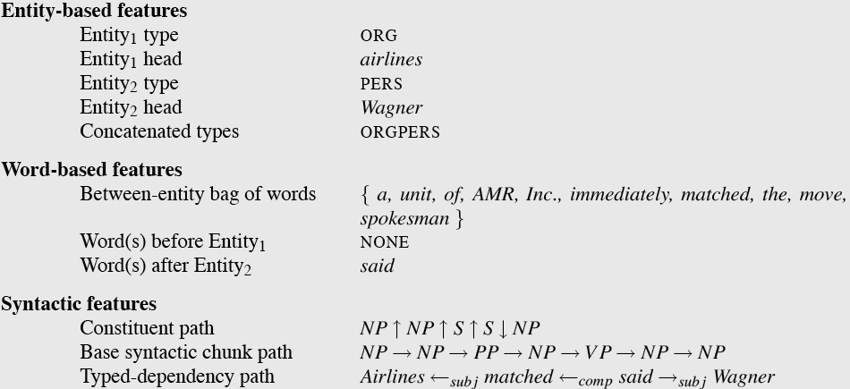
  American Airlines, a unit of AMR, immediately matched the move, spokesman Tim Wagner said.

Slide 63
Classifiers for supervised methods
Now you can use any classifier you like
  MaxEnt
  Naïve Bayes
  SVM
  ...
Train it on the training set, tune on the dev set, test on the test set

Slide 64
Evaluation of Supervised Relation Extraction
Compute P/R/F₁ for each relation (both labeled and unlabeled versions, like with parsing)

Slide 65
Summary: Supervised Relation Extraction
+ Can get high accuracies with enough hand-labeled training data, if test similar enough to training
- Labeling a large training set is expensive
- Supervised models are brittle, don’t generalize well to different genres

Slide 66
Seed-based or bootstrapping approaches to relation extraction
No training set? Maybe you have:
  A few seed tuples or
  A few high-precision patterns
Can you use those seeds to do something useful?
  Bootstrapping: use the seeds to directly learn to populate a relation

Slide 67
Relation Bootstrapping (Hearst 1992)
Gather a set of seed pairs that have relation R
Iterate:
  Find sentences with these pairs
  Look at the context between or around the pair and generalize the context to create patterns
  Use the patterns for grep for more pairs

Slide 68
Bootstrapping
<Mark Twain, Elmira> Seed tuple
  Grep (google) for the environments of the seed tuple
  “Mark Twain is buried in Elmira, NY.”
    X is buried in Y
  “The grave of Mark Twain is in Elmira”
    The grave of X is in Y
  “Elmira is Mark Twain’s final resting place”
    Y is X’s final resting place.
Use those patterns to grep for new tuples
  Often use confidence values to avoid drift
Iterate

Slide 69
Dipre: Extract <author,book> pairs
Brin, Sergei. 1998. Extracting Patterns and Relations from the World Wide Web.
Start with 5 seeds:
Find Instances:
  The Comedy of Errors, by William Shakespeare, was
  The Comedy of Errors, by William Shakespeare, is
  The Comedy of Errors, one of William Shakespeare's earliest attempts
  The Comedy of Errors, one of William Shakespeare's most
Extract patterns
  ?x , by ?y , ?x , one of ?y ‘s
Now iterate, finding new seeds that match the pattern
Author | Book
Isaac Asimov | The Robots of Dawn
David Brin | Startide Rising
James Gleick | Chaos: Making a New Science
Charles Dickens | Great Expectations
William Shakespeare | The Comedy of Errors

Slide 70
Distant Supervision
Combine bootstrapping with supervised learning
  Instead of 5 seeds,
    Use a large database to get huge # of seed examples
  Create lots of features from all these examples
  Combine in a supervised classifier
  Need to also create negative examples via random sampling

Slide 71
Distant supervision paradigm
Like supervised classification:
    Uses a classifier with lots of features
    Supervised by detailed hand-created knowledge
    Doesn’t require iteratively expanding patterns
Like unsupervised classification:
    Uses very large amounts of unlabeled data
    Not sensitive to genre issues in training corpus

Slide 72
Distantly supervised learning of relation extraction patterns
For each relation
For each tuple in big database
Find sentences in large corpus with both entities
Extract frequent features (parse, words, etc)
Train supervised classifier using thousands of patterns
Born-In
1
<Edwin Hubble, Marshfield>
<Albert Einstein, Ulm>
2
3
Hubble was born in Marshfield
Einstein, born (1879), Ulm
Hubble’s birthplace in Marshfield
4
PER was born in LOC
PER, born (XXXX), LOC
PER’s birthplace in LOC
5
P(born-in | f₁,f₂,f₃,…,f₇₀₀₀₀)

Slide 73
Unsupervised relation extraction
Open Information Extraction:
  extract relations from the web with no training data, no list of relations

Slide 74
Evaluation of Semi-supervised and
Unsupervised Relation Extraction
Since it extracts totally new relations from the web
  There is no gold set of correct instances of relations!
    Can’t compute precision (don’t know which ones are correct)
    Can’t compute recall (don’t know which ones were missed)
Instead, we can approximate precision (only)
  Draw a random sample of relations from output, check precision manually
Can also compute precision at different levels of recall.
Precision for top 1000 new relations, top 10,000 new relations, top 100,000
In each case taking a random sample of that set
But no way to evaluate recall

Slide 75
Temporal IE for Temporal Reasoning
Another area, optional

Slide 76
Chapter Summary
IE involves techniques for extracting limited forms of semantic content, e.g.,
  Named entities
  Relations among entities
Methods included various types of machine learning as well as hand crafted methods

