Slide 1
Logistic Regression
Chapter 5
1
Notes:
1

Slide 2
Classification
Learn: f:X->Y
  X – features
  Y – target classes

Slide 3
Generative vs. Discriminative Models
Generative
Discriminative
Learn a model of the joint probability p(d, c)
Use Bayes’ Rule to calculate p(c|d)
Build a model of each class; given example, return the model most likely to have generated that example
Examples: Naive Bayes, HMM
Notes:
Example from Ng notes:
Discriminative: “Consider a classification problem in which we want to learn to distinguish between elephants (y = 1) and dogs (y = 0), based on some features of an animal. Given a training set, an algorithm like logistic regression or the perceptron algorithm (basically) tries to find a straight line—that is, a decision boundary—that separates the elephants and dogs. Then, to classify a new animal as either an elephant or a dog, it checks on which side of the decision boundary it falls, and makes its prediction accordingly. “
Generative: “Here’s a different approach. First, looking at elephants, we can build a model of what elephants look like. Then, looking at dogs, we can build a separate model of what dogs look like. Finally, to classify a new animal, we can match the new animal against the elephant model, and match it against the dog model, to see whether the new animal looks more like the elephants or more like the dogs we had seen in the training set.” http://cs229.stanford.edu/notes/cs229-notes2.pdf

Slide 4


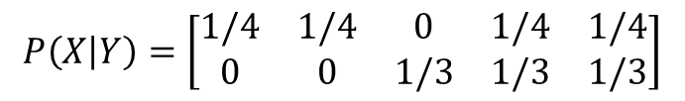

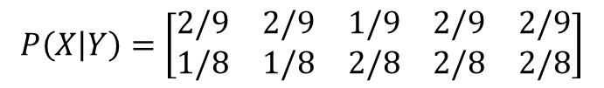
Naive Bayes Review
Features = {I hate love this book}
Training
  I hate this book
  Love this book
What is P(Y|X)?
Prior p(Y)
Testing
  hate book
Different conditions
  a = 0 (no smoothing)
  a = 1 (smoothing)

Slide 5
Generative vs. Discriminative Models
Generative
Discriminative
Learn a model of the joint probability p(d, c)
Use Bayes’ Rule to calculate p(c|d)
Build a model of each class; given example, return the model most likely to have generated that example
Examples: Naive Bayes, HMM
Model p(c|d) directly
Class is a function of document vector
Find the exact function that minimizes classification errors on the training data
Learn boundaries between classes
Example: Logistic regression
Notes:
Example from Ng notes:
Discriminative: “Consider a classification problem in which we want to learn to distinguish between elephants (y = 1) and dogs (y = 0), based on some features of an animal. Given a training set, an algorithm like logistic regression or the perceptron algorithm (basically) tries to find a straight line—that is, a decision boundary—that separates the elephants and dogs. Then, to classify a new animal as either an elephant or a dog, it checks on which side of the decision boundary it falls, and makes its prediction accordingly. “
Generative: “Here’s a different approach. First, looking at elephants, we can build a model of what elephants look like. Then, looking at dogs, we can build a separate model of what dogs look like. Finally, to classify a new animal, we can match the new animal against the elephant model, and match it against the dog model, to see whether the new animal looks more like the elephants or more like the dogs we had seen in the training set.” http://cs229.stanford.edu/notes/cs229-notes2.pdf

Slide 6
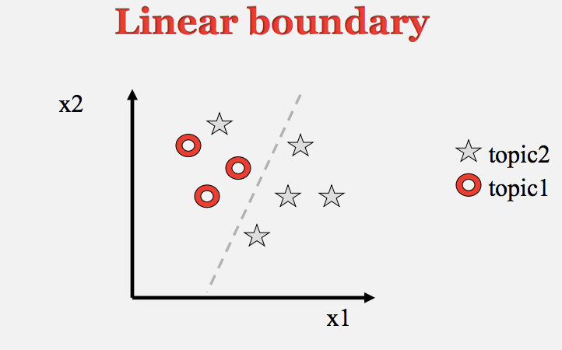
Slide from Drago Radev

Slide 7
Discriminative vs. Generative Classifiers
Discriminative classifiers are generally more effective, since they directly optimize the classification accuracy. But
  They are sensitive to the choice of features
    Plus: easy to incorporate linguistic information
    Minus: until neural networks, features extracted heuristically
  Also, overfitting can happen if data is sparse
Generative classifiers are the “opposite”
  They directly model text, an unnecessarily harder problem than classification

Slide 8
Review
Multiclass NB and Evaluation
NB tailored to sentiment
Generative vs discriminative classifiers

Slide 9
Assumptions of Discriminative Classifiers
Data examples (documents) are represented as vectors of features (words, phrases, ngrams, etc)
Looking for a function that maps each vector into a class.
This function can be found by minimizing the errors on the training data (plus other various criteria)
Different classifiers vary on what the function looks like, and how they find the function

Slide 10
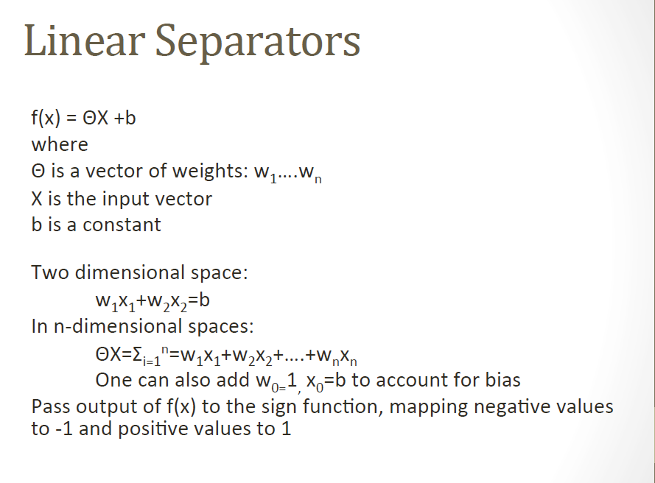

Slide 11
How to find the weights?
Logistic regression is one method
Training using optimization
  Select values for w
  Compute f(x)
  Compare f(x) output to gold labels and compute loss
    Cross-Entropy (Section 5.3)
  Adjust w

Slide 12
What does a logistic regression model look like?
Given document instance x and sentiment label y
We can propose various features that we think will tell us whether y is + or -:
  f1(x): Is the word “excellent” used in x?
  f2(x): How many adjectives are used in x?
  f3(x): How many words in x are from the positive list in our sentiment lexicon?
  ...
We then need some way to combine these features to help us predict y

Slide 13
A Feature Representation of the Input
But where did the feature representation (and interactions) come from?

Slide 14
Classification Decision
But where did the weights and bias come from?

Slide 15
Motivating Logistic Regression, continued
if f1(x) + f2(x) + … + fn(x) > thresh: return + else return -
  Problem: not all features are equally important
if w₀ + w₁f₁(x) + … + w_{n}f_{n}(x) > 0: return + else return –
  Problem: not probabilistic
Apply sigmoid function

Slide 16
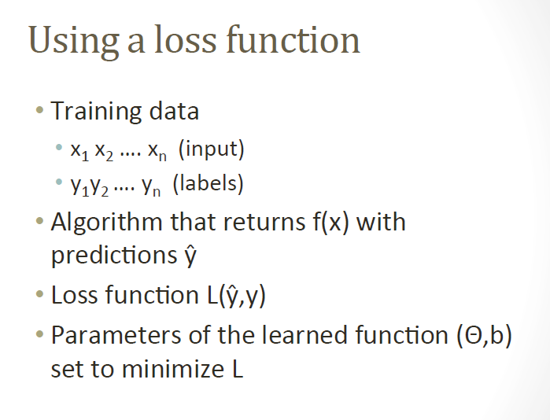

Slide 17
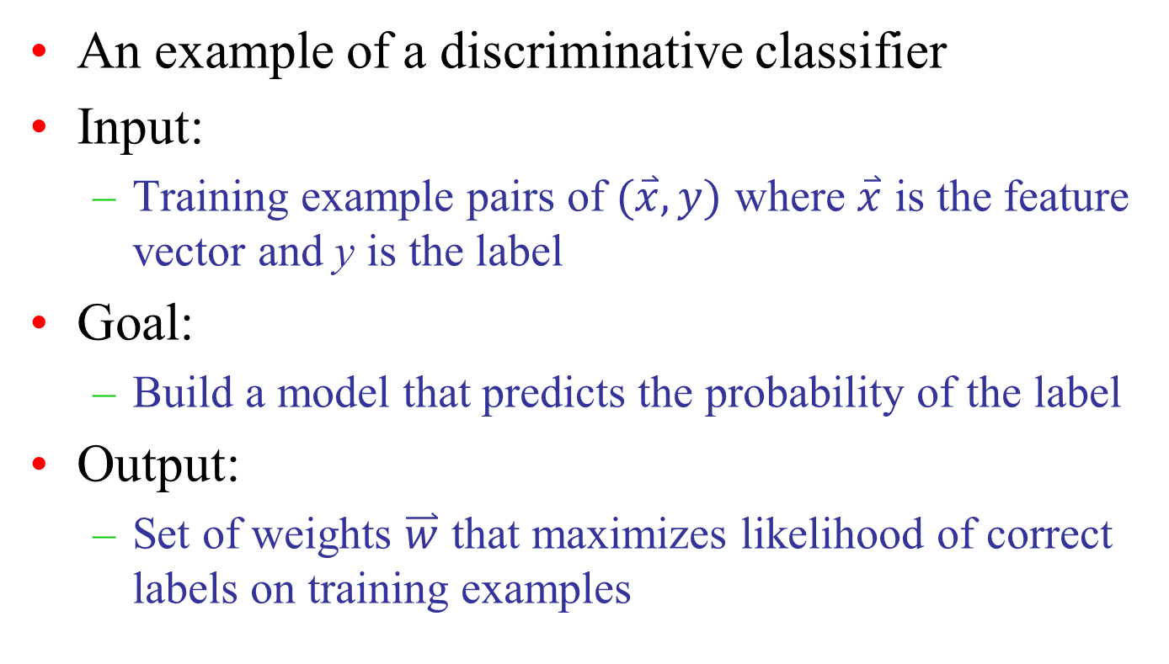
Logistic Regression

Slide 18
Logistic Regression
Similar to Naive Bayes (but discriminative!)
  Features don’t have to be independent
Examples of features
  Anything of use
  Linguistic and non-linguistic
  Count of “good”
  Count of “not good”
  Sentence length

Slide 19
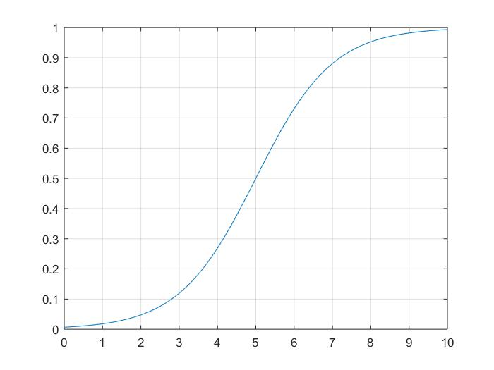
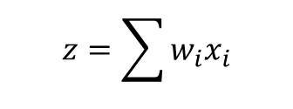
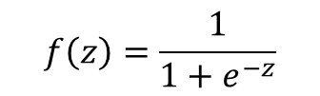
Classification using LR
Compute the feature vector x
Multiply with weight vector w
Compute the logistic sigmoid function

Slide 20
Examples
Example 1
  x = (2,1,1,1)
  w = (1,-1,-2,3)
  z = 2-1-2+3=2
  f(z) = 1/(1+e⁻²)
Example 2
  x = (2,1,0,1)
  w = (0,0,-3,0)
  z = 0
  f(z) = 1/(1+e⁰) = 1/2

Slide 21
Why Sigmoid?
First, Linear Regression
Regression used to fit a linear model to data where the dependent variable is continuous:
Given a set of points (Xi,Yi), we wish to find a linear function (or line in 2 dimensions) that “goes through” these points.
In general, the points are not exactly aligned:
  Find line that best fits the points

Slide 22
Error
Error:
  Observed value - Predicted value

Slide 23
Logistic Regression
Regression used to fit a curve to data in which the dependent variable is binary, or dichotomous
Example application: Medicine
  We might want to predict response to treatment, where we might code survivors as 1 and those who don’t survive as 0

Slide 24
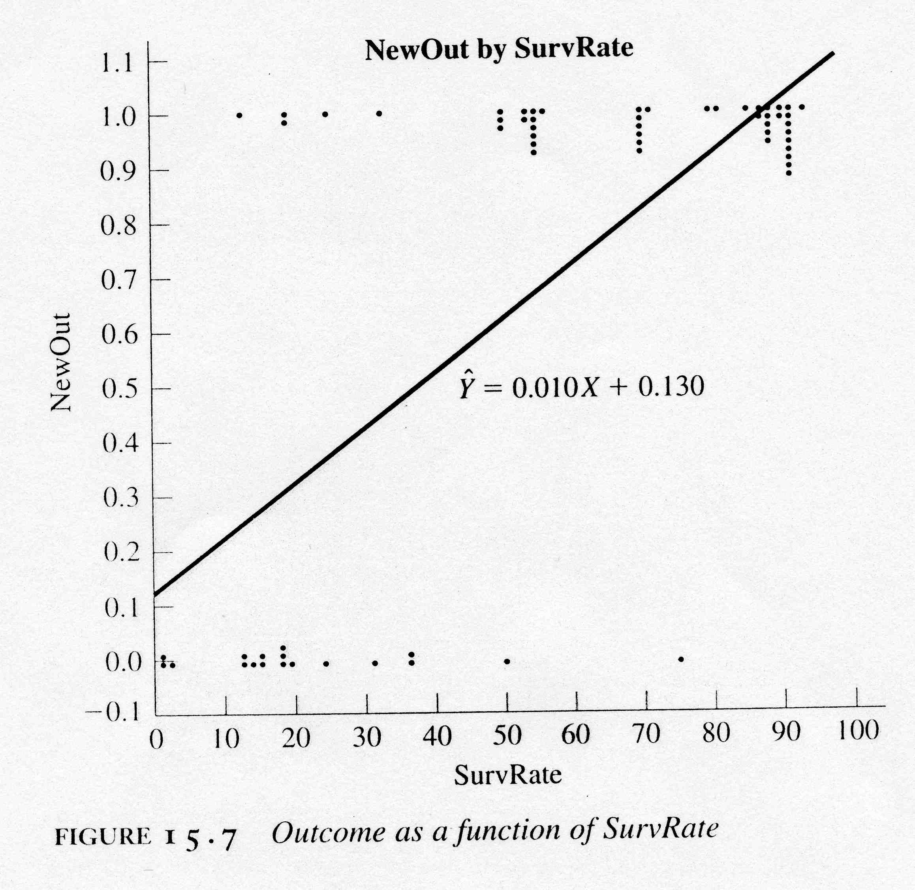
Example
Observations:
For each value of SurvRate, the number of dots is the number of patients with that value of NewOut
Regression:
Standard linear regression
Problem: extending the regression line a few units left or right along
the X axis produces predicted probabilities that fall outside of [0,1]

Slide 25
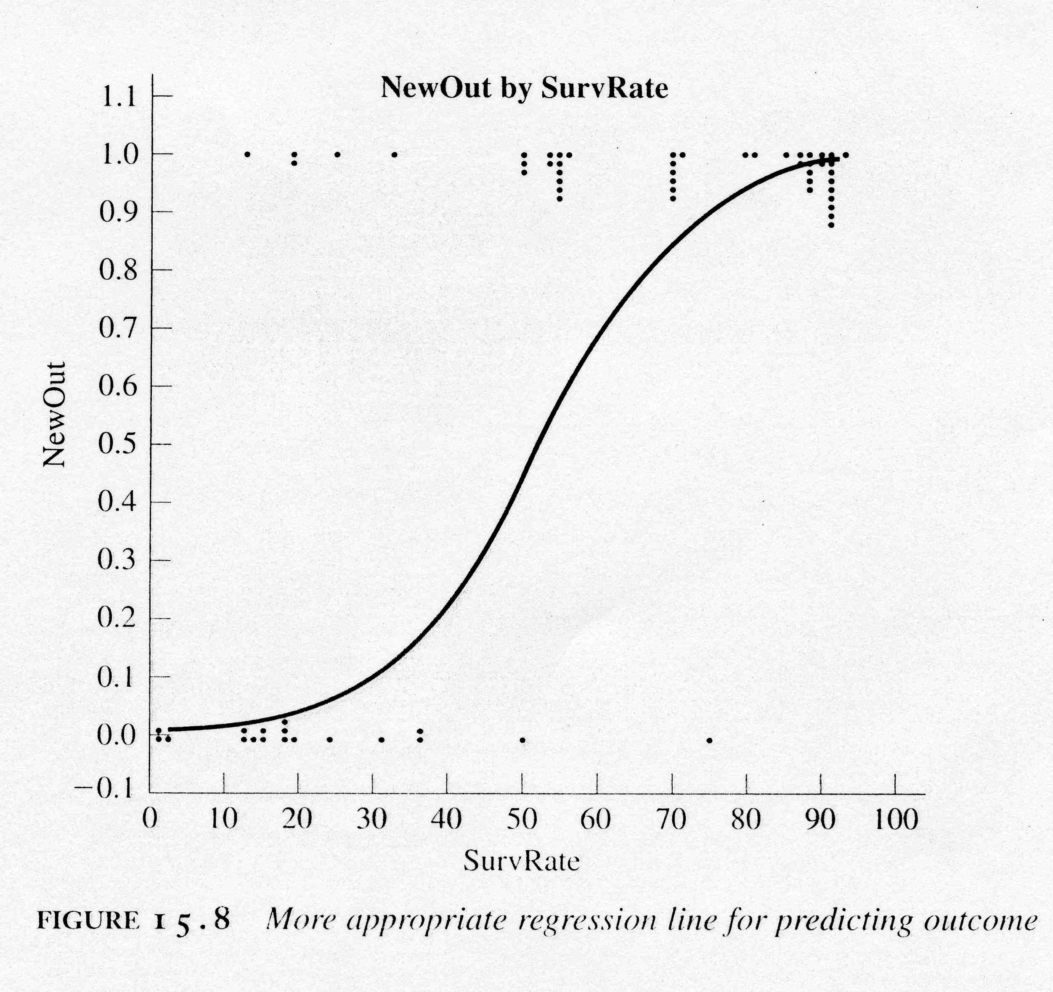
A Better Solution
Regression Curve:
Sigmoid function!
(bounded by asymptotes y=0 and y=1)

Slide 26
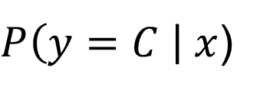
  Logistic Regression
w
x
σ

Slide 27
Constructing a Learning Algorithm
The conditional data likelihood is the probability of the observed Y values in the training data, conditioned on their corresponding X values. We choose parameters w that satisfy
where w = <w₀,w₁ ,…,w_{n}> is the vector of parameters to be estimated, y^{l} denotes the observed value of Y in the l th training example, and x^{l} denotes the observed value of X in the l th training example

Slide 28
Constructing a Learning Algorithm
Equivalently, we can work with the log of the conditional likelihood:
This conditional data log likelihood, which we will denote l(W) can be written as
Note here we are utilizing the fact that Y can take only values 0 or 1, so only one of the two terms in the expression will be non-zero for any given y^{l}

Slide 29
Fitting LR by Gradient Descent
Unfortunately, there is no closed form solution to maximizing l(w) with respect to w. Therefore, one common approach is to use gradient descent
  Beginning with initial weights of zero, we repeatedly update the weights
  Details optional, see text, but should understand following concepts
    Loss function
    Gradient descent
      Gradient, learning rate, mini-batch training
    Regularization
      Overfitting

Slide 30
Gradient Descent
Learning Rate:
the magnitude of the amount to move is the slope (more generally, the gradient) weighted by the learning rate
if too high, overshoot minimum
if too low, take too long to learn
common to begin high, then decrease

Slide 31
Some Practical Issues
Feature representation
  want all features to have similar value ranges
  too many features? feature selection
Efficiency
  Stochastic Gradient Descent / Batching
Over-fitting
  Regularization
Classifying more than two categories

Slide 32
Mini-batch training
Stochastic gradient descent chooses a random example at a time
To make movements less choppy, compute gradient over batches of training instances from training set of size m
  If batch size is m, batch training
  If batch size is 1, stochastic gradient descent
  Otherwise, mini batch training (for efficiency)

Slide 33
Regularization
Weight training can yield models that don’t generalize well to test data (i.e., that overfit to training data)
To avoid overfitting, a regularization term (various options) is used to penalize large weights
  L2 quadratic function of the weight values
  L1 linear function of the weight values

Slide 34
Multinomial Logistic Regression
More than two classes
AKA softmax regression, maxent classifier
  Instead of sigmoid, use “softmax function”
  Instead of having just one set of weights and one set of features, different set of weights and feature vectors for each class label
  Loss function changes too

Slide 35
Summary of Logistic Regression
Learns the Conditional Probability Distribution P(y|x)
Local Search.
  Begins with initial weight vector.
  Modifies it iteratively to maximize an objective function.
  The objective function is the conditional log likelihood of the data – so the algorithm seeks the probability distribution P(y|x) that is most likely given the data.

Slide 36
Two Phases
Training
  we train the system (specifically the weights w and b), e.g., using stochastic gradient descent and the cross-entropy loss
Test
  Given a test example x we compute p(y | x) and return the higher probability label y = 1 or y = 0

Slide 37
Final Comments
In general, NB and LR make different assumptions
  NB: Features independent given class -> assumption on P(X|Y)
  LR: Functional form of P(Y|X), no assumption on P(X|Y)
LR is optimized
  no closed-form solution
LR is interpretable

Slide 38
Summary
Logistic regression is a supervised machine learning classifier (discriminative)
Use: LR extracts real-valued features from the input, multiplies each by a weight, sums them, and passes the sum through a sigmoid function to generate a probability. A threshold is used to make a decision
Learning: The weights (vector w and bias b) are learned from a labeled training set via a loss function that must be minimized, e.g., by using (iterative) gradient descent to find the optimal weights, and regularization to avoid overfitting

