Slide 1
Power-Aware Speed Scaling in Processor Sharing Systems
Adam Wierman, Lachlan L.H. Andrew, Ao Tang
Optimality, fairness, and robustness in speed scaling designs
Lachlan L.H. Andrew, Minghong Lin, Adam Wierman
Presented by Daniel Cole

Slide 2
The Stochastic Model (Queueing Theory)
Jobs are serviced
Jobs enter the queue
Jobs leave the queue
A/S/n:
(A) Arrival Process, probability density distribution of job arrivals
(S) Service Process, probability density distribution of job size
(n) number of servers
We’ll mostly use M/M/1 or M/GI/1
First half we’re always using processor sharing (PS)
Objective is response time of job plus energy:
Always use cost per unit time instead:
Notes:
M = Markov, GI = General Independent, and 1 = one server

Slide 3
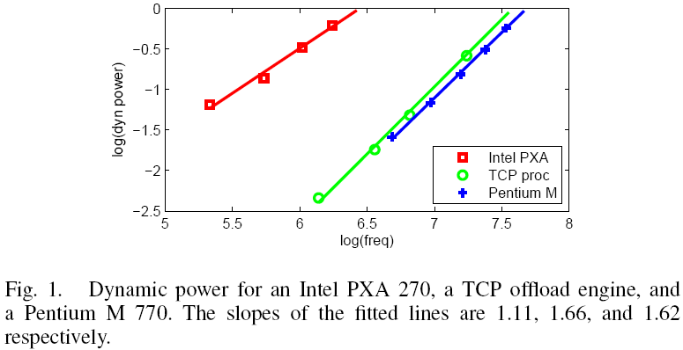
Power Model
Mostly, the normal
However, is assumed very often:
Notes:
TCP offload engine is in a paper describing ultra-low voltage circuits, Intel PXA 270 is an embedded processor, Pentium M 770 is a mobile processor

Slide 4
Objective: Flow plus Energy
Objective is response time of job plus energy:
Always use cost per unit time instead:
Arrival rate is , mean job size is
Define load as
Notes:
Rho is thus work over time

Slide 5
Are these models reasonable?
Poisson Arrivals: This assumption is a very good approximation in real systems that meet the following rules:
The number of customers in the system is very large
Impact of a single customer on the performance of the system is very small
All customers are independent
Notes:
They use alpha = 2 a lot but they justify this with processors that, in general are probably not in the best situations for meeting these conditions for a poisson arrival rate, especially the first two, e.g., real time systems or any mobile system. My impression is that stochastic analysis is justified because it is “more real” than worst case, but this seems to weaken that.

Slide 6
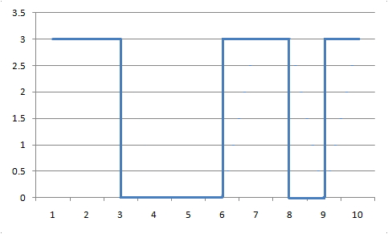
Three Schemes
Static:
Gated Static:
Dynamic:

Slide 7
Optimal Speeds
If we can only run at one speed, at what speed should we run?
Set derivative equal to 0:
Notes:
The equation E[N] = rho/(s-rho) comes from basic queueing theory for M/M/1 I believe.

Slide 8
Optimal Speeds
What if we can shut down?
Use same method as before:
For :
Notes:
Only difference here is that we only incur energy costs during the fraction of the time (rho/s) that the server is busy. The first term, expected number of jobs in the queue, does not change because if anything is in the queue we act exactly the same way.

Slide 9
Optimal Speeds
What if we can do whatever we want?
Use a dynamic programming approach to solve numerically for a known .
Notes:
They use a previously presented more general approach tailored to our case.

Slide 10
What is the difference between the three approaches?
Create bounds and compare:
Most notable: for , gated static has a cost within a factor of 2 of the optimal.
Also if , we can bound the optimal speed:
For large n,
Recall: Gated Static is
Notes:
For the alpha = 2 gated static is 2-competitive, they use two lower bounds on the dynamic. The one is a single job and the other is a lower bound based on the minimum time-averaged speed required to maintain stability(?). They then choose a rho and beta (gamma) that maximize the ratio of static to fully dynamic.
Clearly gated static is better than static by definition (just running at the static speed but turning off when nothing’s there is better)
Probability of large n is small
We’ll see something similar to the optimal speed later…
n is the number of jobs currently being processed

Slide 11
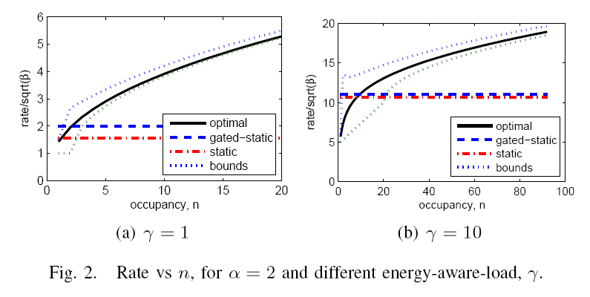
Comparing Speed Numerically
Notes:
I skipped all the upper and lower bounds on the dynamic optimal speed.
Gamma = rho/beta^1/alpha, so as gamma goes up, either we have more work coming in or energy is more important (or delay is less important)

Slide 12
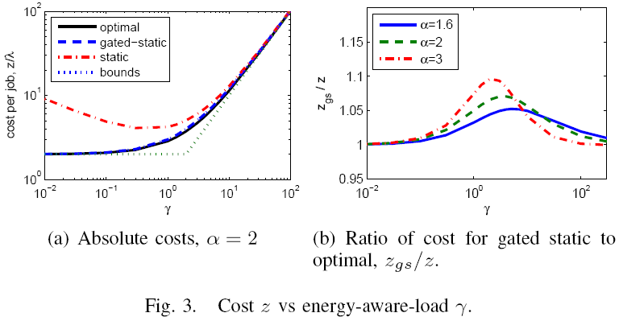
Comparing Cost Numerically
Notes:
We have a lower bound on optimal in (a) from theorem 2

Slide 13
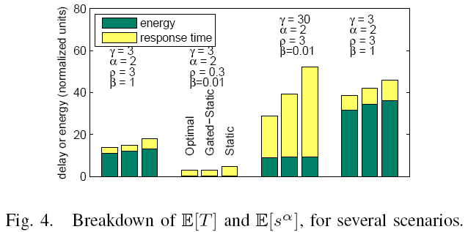
Breakdown of Cost
Should probably be
Notes:
First, change rho for fixed gamma, second, changing beta for fixed rho, and finally changing only alpha
Recall that rho = rate * mean_size = load
Gamma = rho / beta^(1/alpha)
1->2: Reduce load (rho) and our concern for energy increases (beta) (or equivalently, reduce our delay aversion)
1->3: Increase concern for energy only (or reduce delay aversion)
1->4: just increase alpha

Slide 14
Why use dynamic speed scaling?
It’s more complicated than gated static and it offers little improvement
Answer: Robustness
All previous schemes have used the expected load to set speed
Add a scheme not dependent on :
Linear:
Notes:
Nice because it has the number of current jobs, beta, and power information (1/alpha)
As beta increases we can go faster because we care less about speed, but as alpha increases speed hurts energy objective more, thus speed decreases.

Slide 15
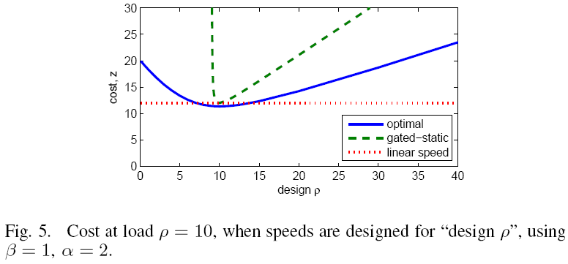
Load Misestimation

Slide 16
How good is linear?
For , it has a cost identical to gated static
This implies it is 2-competitive
Does this graph suggest linear is “much better” than OA?
Notes:
Alpha = 2 identical cost proof is just a derivation of linear cost using formulas.
Recall that OA basically runs optimally as if nothing will come in the future…
They don’t say explicitly that it is much better than OA, they say OA is designed for rho = 0 and this graph suggests linear scaling is much better than designing for rho = 0.

Slide 17
Summary
Dynamic speed scaling is only good for robustness
We only need linear scaling to achieve good results (2OPT) and good robustness (same results regardless of actual arriving load)
Optimal dynamic scaling offers a tiny amount of improvement if the load is known, otherwise it is less robust than linear

Slide 18
Intermission

Slide 19
Some Worst Case Results
Clairvoyant: SRPT + is exactly 2 competitive (lower and upper bounds)
Non-Clairvoyant: PS + is
We will skip, but essentially uses modified techniques from previous results, specifically Bansal, et al. 09, and Chan, et al. 09
Notes:
Here’s where we see speed similar to stochastic speed from the first paper for alpha = 2 (sqrt(beta*b) in previous paper)
Two papers are “speed scaling with an arbitrary power function” and “non-clairvoyant speed scaling for flow and energy”

Slide 20
More Worst Case
Give a 2-OPT lower bound for all natural algorithms, defined as:
Works on a single job between arrival/completion events (think SRPT)
Always run at speed proportional to, or faster or slower than
Notes:
These are for general alpha, and the proof uses large alphas and says that one of the following two instances will cause everyone to fail:
A batch of jobs arrives with size 1 at time 0 and no more arrivals (batch jobs)
A batch of jobs plus periodic arrivals of size 1

Slide 21
What about SRPT in the stochastic setting?
Will not analytically determine optimal for SRPT as with PS
Speeds suggested by worst case results for both SRPT and PS are the same, we’ll use them
Use previous numerical algorithm for optimal under PS to find “optimal” speeds for SRPT
Recall the speed for large n from the first paper
Notes:
Apparently SRPT is harder even in the static setting
Recall that for large n, s_n = rho + sqrt(n*beta) for optimal under PS in the first paper and the lower bound uses beta*n = s_n * P’(s_n) – P(s_n) which gives sqrt(beta*n) for alpha = 2.

Slide 22
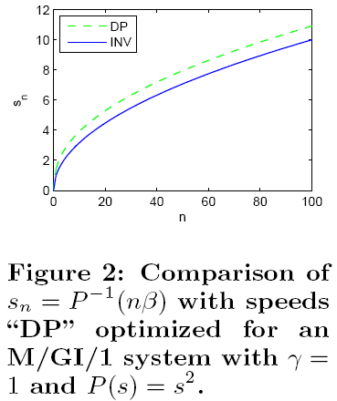
Speeds
Notes:
Optimized means a PS queue

Slide 23
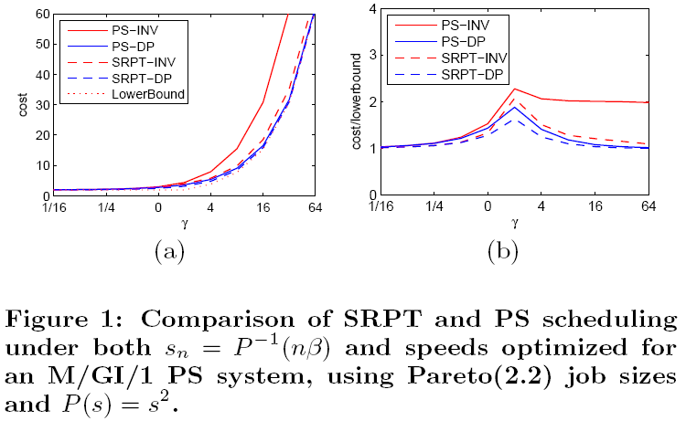
Stocastic SRPT and PS
Notes:
INV stands for inverse, i.e., P^(-1)(n*Beta)
For alpha > 3, SRPT-INV degrades significantly in the same manner as PS-INV here
Claims that this is “a comparison of the performance of the worst-case schemes for SRPT and PS with the stochastic schemes” but is that fair? If you know the input distribution would you really expect the worse case algorithm to be the best?
Note, the lower bound (for the worst case model) used has an optimal speed that matches the asymptotic form of the stochastic optimal for PS (alpha = 2).
Lower bound in the graph is a general lower bound for GI/GI/1 queues (a lower bound for a single job, I believe, prop 8 pointing to theorem 2 in the original)

Slide 24
Gated-Static Revisited
Calculating the optimal speed for gated-static for SRPT is too hard to do analytically
We will approximate it (but not go into any details here)
Notes:
The approximations are mostly built on the things that behave the same as the optimal asymptotically (heavy or light traffic)
The problem appears to be estimating the expected value of the delay which even for a speed of 1 is a double integral.

Slide 25
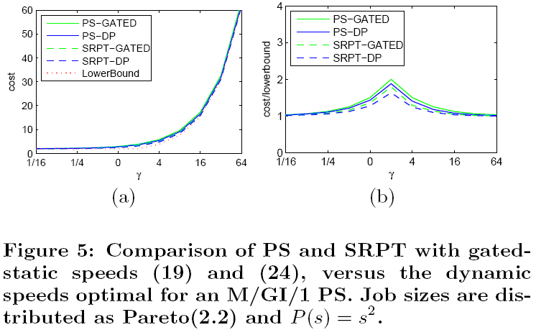
Gated-Static vs. DP
Notes:
Remember our lower bound holds regardless of scheduler in GI/GI/1
Not much difference between SRPT and PS
For alpha = 2 PS and SRPT gated are O(1) competitive (in M/GI/1) when using the optimal speeds from the DP for PS queue. Reason: z_SRPT(gated) <= z_PS(gated) and z_PS(gated) <= 2z_PS(non-gated), z_PS(non-gated) <= z_PS(nBeta) in a M/GI/1 queue with known rho. Finally we know that z_PS(nBeta) is constant competitive in the worst case model
Another point for scheduling doesn’t matter, only speed…

Slide 26
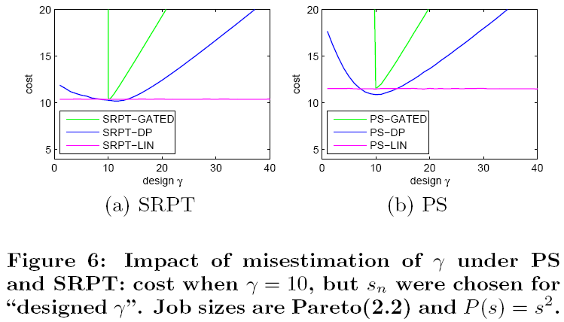
Robustness
Notes:
Gamma = rho/beta^alpha
I’m leaving out Corollary 14 even if it is kind of neat.
Corollary 14: for alpha in (1,2], using the DP optimal speeds (PS) for a M/GI/1 queue, and using either PS or SRPT, is constant competitive in the worst case model (works for any fixed rho or beta)
Another fact to say that scheduling isn’t important (still degradation occurs if the target rho is wrong as figure 6 shows)
Why not show the robustness of the worse case speeds?

Slide 27
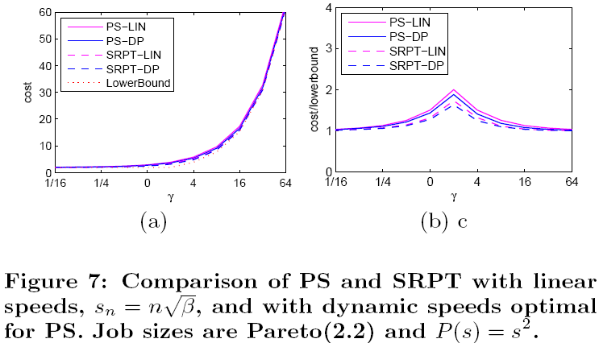
Linear Scaling (Again)
However, linear scaling is not constant competitive…
Notes:
So they will compare the worse case algorithms with algorithms designed for best case, but won’t compare worst case algorithms with average case algorithms with the average is wrongly estimated? Worst case is designed to be robust at all costs…

Slide 28
Fairness
Summary: Speed scaling magnifies unfairness
Reason: If SRPT runs no faster than PS and there is an infinitely large job, the large job is only serviced during idle periods which are shorter for SRPT than PS
Note that SRPT with static speeds is considered fair
Notes:
PS is basically what we compare to for determining fairness (so they are at least implicitly saying PS isn’t near optimal)
Maybe you can dispute fairness anyway
SRPT having shorter idle periods is proven in lemma 22 in the appendix

Slide 29
Summary
Scheduling isn’t that important, but speed is very important
Speed scaling isn’t really about performance, it is about robustness
Can’t have optimal, robust, and fair:
Dynamic: optimal, robust, not fair
Static: near-optimal, not robust, fair
I omitted: O(1) competitiveness of stochastic policies
Notes:
O(1) for stochastic is only for alpha in (1,2]

