Slide 1
Reducing Network Energy Consumption via Sleeping and Rate-Adaption
Sergiu Nedevschi, Lucian Popa, Gianluca Iannaccone, Sylvia Ratnasamy, David Wetherall
Presented by Pat McClory

Slide 2
Outline
Introduction
Potential Approaches
Putting Network Elements to Sleep
Rate Adaption
Energy Savings

Slide 3
Introduction
There is opportunity for substantial reductions in the energy consumption of existing networks.
Networks are provisioned for worst-case load, which typically exceeds their long term utilization.
Backbone utilizations under 30%
Energy consumption of network equipment remains substantial even when the network is idle.

Slide 4
Potential Approaches
Two main potential approaches to reducing energy consumption in networks:
Putting components to sleep (analogous to sleep states in processors)
Link rate adaption (analogous to speed scaling)

Slide 5
Putting Network Elements to Sleep
Model:
p_s – power draw in sleep mode (small fraction of p_i).
δ – time it takes to transition in and out of sleep states.

Slide 6
Entering and Exiting Sleep States
Network equipment must support a mechanism for invoking and exiting sleep states.
Two main approaches:
Time-driven sleeping
Wake-on-arrival

Slide 7
Opportunistic Sleeping
Link interfaces sleep when idle, i.e. a router is awakened by an incoming packet, forwards it, and returns to sleep if no subsequent packet arrives for some time.
May require frequent transitions which limit savings.
10Gbps link, 5% utilization, 1KB packet size – average packet inter-arrival time is only 15 μs
Requires wake-on-arrival technology.

Slide 8
Traffic Shaping
Approach for creating greater opportunities for sleep.
Shape traffic into small bursts at the edge of the network, edge devices transmit packets in bunches and routers within the network wake up to process a burst, and then return to sleep.
To prevent injecting excessive delay/loss into the network the bursts are bounded.
Buffer interval B – ingress router buffers incoming traffic for up to B ms and then forwards it as a burst.

Slide 9
Coordination
The best possible savings would occur if a router received the incoming bursts from all ingress routers close in time such that it process all incoming bursts and returns to sleep thus incurring exactly one sleep/wake transition per B ms.

Slide 10
Example 1
S0 = 2
S1 = 1
R0
R1
8
3
R2
5
7
R3
R4

Slide 11
Example 2
R0
R1
15
20
1
2
R2
R3

Slide 12
optB&B
S_i,j – start-of-burst time for traffic from each ingress I to egress J.
Exhaustively search all S_i,j to find a set of start times that minimizes the number of transitions across all the interfaces in the network.
Not a practical algorithm but it gives an optimistic bound on what might be achievable if nodes can coordinate traffic shaping.

Slide 13
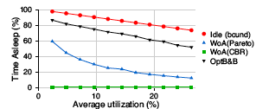
Optimal vs. WoA

Slide 14
Practical Algorithm
Ingress router sends its bursts destined for various egresses one after the other in a single “train of bursts”.
At routers close to the ingress this appears as a single burst which disperses as it traverses through the network.
Bounds the number of bursts seen by any router R in an interval of B ms by the total number of ingress routers that send traffic through R.

Slide 15
Results

Slide 16
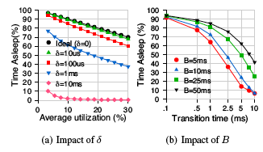
Impact of Transition Time

Slide 17
Rate-Adaption
Model:
Link Rates r_1,…,r_n
r_i < r_i+1
δ – transition time
Time when packet transition is stalled as the link transitions between successive rates.

Slide 18
Optimal Strategy
For a DVS processor the most energy-efficient way to execute C cycles within a given tiem interval T is to run at a clock speed of C/T
For a network link this translates to sending packets at a constant rate equal to the average arrival rate.
Under non-uniform traffic this can result in arbitrary delays. So instead look for an optimal schedule of rates.

Slide 19
Optimal Strategy
Given a packet arrival curve AC, look for a service curve that minimizes energy consumption, while respecting a given upper bound d on the per-packet queuing delay.
Shortest Euclidean distance in the arrival space between the arrival time and shifted arrival curves is the optimal set of rates.

Slide 20
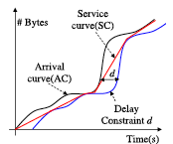
Optimal Strategy

Slide 21
Shortcomings of Optimal Strategy
The optimal service curve isn’t feasible for a number of reasons:
It assumes perfect knowledge of the future arrival curve.
It assumes link rates of infinite granularity
It ignores switching overheads.

Slide 22
Practical Algorithm
Modeled after optimal strategy, but addresses it’s shortcomings.
r_f – predicted arrival rate
Estimated with an exponentially weighted moving average
Transitioning to a higher rate:
A link operating at rate r_i, with queue size q increases its rate to r_i+1 iff
(q/r_i > d OR (δ∗r_f+q)/(r_i+1) > d – δ)

Slide 23
Practical Algorithm
Transitioning to a lower rate:
A link operating at rate r_i, with queue size q decreases its rate to r_i-1 iff
q=0 AND r_f < r_i-1
To discourage oscillations a minimum time between consecutive switches is enforced – Kδ

Slide 24
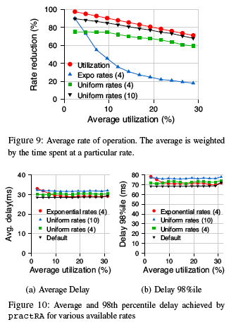
Results

Slide 25
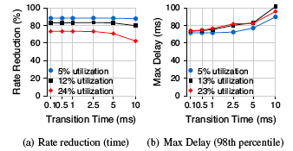
Impact of Transition Time

Slide 26
Energy Savings
Power Model:
E = p_a * T_a + p_i * T_i
p_a – active power, T_a – time active, p_i – idle power, T_i – time idle
p_a(r) = C + f(r)
C – static power
The portion of power that can be reduced using rate adaption

Slide 27
DFS and DVS
To study the effect of frequency scaling alone set f(r) = O(r)
To study the effect of DVS set f(r) = O(r^3)
In practice there is a minimum rate threshold below which scaling the link offers no further reduction in voltage.
λ – maximum scaling factor – limit choice of available operating rates between [r_n/λ, rn]

Slide 28
Idle Power
p_i(r)=C + β * f(r)
β - represents the relative magnitudes of routine work incurred even in the absence of packets to process.
Consider a wide range of values between [0.1,0.9].

Slide 29
Energy Savings From Rate Adaption
Σ(r_k) p_a(r_k)*T_a(r_k) + p_i(r_k)*T_i(r_k)
The results from the previous section give values for T_a and T_i for different r_k’s.
The previous equations allow us to model p_a(r_k) and p_i(r_k) with different values of β, C and f(r).

Slide 30
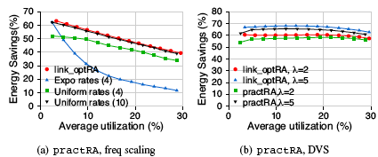
Energy Savings from Rate Adaption
C=.2 β=.5

Slide 31
Energy Savings from Sleeping
E=p_a(r)*T_a + p_i(r)(T_i – T_s) + p_s*T_s
p_s = γ * p_i(r)
Consider γ values between 0 and 0.3.

Slide 32
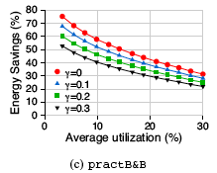
Energy Savings from Sleeping

Slide 33
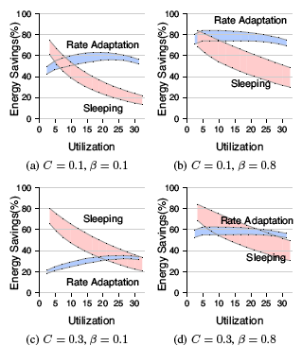
Sleep vs. Rate Adaption – with DVS

Slide 34
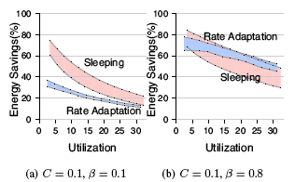
Sleep vs. Rate Adaption – with only DFS

