Slide 1
Joint Optimization of Idle and Cooling Power in Data Centers While Maintaining Response Time
Faraz Ahmad and T. N. Vijaykumar
Purdue University
Presented by: Michael Moeng

Slide 2
Key Idea
Techniques to reduce idle power rely on shutting down servers
Concentrate load in a few servers
Causes hot spots, which increases cooling costs
Techniques to reduce cooling power rely on spreading out load
Spread load on many servers
Keeps all servers on at low utilization, which increases idle power
Joint optimization is crucial for reducing overall power

Slide 3
Outline
Existing techniques
PowerTrade
Static schemes
Dynamic scheme
SurgeGuard
Experimental Results

Slide 4
Idle Power: Spatial Subsetting
Concentrate load in as few servers as possible
Active servers get hotter
Cooling cost largely dominated by maximum temperature
Response time degrades

Slide 5
Temperature: Inverse-temperature assignment
Load servers inversely to the temperature of the room
Example: middle aisle is cooler, so give those servers a higher load
Keeps all servers on, increases idle power

Slide 6
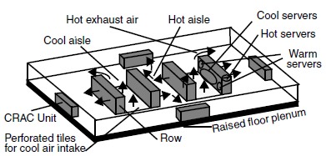
Data Center Model

Slide 7
DVFS: Temporal Subsetting
Degrades response time, especially if transition times are slow
Only reduces CPU component of power (about 1/3 of system power)
Future technologies may not even use DVFS to reduce power

Slide 8
PowerTrade
Define NetPower as:
power_{compute}+ power_{idle} + power_{cooling}
Divide room into zones with similar temperatures properties
Distribute load across zones
Distribute load within single zone
Assume hot, warm, cool zones
Propose 3 policies to distribute load

Slide 9
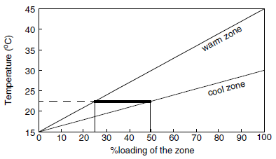
PowerTrade-s: load across zones
Static Scheme, assumes knowledge of:
Zone partitions
Expected load
Use calibration run

Slide 10
PowerTrade-s: load across zones
Calibration results in iso-temp ratio
Hot zone kept on standby if possible

Slide 11
PowerTrade-s: load within a zone
Cool zone:
Less prone to hot spots
Use spatial subsetting to reduce idle power
Warm zone:
Equal load distribution
Hot zone:
Kept in standby if possible
Equal load distribution if necessary

Slide 12
PowerTrade-s: Limitations
Assumes linear relationship between load and temperature
Intra-zone policies do not consider both cooling and idle power
Ignores heat exchange between zones
Calibration runs each zone in isolation

Slide 13
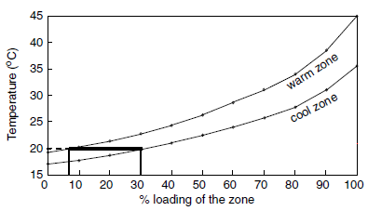
PowerTrade-s++
PowerTrade-s assumed linear relationship between load and temperature
Take multiple samples

Slide 14
PowerTrade-d
Use server groups: ~10 servers
Reduce power by dealing with one group at a time until we reach net power minimum
Compare potential savings from reducing cooling power and reducing idle power
Largest is selected to reduce net power

Slide 15
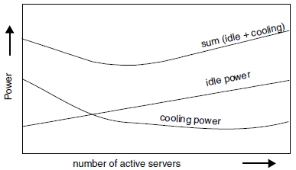
PowerTrade-d: analysis
Do we reach a global minimum?
Cooling and idle power are mostly monotonic
Single global minimum

Slide 16
PowerTrade-d: analysis
How fast is convergence?
About 3 steps per hour
Slow loading changes
Relatively large groups
How do we deal with groups in data centers that handle multiple services?
Servers in a group must all handle a single service
Group size << service server requirement

Slide 17
PowerTrade-d: loading increase
Try to handle new load with existing servers
Activate more if necessary
Else: possible temperature savings increases while possible idle savings decreases
Initially start new group, redistribute load according to inverse-temperature assignment
Measure cooling improvement
Measure idle power degradation
If net benefit, try activating another group and repeat
Else keep current group count

Slide 18
PowerTrade-d: loading decrease
Possible temperature savings decrease, but potential idle savings increases
Try deactivating a group, redistribute load
Measure cooling degradation
Measure idle improvement
If net benefit, try deactivating another group and repeat

Slide 19
PowerTrade-d: group selection
Which server group do we choose to (de)activate?
When deactivating servers, select the hottest server group
When activating servers,
Select the group with the lowest idle power rating (if they differ)
Select the from cool, warm, then hot zones

Slide 20
PowerTrade-d: issues
Server wear from repeated on/off cycles
Try to select from eligible groups in round-robin fashion
Power overhead from activating servers
Loading changes are infrequent, so this contributes little to total power
Some data centers have frontend/backend servers
Add state-aware groups?

Slide 21
SurgeGuard: Maintaining Response Time
Increases in load require servers to transition states, which takes time
Two-tier Scheme:
Overprovision to handle maximum increase in load during next coarse-grained time interval
Replenish reserves at finer granularities to handle spikes

Slide 22
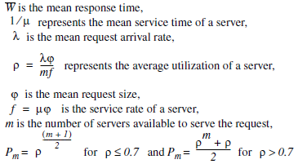
Spatial Subsetting: active servers
Model data center as GI/G/m queue
Allen-Cunneen approximation:

Slide 23
SurgeGuard: coarse-grained overprovisioning
Given desired response time and load, the number of active servers can be derived
Overprovision by reserving extra servers
Worst-case increase in load observed so far
Load change tolerable for power-performance goal
Authors use only? 10% of data center servers

Slide 24
SurgeGuard: fine-grained overprovisioning
What if load decreases one interval, but increases in the next?
Run algorithm after each mini-interval (5 min)
Reserve exceeded in about 0.15% of all 5 minute intervals
Only activate servers for fine-grained overprovisioning
Prevent server wear

Slide 25
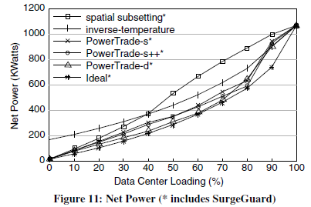
Experimental Results: Net Power
Simulate a data center with 1120 server blades

Slide 26
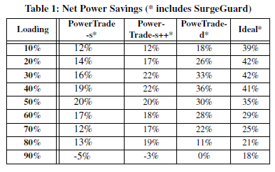
Experimental Results: Net Power
Shows improvement over better of either spatial subsetting or inverse-temperature

Slide 27
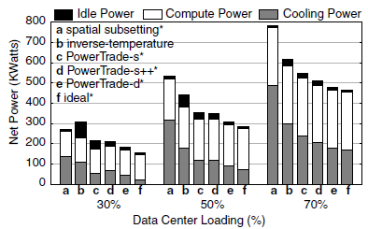
Experimental Results: Net Power Breakdown

Slide 28
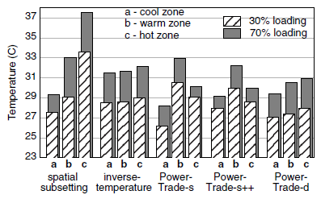
Experimental Results: Temperature Variation

Slide 29
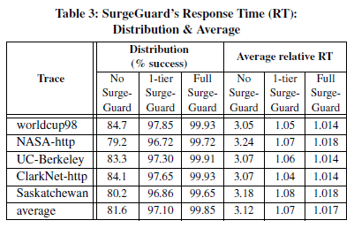
Experimental Results: Response Time

Slide 30
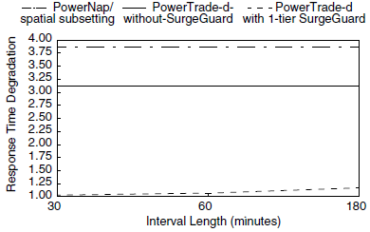
Experimental Results: Response Time

Slide 31
Questions/Comments?

